Slide 1
Using Sycamore
Instructor:
Mark Reed
markreed@unc.edu

Slide 2
Outline
What is a (compute) cluster?
Sycamore technical specifications
  types of nodes
File spaces
What does a job scheduler do?
User environment (modules) and applications
Slurm fundamentals a) submitting b) querying
Job submit examples
Notes:
Basic content slide: Add slide title and slide text in the appropriate places. To create a new slide, go to “Insert > New Slide” from the main menu.

Slide 3
What is a compute cluster?

Slide 4
What is a compute cluster?
Some Typical Components
  Compute Nodes
  Interconnect
  Shared File System
  Software
  Operating System (OS)
  Job Scheduler/Manager
  Large Storage

Slide 5
Compute Cluster Advantages
fast interconnect, tightly coupled
aggregated compute resources
  can run parallel jobs to access more compute power and more memory
large (scratch) file spaces
installed software base
scheduling and job management
high availability
data backup

Slide 6
General computing concepts
Serial computing: code that uses one compute core.
Multi-core computing: code that uses multiple cores on a single machine.
  Also referred to as “threaded” or “shared-memory”
  Due to heat issues, clock speeds have plateaued, you get more cores instead.
Parallel computing: code that uses more than one core
  Shared – cores all on the same host (machine)
  Distributed – cores can be spread across different machines;
Massively parallel: using thousands or more cores, possibly with an accelerator such as GPU from Nvidia or AMD

Slide 7

Sycamore
Geared towards HPC
  Focus on running many core, tightly coupled, computational models
Low latency, high bandwidth switching fabric
Large Memory
Many cores
Slurm job scheduler
High density
Liquid Cooled

Slide 8

Sycamore Nodes
Two types of nodes:
  Both are AMD Epyc nodes
  40 nodes of Epyc 9654
  38 nodes of Epyc 9684X
  Both have 192 physical cores and 1.5 TB memory per node
  The 9684X is a slightly more recent release and has a higher CPU clock speed, 2.55 vs 2.4 GHz and has a larger L3 cache

Slide 9
Sycamore Nodes
40 dual socket AMD EPYC 9654 compute nodes
  96 cores per socket, 192 cores per node
  2.4 GHz clock speed
  1.5 TB RAM
  7,980 total cores
  383 MB of L3 cache
38 dual socket AMD EPYC 9684X compute nodes
  96 cores per socket, 192 cores per node
  2.55 GHz clock speed
  1.5 TB RAM
  7,296 total cores
  1152 MB of L3 cache

Slide 10
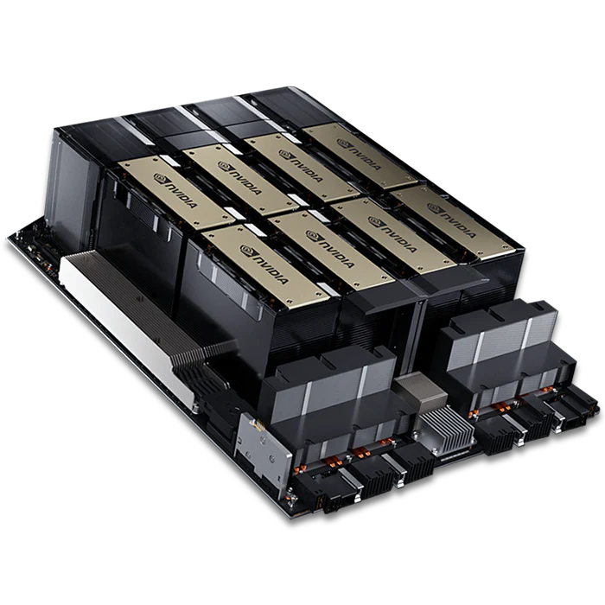

Sycamore GPUs
Sycamore is getting GPUs
7 Nvidia H100 nodes loaners from Lenovo for 120 days
  4 GPUs per node
  28 total GPUs
  Connected on the IB
  Available to purchase as patron
  node
    $85K per node

Slide 11
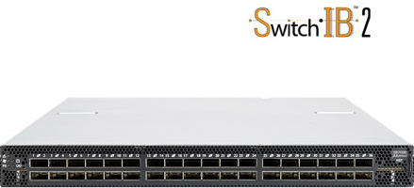
IB Interconnect
Mellanox NDR Infiniband (IB)
High Density so both rack are connected to one switch
Each NDR link is 400 Gb/s bidirectional

Slide 12
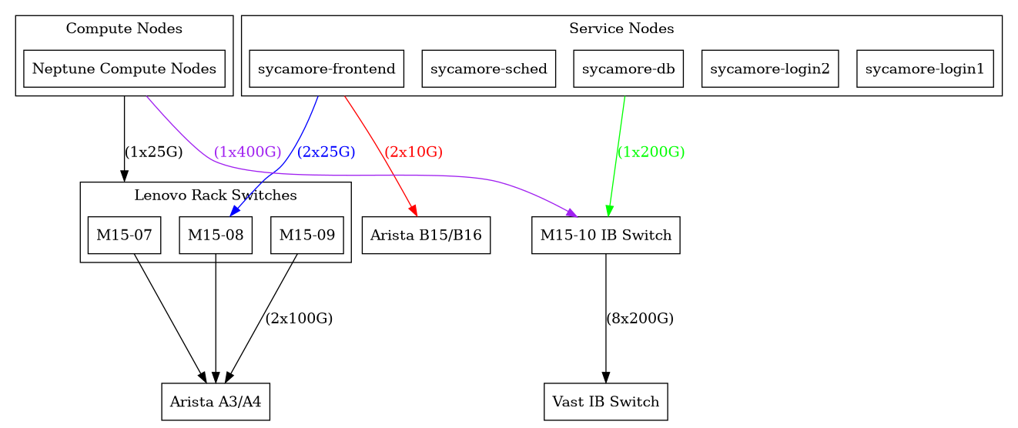
Sycamore Network

Slide 13

File Spaces

Slide 14
Sycamore Storage
The SAME home file system is mounted on BOTH Longleaf and Sycamore (and Dogwood)
Your home directory: /nas/longleaf/home/<onyen>
  Quota: 50 GB soft, 75 GB hard
/users – large file system replacing mass storage
/proj – project space for groups
/work – for fast, large I/O to the VAST file system
  This can be used as scratch but it is not intended to be used long term

Slide 15
User Environment - modules

Slide 16
Modules
The user environment is managed by modules. This provides a convenient way customize your environment. Allows you to easily run your applications.
Modules modify the user environment by modifying and adding environment variables such as PATH or LD_LIBRARY_PATH
Typically you set these once and leave them
  Optionally you can have separate named collections of modules that you load/unload
Even though the home file system is shared for SYC and LL, the module system environment is not
  LMOD uses the environment variable LMOD_SYSTEM_NAME to do this (note: it is set for you when you login)

Slide 17
Using Sycamore
Once on Sycamore you can use module commands to update your Sycamore environment with applications you plan to use, e.g.
module add openmpi_5.0.6/gcc_13.3.0
module save
There are many module commands available for controlling your module environment:
  https://help.rc.unc.edu/modules/

Slide 18
Common Module Commands
module list
module add
module rm
module save
module avail
  module avail abc (matches any module w/ abc in name)
  module keyword
  module spider
module help
More on modules see https://help.rc.unc.edu/modules/
http://lmod.readthedocs.org

Slide 19
MPI/Compiler Modules
See
  https://help.rc.unc.edu/sycamore-mpi-modules/
We have multiple combinations of Compilers and MPI implementations with various versions of each
Generally speaking you pick one, save it and stay with it
MPI Implementation | Compiler Family
Open MPI | Intel
Mvapich2 | GNU (gcc, …)

Slide 20
Compiling
Use the wrapper scripts to compile code, these do all the work of linking in the correct libraries and include files for the compiler/MPI implementation combination
  mpicc
  mpif90, mpif77, mpifort
  mpiCC, mpic++, mpicxx

Slide 21
Job Scheduling and Management
SLURM
Notes:
21
The Title Slide: Add the name of the presentation, the appropriate division or presenter and date of the presentation.

Slide 22
What does a Job Scheduler and batch system do?
Manage Resources
allocate user tasks to resource
monitor tasks
process control
manage input and output
report status, availability, etc
enforce usage policies

Slide 23
Job Scheduling Systems
Allocates compute nodes to job submissions based on user priority, requested resources, execution time, etc.
Many types of schedulers
  Simple Linux Utility for Resource Management (Slurm)
  Load Sharing Facility (LSF) – Used by Killdevil, Kure, …
  IBM LoadLeveler
  Portable Batch System (PBS)
  Sun Grid Engine (SGE)

Slide 24
Slurm
Slurm is an open source, fault-tolerant, and highly scalable cluster management and job scheduling system for Linux clusters.
As a cluster workload manager, Slurm has three key functions.
  allocates exclusive and/or non-exclusive access to resources (compute nodes) to users for some duration of time so they can perform work.
  provides a framework for starting, executing, and monitoring work on the set of allocated nodes
  arbitrates contention for resources by managing a queue of pending work
https://slurm.schedmd.com/overview.html

Slide 25
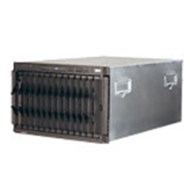
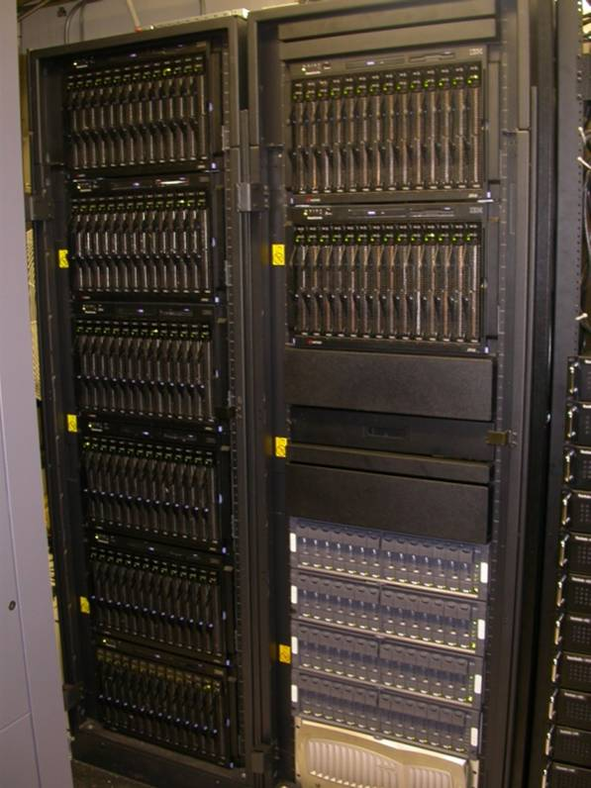
Simplified View of Batch Job Submission
Jobs Queued
job dispatched to run on available host which satisfies job requirements
job_J
job_F
myjob
job_7
Login Node
job routed to queue
sbatch myscript.sbatch
user logged in to login node submits job

Slide 26
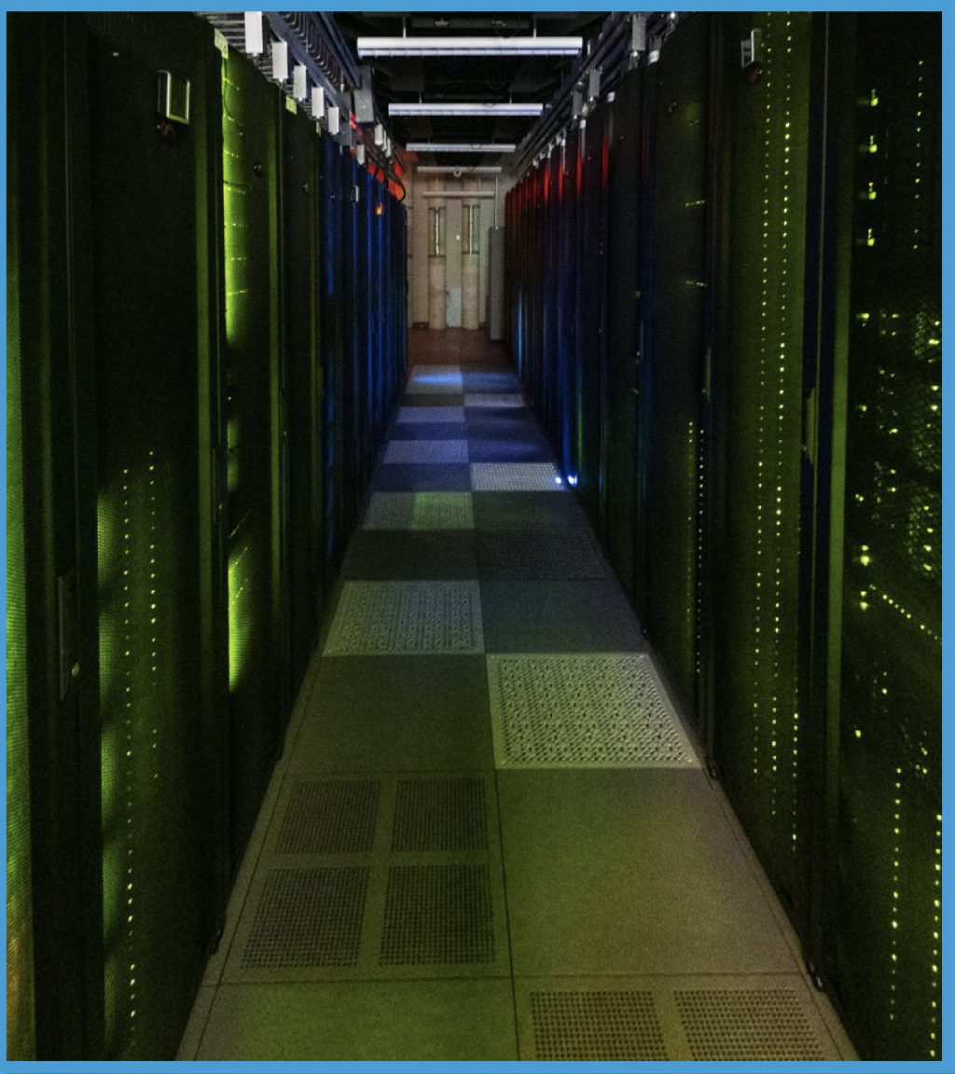

Cluster Images
View down the aisle in the machine room at ITS Manning (Longleaf)
View of Longleaf with lights on

Slide 27
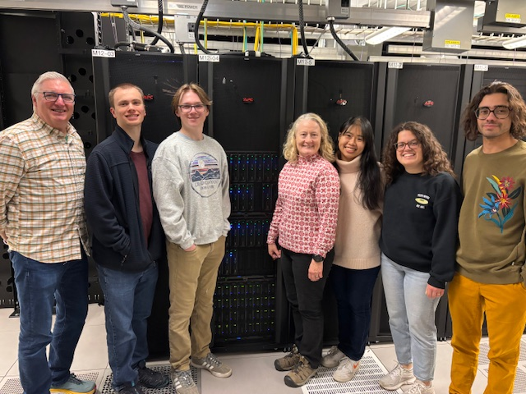
Help Desk Staff

Slide 28


A very large cluster:
Frontier at ORNL
Fastest Supercomputer on the June 2022 Top 500 list. First to break the exaflop barrier
1 Teraflop (TF) = 10¹² Flops
1 Petaflop (PF) = 10¹⁵ Flops
1 Exaflop (EF) = 10¹⁸ Flops

Slide 29
Running Programs on Sycamore
Upon ssh-ing to Sycamore, you are on the Login node.
Programs SHOULD NOT be run on Login node.
  Exceptions would be short running commands that don’t use much time, cores or memory
Submit programs to one of the many, many compute nodes.
Submit jobs using Slurm via the sbatch command.

Slide 30
Common batch commands
sbatch
  submit jobs
squeue – view info on jobs is scheduling queue
  squeue –u <onyen>
scancel – kill/cancel submitted job
sinfo -s
  shows all partitions
sacct – job accounting information
  sacct -j <jobid> --format='JobID,user,elapsed, cputime, totalCPU,MaxRSS,MaxVMSize, ncpus,NTasks,ExitCode‘
Use man pages to get much more info!
  man sbatch

Slide 31
Submitting Jobs: sbatch
Submit Jobs - sbatch
  Run large jobs out of scratch space, smaller jobs can run out of your home space
sbatch [sbatch_options] script_name
Common sbatch options:
  -o (--output=) <filename>
  -p (--partition=) <partition name>
  -N (--nodes=)
  -m (--mem=)<memory amount> Note unit is MB but add g to specify GB
  -t (--time=)
  -J (--jobname) <name>
  --tasks-per-node=<tasks>
  -n (--ntasks) <number of tasks>
    used for parallel threaded jobs

Slide 32
Two methods to submit jobs
The most common method is to submit a job run script (see following examples)
  sbatch myscript.sbatch
  The file (you create) has #SBATCH entries, one per option followed by the command you want to run
Second method is to submit on the command line using the --wrap option and to include the command you want to run in quotes (“ ”)
  sbatch [sbatch options] –wrap=“command to run”

Slide 33

Job Submission Examples

Slide 34
Sycamore Partitions
The main partition is called batch
  minimum of 48 cpus
  maximum in aggregate is 5000 cpus
  max run time is 5 days
small partition
  Minimum of 2 cpu
  Maximum in aggegate is 192 cpus
  Max run time is 5 days
See
  https://help.rc.unc.edu/sycamore-partitions

Slide 35
Sycamore Partitions Cont.
lowpri partition
  Name indicates but that the work is lower priority and thus can be suspended at the discretion of the Slurm administrator. The upside is the job will run with higher priority
  Minimum of 48 cpus
  Maximum of 5000 cpus
  Maximum run time is 5 days
inter partition
  Minimum of 1 cpu
  Maximum of 96 cpu
  Maximum run time 8 hours

Slide 36
MPI sample job submission
#!/bin/bash
#SBATCH --job-name=first_slurm_job
#SBATCH -N 1
#SBATCH -p small
#SBATCH –n 30
#SBATCH –mem-per-cpu=500m
#SBATCH --time=10:00:00 # format days-hh:mm:ss
mpirun my_parallel_MPI_job # Note no need to specify the number of MPI processes
Submits an MPI job to run 30 tasks on one node
small partition, 10 hour runtime limit
Specify 500 MB of memory per cpu. The default memory is pretty small. Specifying per cpu is helpful if you change the number of tasks
See man sbatch for other time formats

Slide 37
small sample job submission
#!/bin/bash
#SBATCH --job-name=first_slurm_job
#SBATCH -N 4
#SBATCH -p batch # Note if you don’t specify a partition it will default to batch
#SBATCH –n 300
#SBATCH –mem-per-cpu=500m
#SBATCH --time=10:00:00 # format days-hh:mm:ss
mpirun my_parallel_MPI_job # Note no need to specify the number of MPI processes
Submits an MPI job to run 300 tasks over four nodes
Batch partition, 10 hour runtime limit
Specify 500 MB of memory per cpu. The default memory is pretty small. Specifying per cpu is helpful if you change the number of tasks
See man sbatch for other time formats

Slide 38
Printing Job Info at end
#!/bin/bash
#SBATCH --job-name=first_slurm_job
#SBATCH -N 2
#SBATCH -p batch
#SBATCH –ntasks=200
#SBATCH –mem-per-cpu=100
#SBATCH --time=5:00:00 # format days-hh:mm:ss
mpirun my_parallel_MPI_job
sacct -j $SLURM_JOB_ID --format='JobID,user,elapsed, cputime, totalCPU, ncpus,NTasks'
sacct command at the end prints out some useful information for this job. Note the use Slurm environment variable with the jobid
The format picks out some useful info. See “man sacct” for a complete list of all options.

Slide 39
Run job from command line
You can submit without a batch script, simply use the --wrap option and enclose your entire command in double quotes (“ ”)
Include all the additional sbatch options that you want on the line as well
sbatch -t 12:00 -N 2 --ntasks-per-node=50 -o slurm.%j -p small –mem-per-cpu=300 --wrap=“mpirun myjob”
Note you can mix the “-” and “--xx=” notations

Slide 40
Email example
#!/bin/bash
…
# comma separated list
#SBATCH --mail-type=BEGIN, END
#SBATCH --mail-user=YOURONYEN@email.unc.edu
# Here are your mail-type options: NONE, BEGIN, END, FAIL,
# REQUEUE, ALL, TIME_LIMIT, TIME_LIMIT_90, TIME_LIMIT_80,
# ARRAY_TASKS

Slide 41






Questions and Comments?
For assistance with any of our services, please contact Research Computing
  Email: research@unc.edu
  Phone: 919-962-HELP
  Submit help ticket at http://help.unc.edu

Slide 42
Supplemental Material

Slide 43
Getting an account:
https://help.rc.unc.edu/request-a-cluster-account/
Faculty, staff, undergrad and graduate students can request an account by following these steps:
Go to help.unc.edu and log in with your onyen.
Search for Compute Cluster Access in the catalog section of help.unc.edu.
Click on Computer Cluster Access.
Complete the service request form and click “Request”.
You will be notified by email when your account is ready.

Slide 44
Login to Sycamore
Use ssh to connect:
  ssh sycamore.unc.edu
  ssh onyen@sycamore.unc.edu
SSH Secure Shell with Windows
  see http://shareware.unc.edu/software.html
For use with X-Windows Display:
  ssh –X Sycamore.unc.edu
  ssh –Y Sycamore.unc.edu
Off-campus users (i.e. domains outside of unc.edu) must use VPN connection

Slide 45

X Windows
An X windows server allows you to open a GUI from a remote machine (e.g. the cluster) onto your desktop. How you do this varies by your OS
Linux – already installed
Mac - get Xquartz which is open source
  https://www.xquartz.org/
MS Windows - need an application such as X-win32. See
  http://help.rc.unc.edu/research-computing-application-x-win32/
  MobaXterm has a free version
  https://mobaxterm.mobatek.net/download.html

Slide 46
File Transfer
Different platforms have different commands and applications you can use to transfer files between your local machine and Sycamore:
Linux– scp, rsync
  scp: https://kb.iu.edu/d/agye
  rsync: https://en.wikipedia.org/wiki/Rsync
Mac- scp, Fetch
  Fetch: http://software.sites.unc.edu/shareware/#f
Windows- SSH Secure Shell Client, MobaXterm
  SSH Secure Shell Client: http://software.sites.unc.edu/shareware/#s
  MobaXterm: https://mobaxterm.mobatek.net/

Slide 47
File Transfer
Globus– good for transferring large files or large numbers of files. A client is available for Linux, Mac, and Windows.
  http://its.unc.edu/?s=globus
  https://www.globus.org/
  https://help.rc.unc.edu/Getting-Started-with-Globus-Connect/

Slide 48
Sycamore Links
Sycamore page with links
  https://help.rc.unc.edu/sycamore-cluster/
Sycamore Getting Started
  https://help.rc.unc.edu/getting-started-on-sycamore/
Slurm examples
  https://help.rc.unc.edu/sycamore-slurm-examples/
Sycamore partitions
  https://help.rc.unc.edu/sycamore-partitions-and-user-limits/

