Slide 1
Using Longleaf: Jump to References
Access/log in to longleaf: ssh or OOD
Check your quota for home, users, work & proj
Copying files on/off: Data mover server, sftp & Globus
Module commands
SLURM, SLURM commands, SLURM sbatch/srun options
Finding how much time and memory a job used: seff & sacct
SLURM examples by module
SLURM sbatch/srun extra options
Log In | File Storage | Modules | Compute Nodes | Execute Jobs
Notes:
1

Slide 2
Using Longleaf: ITS Research Computing
Before we begin:
Establish a VPN connection with UNC.
[For VPN instructions, search https://help.unc.edu for VPN.]
If you do not have longleaf account yet, request it now:
https://help.rc.unc.edu/request-a-cluster-account/
If there's time, download…
and install the ssh app longleaf prefers:
https://help.rc.unc.edu/getting-logged-on/
These Using Longleaf course slides:
https://help.rc.unc.edu/presentations/
ZOOM-related:
In the chat to everyone area: Type your full name (used for attendance purposes)
Mute your microphone (if it is not already muted).
Un-mute your microphone and interrupt me for immediate/quick clarification
Use "chat" to post your questions that require more time and I will answer them after exercises.
Notes:
2

Slide 3
Using Longleaf
ITS Research Computing
help.rc.unc.edu

Slide 4
Course Outline
Why & when to use the Longleaf Cluster
What Longleaf is & how it is organized
How to get files on/off Longleaf
How to make Longleaf compute/do something
SLURM Examples for some commonly used apps
SAS, R, python, matlab, ...
Notes:
4

Slide 5
Take Poll

Slide 6
I Have A Job I Want Done!
What is your goal? Run a job/multiple jobs!
Tell the system to use:
my input data file/settings,
the software/app I want used
my script/list of steps for that software
To do a series of long/big/complicated math
And give me back the results/output!
One job is each time you say: Go!
It usually takes many jobs (attempts) to finally get everything correct so it does what you wanted it to do.
Notes:
6

Slide 7
ITS Research Computing: Complete Jobs!
https://help.rc.unc.edu
research@unc.edu answered during business hours, M-F
Provides "computing infrastructure as well as other technology tools and capabilities to support the research needs of University faculty and staff"
Resource examples:
VCL: Virtual Computing Lab
Longleaf Cluster (today)
Dogwood Cluster
DGX Cluster
Secure Research Workstation
Access to Xsede Campus Champions program
List grows all the time...including some cloud computing.
Notes:
7

Slide 8
When/Why an HPC Like Longleaf?
Powerful Computing
Huge Data/Memory Size
Fast Run Time
Best Value
…And you agree to share it with 3,000+ others, play fair & follow the rules.
Notes:
Powerful Computing
Your research project does a lot of complicated calculations & uses a program that requires lots of computing resources or requires specialized high-powered hardware (e.g. GPU, cpus for parallel processing,…). You’ve tried running it on your computer, but it crashes/dies.
Huge Data/Memory Size
Your research project uses files that are too huge for your computer to hold or process quickly through the software you need. You keep getting out of memory problems.
Fast Run Time
You need to use software that is (perhaps) installed on your own computer or the VCL, but it takes days/weeks/months for your job to run there. Too long! [Note: The VCL’s (Virtual Computer Lab) time limit is 10 hours per reservation.] And the software is on longleaf.
Best Value
You don’t have the resources to buy your own HPC and software license; and hire a tech staff to maintain/secure it. Or maybe your grant does have the financial resources to buy it, but you want experienced UNC ITS staff to install and maintain it for you (“Patron node”).
…And you agree to share it with others, play fair & follow the rules.

Slide 9
General computing concepts
Serial computing: code that uses one compute core.
Multi-core computing: code that uses multiple cores on a single machine.
Also referred to as “threaded” or “shared-memory”
Due to heat issues, clock speeds have plateaued, you get more cores instead.
Parallel computing: code that uses multiple cores
Shared – cores all on the same host (machine)
Distributed – cores can be spread across different hosts (machines); eg: cloud computing
Massively parallel: code that uses thousands or more cores

Slide 10
Longleaf Cluster (vs Dogwood vs VCL)
Longleaf best suited for:
workloads consisting of a large number of jobs, each requiring a single compute host
serial processing (versus parallel processing)
data science and statistical computing workloads, very large memory jobs, and GPU computing.
Dogwood best suited for:
large, multi-node, tightly coupled computational models typically using a message passing (e.g. MPI) or hybrid (OpenMP + MPI) programming model.
parallel processing
VCL best suited for:
Small jobs that run in less than day on your computer...if only you had the software loaded (e.g. SAS, stata, linux).

Slide 11
Before Computing on Longleaf...
Properly
Connect to Longleaf (log on)
Move your project’s data & programs to/from storage areas in longleaf
Pick and manage your software “modules”
Schedule jobs to run on longleaf’s compute nodes
Monitor the status of jobs, their output and results
Navigate a Linux operating system (not in this course)
THEN you can have fun doing your project on longleaf.

Slide 12
Longleaf (LL) Components
ssh
Apps/Modules/SW
Login Nodes
Compute Nodes
ssh longleaf.unc.edu
Open OnDemand
https:// ondemand.rc.unc.edu
Scheduler: SLURM
Globus
https://www.globus.org
Data Mover
Files: data/programs
sftp
sftp rc-dm.its.unc.edu

Slide 13
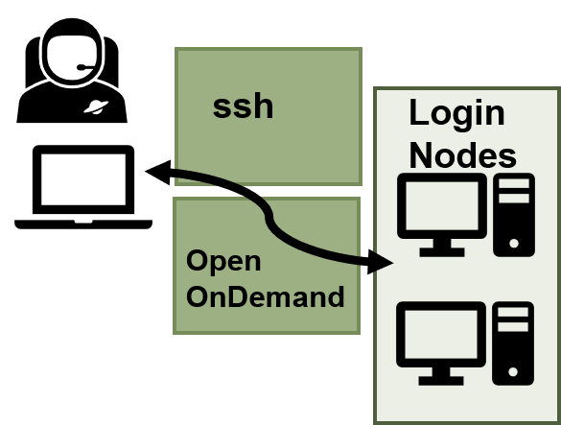
Access Longleaf; Not to Move Data
Two ways to connect:
Via an ssh connection: ssh –X <onyen>@longleaf.unc.edu
Requires an ssh program on your computer, and not the one your computer came with.
If connecting from off-campus, your computer is required to establish a VPN connection to UNC before connecting to longleaf. Search help.unc.edu for VPN.
Via Open OnDemand (OOD): https://ondemand.rc.unc.edu
Yes any browser will do! (But not designed for your cell phone)
Limited access to longleaf, but enough for many users.
DUO authentication required.
https://help.rc.unc.edu/getting-logged-on/

Slide 14
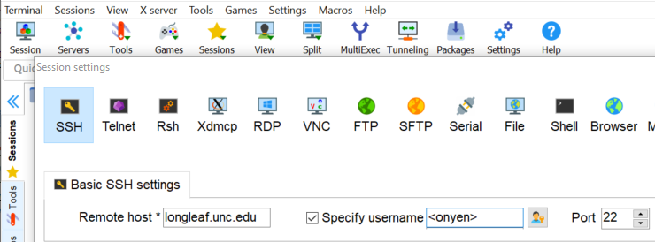
SSH to longleaf.unc.edu Login Node
Open MobaXTerm, XQuartz or other ssh program/app on your computer:
1
2
3
4
5
6
Password: <type your password with eyes closed; no feedback shows>
…
<onyen>@longleaf-login5 ~]$ <type linux commands here>
Commands typed run on a login node.
Notes:
https://help.rc.unc.edu/Assets/helpVideos/logon_longleaf_ssh.mp4

Slide 15
OOD or SSH: Which to Use?
Open OnDemand (OOD) | Linux Shell Access (ssh)
Novice/beginner linux user Prefers point and click No ssh program to download & install on your computer! | Experienced linux user Prefers typing in commands Having a lot of browser tabs/windows open is annoying.
OOD best use: | SSH best use:
Jobs run interactively/use GUI in modules Checking: Is my job done yet? Quick change & re-submit. Testing or debugging a script with a small data file & short program. | Cannot do what needs doing with Open OnDemand interface. User needs to do sophisticated editing of files/fancy emacs features and “regular expressions”
Allows reconnection for you to continue interactive session where you left off (until you end job or time runs out). | Once pc disconnects, connection terminates & interactive jobs end. Cannot reconnect to session.
Mix and match OOD & SSH connections....both access same jobs and files!

Slide 16
OOD Has SSH-like Access Too
OOD also has a page that gives its own shell access point into longleaf!
The shell gives you a command-line prompt where you type linux commands (no point and click).
This course will use this area in OOD to show you some commands you will most likely need on longleaf.
These are linux commands, so they are the same commands work in secure shell (ssh) apps that connect to longleaf.

Slide 17
OOD: Quick Tour

Slide 18
OOD: Files

Slide 19
Exercise: Open On Demand (OOD)
Go to OOD: https://ondemand.rc.unc.edu and the Files link to:
See a list of the files in your home directory
Make a (new) directory in your home directory called: class
Create a new file in class called hello.py & put this into hello.py:
# This program prints Hello, world! print('Hello, world!')
Save and close hello.py
If you finish early:
View hello.py to make sure those lines are still in there.
Make a new directory in your home dir. called: scratch_class
Copy hello.py to your scratch_class folder
Rename hello.py to hola.py
Make of copy hola.py called hello.py

Slide 20
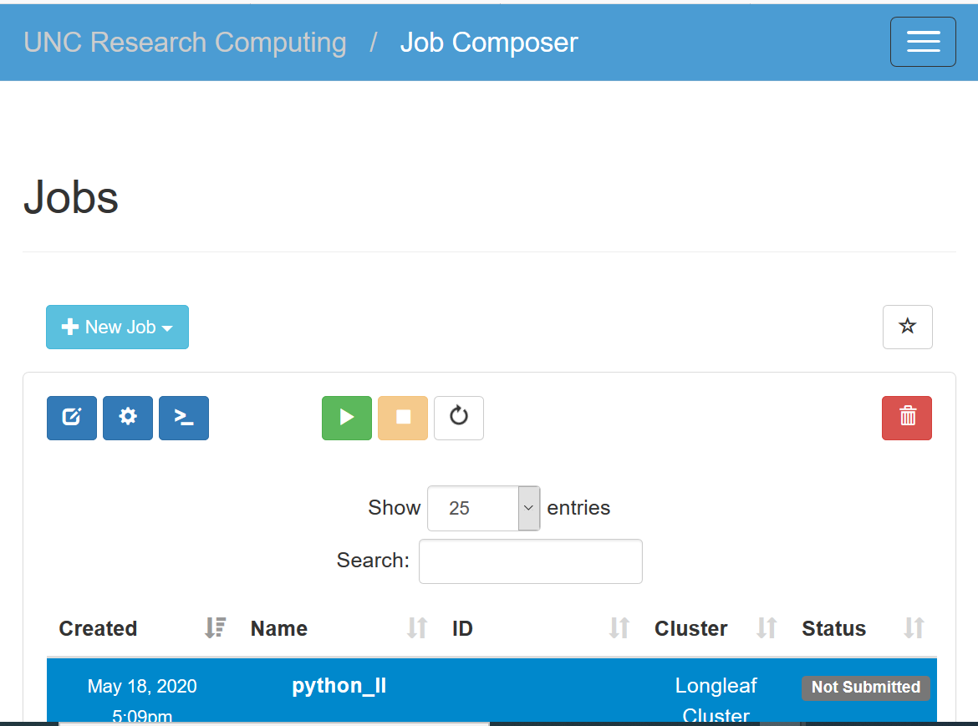
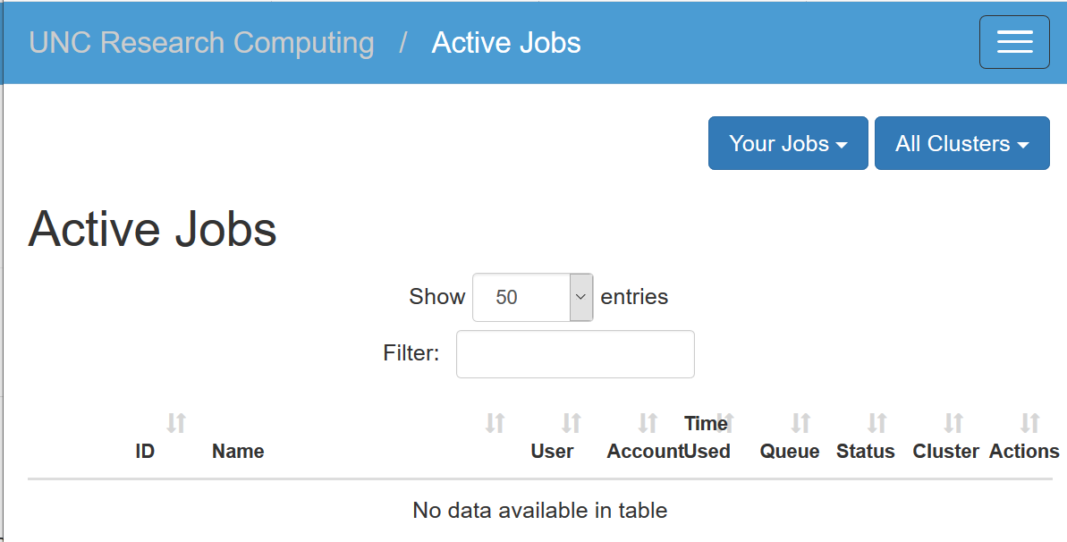
OOD: Jobs

Slide 21
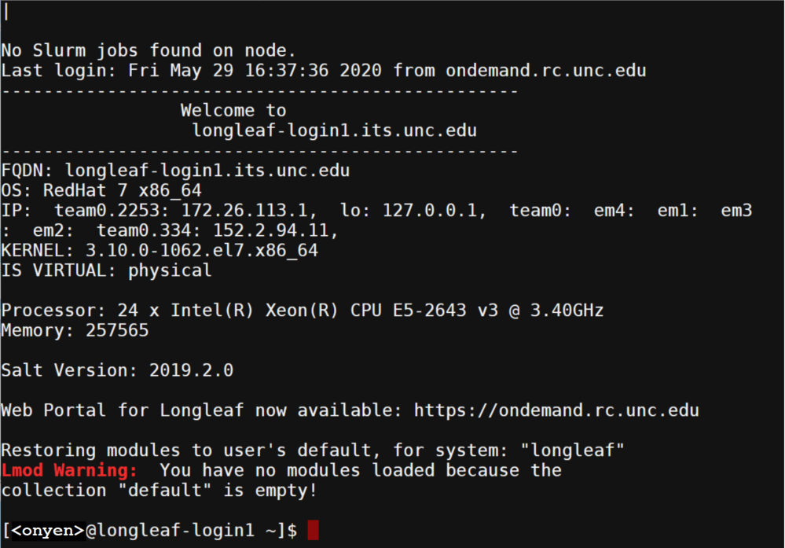
OOD: Clusters

Slide 22
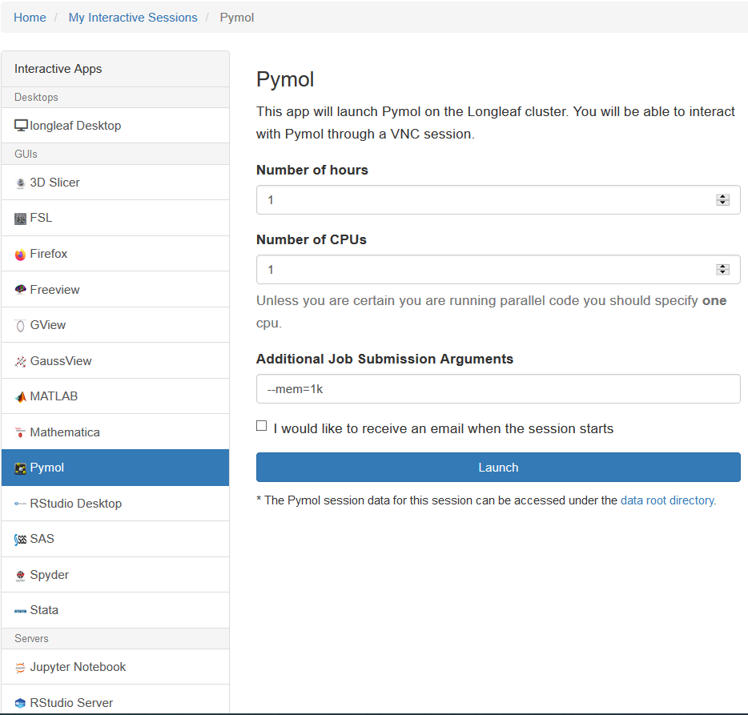
OOD: Interactive Apps

Slide 23
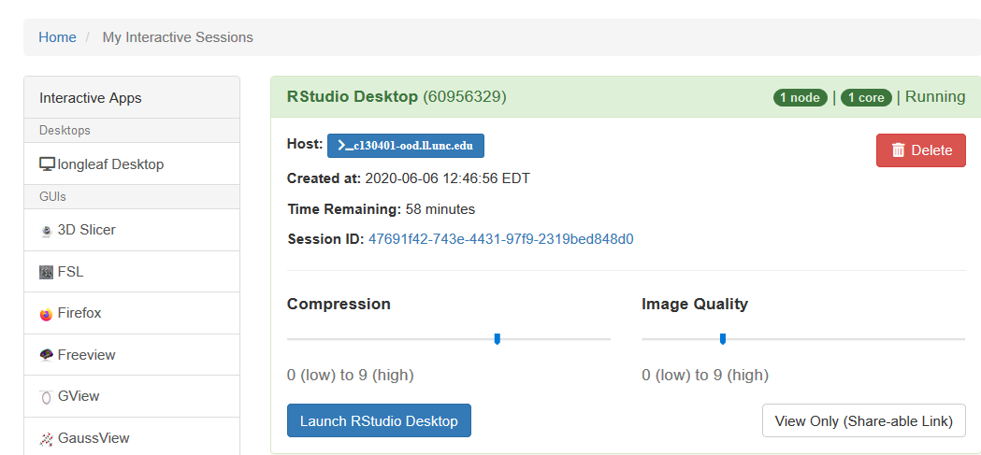
OOD: MY Interactive Apps

Slide 24
OOD: Connectivity Error: Restart
Can’t figure out error? Send email to research@unc.edu & include:
The error message (cut’n’paste or attach file or screenshot)
What type of interactive session is this? (e.g. Rstudio Desktop)
Screen shot of the My Interactive Sessions description of the session or
Your onyen
Job id
Host id
Session id

Slide 25
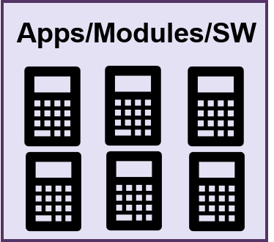
Available Apps/Modules
ssh
Apps/Modules/SW
Login Nodes
Compute Nodes
ssh longleaf.unc.edu
Open OnDemand
https:// ondemand.rc.unc.edu
Scheduler: SLURM
Globus
https://www.globus.org
Data Mover
Files: data/programs
sftp
sftp rc-dm.its.unc.edu

Slide 26
Take Poll

Slide 27
LL Apps/Modules/Software
670+ modules installed on Longleaf for you. Pick the one(s) you want!
For a job to use a module, you will need to do one of the following:
Load only the module needed in your current session and then submit (sbatch/srun)
Save the module currently loaded so that it always loads for every job
Insert the module command into the job's script so that it is loaded when the job runs.
Best practice:
Only load the module(s) your jobs need. Loading all the modules you might want to use ever likely will cause path problems/conflict errors.
Caution:
In some cases, it matters the order in which you load modules. If your job produces path errors/command not found errors, try loading less modules or loading modules in a different order.
Note: Modules modify the user environment by modifying and adding environment variables such as PATH or LD_LIBRARY_PATH
https://help.rc.unc.edu/modules-approach-to-software-management/

Slide 28
Module Commands
All module commands start with "module".
See all modules available for you to load:
module avail for example: module avail python
module keyword
module spider
Add a module to my session: module load <module name>
See all loaded in MY session: module list
Remove module from session: module rm <module name>
Save current session's list of modules to load automatically every time I log in and for every job: module save
Find more module commands: module help
https://help.rc.unc.edu/modules

Slide 29
Exercise: Modules
Use OOD's Clusters: Longleaf cluster shell access window:
See a list of all of longleaf's modules
See how many versions of python longleaf has
Which one would you get if you didn't specify a version?
Load python version 2.7.12
Save that module so that you don't have to re-load it next time you login.
Remove all modules to start over (hint: You'll need the module help to find this command)
Save your environment (with no modules loaded).
Extra credit/advanced: List the available r modules (only).
Notes:
module -r avail '^r/'

Slide 30
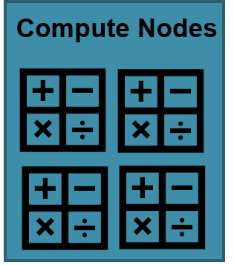
Types of LL Compute Nodes
ssh
Apps/Modules/SW
Login Nodes
Compute Nodes
ssh longleaf.unc.edu
Open OnDemand
https:// ondemand.rc.unc.edu
Scheduler: SLURM
Globus
https://www.globus.org
Data Mover
Files: data/programs
sftp
sftp rc-dm.its.unc.edu

Slide 31
Types of LL Compute Nodes
Every longleaf account can use
general compute nodes:
147 compute nodes, each with 24 physical cores, 256-GB RAM
30 compute nodes, each with 36 physical cores, 754-GB RAM
…
GPU compute nodes
Other types of compute nodes accessible upon request (research@unc.edu)
Large memory compute nodes (bigmem):
5 compute nodes, each with 64 physical cores, 3-TB RAM
Big data compute nodes (bigdata):
30 compute nodes, each with 12 physical cores, 256-GB RAM
https://help.rc.unc.edu/getting-started-on-longleaf/#System%20Information

Slide 32
General Compute Nodes
Intel Xeon processers, E5-2680 v3
Haswell microarchitecture (22 nm lithography)
Dual socket, 12-core (24 cores per node)
Hyperthreading is on so 48 schedulable threads
2.50 GHz processors for each core
DDR4 memory, 2133 MHz
9.6 GT/s QPI
256 GB memory
30 MB L3 cache
1x400 GB-SSD
2x 10Gbps Ethernet
120 MW TDP

Slide 33
Big Data Nodes
Intel Xeon processers, E5-2643 v3
Haswell microarchitecture (22 nm lithography)
Dual socket, 6-core (12 cores per node)
Hyperthreading is on so 24 scheduable threads
3.40 GHz processors for each core
DDR4 memory, 2133 MHz
9.6 GT/s QPI
256 GB memory
20 MB L3 cache
2x800 GB-SSD
2x 10Gbps Ethernet
135 MW TDP

Slide 34
Extreme Memory Nodes
Intel Xeon processers, E7-8867 v3
Haswell microarchitecture (22 nm lithography)
Quad socket, 16-core (64 cores per node)
Hyperthreading is on so 128 scheduable threads
2.50 GHz processors for each core
DDR4 memory, 2133 MHz
9.6 GT/s QPI
3.0 TB memory
45 MB L3 cache
1.6 TB SSD
2x 10Gbps Ethernet
165 MW TDP

Slide 35
GPU Nodes, Compute Host
Intel Xeon processers, E5-2623 v4
Broadwell microarchitecture (14 nm lithography)
Dual socket, 4-core (8 cores per node)
Hyperthreading is on so 16 scheduable threads
2.60 GHz processors for each core
DDR4 memory, 2133 MHz
8.0 GT/s QPI
64 GB memory
10 MB L3 cache
no SSD
2x 10Gbps Ethernet
85 MW TDP

Slide 36
GPU Nodes, Device
Nvidia GeForce GtX 1080 graphics card
Pascal Architecture
8 GPUs per node
2560 CUDA cores per GPU
1.73 GHz clock
8 GB Memory
320 GB/s mem b/w
PCIe 3.0 bus

Slide 37
Exercise: Compute Nodes
Use OOD's Clusters: Longleaf cluster shell access window:
See a list of all of longleaf's compute nodes by typing:
sinfo
How many nodes does it say are there in the general partition?
At the login node, type: top and then q (to stop it running). Do you see anyone running jobs on the login node?

Slide 38
Scheduling a Job: SLURM
Scheduler:SLURM
ssh
Apps/Modules/SW
Login Nodes
Compute Nodes
ssh longleaf.unc.edu
Open OnDemand
https:// ondemand.rc.unc.edu
Scheduler: SLURM
Globus
https://www.globus.org
Data Mover
Files: data/programs
sftp
sftp rc-dm.its.unc.edu

Slide 39
Scheduling a Job: SLURM
Scheduler:SLURM
A compute job is a request to:
Use a module with my data & my code/script to compute something
Requires resources: # & type of nodes, # cpus, time, memory
Longleaf's compute nodes are a shared resource: SLURM is the scheduler to find and reserve the resources you say the job needs.
Jobs are queued/wait-in-line/pending until the necessary resources are available.
You must submit your compute jobs to SLURM in order to get access to a compute node.
Not using SLURM to run jobs is considered an abuse of the system and can result in permanent revocation of your access to longleaf. System administrators and bot programs troll longleaf & kill any processes found outside SLURM.

Slide 40
What is SLURM?
Scheduler:SLURM
SLURM is an open source, fault-tolerant, and highly scalable cluster management and job scheduling system for Linux clusters.
As a cluster workload manager, SLURM has three key functions.
allocates exclusive and/or non-exclusive access to resources (compute nodes) to users for some duration of time so they can perform work
manages a queue that distributes resources “fairly”
provides a framework for starting, executing, and monitoring work on the set of allocated nodes
https://slurm.schedmd.com/overview.html
https://slurm.schedmd.com/pdfs/summary.pdf

Slide 41
How SLURM Prioritizes Jobs
Scheduler:SLURM
Compute nodes are always busy; jobs wait in the queue/line (status: PENDING) before they are assigned to a compute node to execute (status: RUNNING).
SLURM has a "fair-share" algorithm to decide a job's place in line.
SLURM moves up jobs that request fewer resources:
Nodes, tasks, time, memory

Slide 42
How SLURM Prioritizes Jobs
Scheduler:SLURM
If you submit your job to SLURM requesting:
A lot more resources than the job needs, then it will wait a lot longer in the queue than it needs to before it starts running.
Fewer resources than it needs, then your job will wait less, but will die when it runs out and SLURM will tell you what it ran out of: OOM (out of memory) is the most common.
Learn what your jobs need from a job that ran successfully: See how much SLURM says it used!

Slide 43
Common SLURM Commands
Scheduler:SLURM
All SLURM commands start with "s":
sbatch: submit a batch job request
srun: submit an interactive job request
squeue: view status of running or pending job(s)
scancel: kill/cancel submitted job
sacct: view info about how a finished job ran
(eg: memory usage, time needed, errors: OOM?)
sinfo: shows status of all partitions
Use man pages to get much more info!
man sbatch (also online)

Slide 44
Submit Job: sbatch or srun
Scheduler:SLURM
Let OOD write your SLURM for you (using Jobs: Job Composer or Interactive Sessions)
Put your SLURM in a file and submit the SLURM script:
sbatch myscript.sl
The SLURM script file's first 3 lines are (do not indent):
#!/bin/bash
#SBATCH....
#SBATCH for job SLURM options (one per line) and then lines without #SBATCH are the commands you want to run

Slide 45
Submit Job: sbatch or srun
Scheduler:SLURM
Or:
3. Type the command on one line using the --wrap option to include the command you want to run in quotes (“ ”)
sbatch [sbatch options] --wrap=“command to run”
(See examples at the end for 2 & 3)
DO NOT execute your script at $ login prompt! That's called running on the login node! It's an abuse of the system. (Allowed exception: To see if you've got the command right and you kill/stop/cancel the execution after a minute.)

Slide 46
Common sbatch/srun Options
Scheduler:SLURM
-N (--nodes=) -N 1
-N 1 for all longleaf jobs [dogwood allows more]
-n (--ntasks) <number of tasks> -n 1
used for parallel (non-serial) jobs
--mem= --mem=50g
-t (--time=) -t 1-22:33:44
-p (--partition=) <partition name>
-o (--output=) <filename>
-o /nas/longleaf/home/<onyen>/class_jobs/myJob%j.out
-J (--jobname) <name>

Slide 47
SLURM Partitions (Queues)
Scheduler:SLURM
Everyone has access to:
Defaults:
-p general –t 0-01:00:00 –N 1 –n 1 --mem=2g
Partition: general.
Time limit: one hour.
Memory limit: 2 GB.
Number of cpus & nodes: one.
general | Nearly all your sbatch jobs. SLURM assigns general jobs to supporting partitions, so don’t include a partition for general sbatch jobs. Leave it out and let SLURM decide.
interact | For short interactive sessions: debugging your program.
gpu, beta-gpu, volta-gpu, … | These partitions are for accessing our gpus. Requires SLURM qos setting. See: https://help.rc.unc.edu/gpu/
datamover | Jobs that just copy/delete files using data mover servers.
webportal* | OOD interactive session jobs only. You can’t submit (sbatch/srun) jobs in your ssh sessions to this partition.
Notes:
Remember: do not specify –partition=general (let SLURM use the default partitions instead)

Slide 48
SLURM Partitions (Queues)
Scheduler:SLURM
Accessible to those who need & request:
snp | (Single Node Parallel) Parallel jobs that need all/most cores on a node: but not more than are on one node (multi-node processing jobs need Dogwood), Need a high percentage of a node’s total memory; effectively they need the entire node.
bigmem | Very large memory jobs
bigdata | Jobs that use very large files
Patron nodes | PIs can purchase compute nodes for private use on longleaf. See: https://help.rc.unc.edu/patron/

Slide 49
SLURM Job’s Memory Usage
Scheduler:SLURM
“seff” is a new tool to see efficiency of a job’s memory request:
$ seff <job_id>
Output looks like:
Job ID: 12341234
…
State: COMPLETED (exit code 0)
Cores: 1
CPU Utilized: 10:17:55
CPU Efficiency: 99.96% of 10:18:08 core-walltime
Job Wall-clock time: 10:18:08
Memory Utilized: 399.55 MB
Memory Efficiency: 4.88% of 8.00 GB
https://help.rc.unc.edu/techdocs/monitoring-memory-usage/

Slide 50
Ex: Your Efficiency Trends
Scheduler:SLURM
sacct -u <onyen> -S 2023-09-01 -E 2023-12-31 --state=cd --format=jobid -Xn |xargs -L1 -I{} sh -c " seff {} ; echo "|egrep "Memory Eff"
If you get a bash error: -bash: xargs -L1: command not found, retype the command (the copy’n’paste also copied over hidden characters)
Want to understand what that command is doing or make it better? Take our Shell Scripting course!

Slide 51
SLURM: Guessing Time/Mem
Scheduler:SLURM
Tips for good starting guesses for SLURM time and memory:
A previous job of yours that ran successfully.**
A lab/classmate's job that does something similar.**
An example that matches the module you are using in the SLURM examples appendix section of this presentation.
An example that matches the module you are using on the Longleaf SLURM examples web page: https://help.rc.unc.edu/techdocs/longleaf-slurm-examples/
If none of these work for your job, then start with the general default settings and increase your job's time/memory in 10% increments until you get one that runs successfully.**
___________
** Use seff <job-id> to see how much to use for your (next) job.

Slide 52
SLURM Partition Limits
Scheduler:SLURM
We set limits on the number of resources a single person or job can request. Some of the limits are set at the user level (across all their jobs), most are set at the partition (and "qos") levels. We update them regularly to improve performance and adjust for new/changed resources.
Helpful SLURM commands to see limits:
$ scontrol show partition
$ scontrol show partition general
$ sacctmgr show qos format=name%15,mintres,grptres,maxtres%20,maxtrespernode,maxtrespu%20,maxjobs,mintres,MaxSubmitJobsPerUser,maxtrespa
$ sacctmgr show user where name=<ONYEN> withassoc format=user,DefaultQOS,account%20,qos

Slide 53
SLURM Commands Exercise
Scheduler:SLURM
Use seff to find out how efficient job 23866216 was.
Use sacct to find out how these jobs ended:
sacct -j 23866216,23585068,23584974,23615175
3. Use squeue to see how many jobs are currently running in the interact partition:
squeue -p interact
4. Use scontrol to see ood partition: What’s the longest time allowed? What QOS does the ood partition use?
scontrol show partition webportal
5. Use sacctmgr to see limits for qos that the partition webportal uses:
sacctmgr show qos ood format=name,maxtres%40qos

Slide 54
SLURM Commands Exercise
Scheduler:SLURM
Use sacct to see how efficient an onyen’s jobs have been over the last 30 days (change the dates to make it more interesting):
sacct -S 2024-01-01 -E 2024-06-30 --timelimit-min=2- --timelimit-max=11- --state=cd --format=jobid -u <onyen> -Xn |xargs -L1 -I{} sh -c " seff {} ; echo "|egrep "Memory Eff"
Use sacct to see list of those jobs:
sacct -S 2024-01-01 -E 2024-05-31 --timelimit-min=2- --timelimit-max=11- --state=cd –u <onyen>
Use sacct to see list of those jobs, with more helpful information:
sacct -S 2024-01-01 -E 2024-05-31 --timelimit-min=2- --timelimit-max=11- --state=cd –u <onyen> --format=jobid,elapsed,maxrss,reqmem --units=g
Use sacct to see list of other columns you can put in the format string:
sacct --helpformat

Slide 55
SLURM Examples (ssh)
Scheduler:SLURM
$ sbatch –n 1 –N 1 -p general –t 1-22:33:44 –-mem=10g –-wrap=“r <name of r script>”
$ sacct --format=user,jobid,partition,end,State%15,exitcode,reqmem,maxRSS,elapsed,timelimit --units=G –j <jobid>
The above commands are shown in this tiny font because each command must be typed on a continuous line (no return). Below are the same commands in a larger font so you can read them, but ignore the line breaks in each:
$ sbatch –n 1 –N 1 -p general –t 1-22:33:44 --mem=10g --wrap=“r <name of r script>”
$ sacct --format=user,jobid,partition,end,State%15,exitcode,reqmem,maxRSS,elapsed,timelimit --units=G -j <jobid>

Slide 56
Examples: R SLURM script
Scheduler:SLURM
#!/bin/bash
#SBATCH -N 1
#SBATCH -t 07-00:00:00
#SBATCH --mem=10g
#SBATCH -n 1
module add r
Rscript mycode.R
Equivalent to:
sbatch –t 0-07:00:00 --mem=10g --wrap=“Rscript mycode.R”
Submits job to general partition, 1 node, 1 task, 7-day limit, 10 GB memory limit.
**sbatch options ORDER doesn’t matter**
sbatch --mem=10g --wrap=“Rscript mycode.R” –t 0-07:00:00

Slide 57
Common SLURM Mistakes
Scheduler:SLURM
Once one job has completed successfully, all other similar jobs should be submitted with the same SLURM settings.
Assuming if you submit one job and then a second one that the second one won’t start until after the first one starts.
A job that fails with an “out of memory” error just needs to be resubmitted with more memory.
A job that fails with an “out of time” error just needs to be resubmitted with more time.
There is no way to tell if a job is really running and making progress through the data/calculation until it is done.

Slide 58
Files: Your Data, Scripts & Programs
ssh
Apps/Modules/SW
Login Nodes
Compute Nodes
ssh longleaf.unc.edu
Open OnDemand
https:// ondemand.rc.unc.edu
Scheduler: SLURM
Globus
https://www.globus.org
Data Mover
Files: data/programs
sftp
sftp rc-dm.its.unc.edu

Slide 59
Take Poll

Slide 60
File Storage Areas: For Jobs to Use
home | Path | /nas/longleaf/home/<onyen> (e.g. /nas/longleaf/home/abc )
 | Quota | 50 GB soft, 75 GB hard
 | Notes | Starting point when you log in (unless you reconfigured setting)
work | Path | /work/users/<o>/<n>/<onyen>
 | Quota | https://help.rc.unc.edu/storage
 |  | For medium or big files needed for your current compute jobs
users | Path | /users/<o>/<n>/<onyen>
 | Quota | https://help.rc.unc.edu/storage
 | Notes | For /work files you are infrequently using.
project (proj) | Path | /proj/<PI_project_name>
 | Quota | Usually < 20TB
 | Notes | Created for faculty (PI) to have teams to share space & files.
<o>,<n>,<onyen> refer to your onyen https://help.rc.unc.edu/storage

Slide 61
Checking Quota: Any Space Left?
Name | Website or Command*
home | https://service.rc.unc.edu/
/proj/ and /overflow/ | https://service.rc.unc.edu/ Login and, if you don’t see it listed, search for your onyen
/work/ and /users/ | Type (substitute with your onyen): du /work/users/<o>/<n>/<onyen> -s -h du /users/<o>/<n>/<onyen> -s -h And compare to the quota
* Commands need to be typed in an ssh connection or OOD's, Clusters: Longleaf cluster shell access window

Slide 62
Folder Exercises
How full is your home directory?
How full is your /users/ directory?

Slide 63
Backups and Power Outages
Name | Is it backed up?
home | Yes – via “snapshots” See: https://help.rc.unc.edu/snapshots-for-file-recovery-in-research-computing-nas-filesystems
/work/ (and /users/) | No – immediately gone after removal, so plan accordingly.
project (/proj/) | Not usually; only in rare situations. Assume not.
Power “blips” are fine/covered.
The data center itself has UPS (Uninterrupted Power Source of batteries), but the UPS does not support OOD and compute nodes. All jobs currently running will stop. sbatch jobs will be re-submitted when the compute nodes are back up. Login nodes (ssh) are on the UPS and remain online. It takes ~4-8 hours for RC staff to bring everything back up from a power outage.

Slide 64
SLURM & Power Outages
Scheduler:SLURM
Compute nodes are not on the UPS. They go down during a power hit. When power is restored, SLURM restarts any jobs that were running. ALWAYS include the email option in your SLURM so that SLURM sends you email if it restarts your job:
#SBATCH --mail-type=BEGIN,REQUEUE #SBATCH --mail-user=your@email.address
or
--mail-type=BEGIN,REQUEUE --mail-user=your@email.address
Here are your mail-type options: BEGIN, END, FAIL,REQUEUE, ALL, TIME_LIMIT,TIME_LIMIT_90,TIME_LIMIT_80,ARRAY_TASKS
Check: https://itsstatus.unc.edu/#past-incidents
[For jobs that take more than 3 days to run, consider adding restart logic to the process so that restarts will work correctly.]
Notes:
That may be the only way you learn that it was restarted

Slide 65
Archival for Old Data
Evolving Topic in RC
“mass storage” (or /ms/) has been decommissioned.
Available cloud-based solution for cold storage: Files you need to keep but don’t think you’ll need to access them again and at most no more than once a year or so.
/users/ for “cool” files that are not yet cold or are too small for long term clould-based cold storage.
For latest status and updates, check:
https://help.rc.unc.edu/mass-storage/
https://help.rc.unc.edu/storage

Slide 66
Common Data Available
New and expanding resource: /datacommons/
Library of read-only public datasets commonly used in research.
Lots of space available right now!
Nominate ones you want by email to research@unc.edu

Slide 67
My Data is Very Sensitive
HIPAA data?
Not allowed on longleaf. Must be de-identified or email us to see if your project qualifies for one of our secure workstation solutions.
Not HIPAA, but data use agreement needs something?
Email research@unc.edu about your project requirements.
Aspera needed to upload for NCBI?
You can install aspera in your account and use on our data mover servers! Email us for instructions & ssh into a data mover server to use the aspera command line mode.
Collaborators are not UNC-ers and don’t have Globus?
Write us at research@unc.edu for other ways to involve collaborators.

Slide 68
Take Poll

Slide 69
Copying Files
ssh
Apps/Modules/SW
Login Nodes
Compute Nodes
ssh longleaf.unc.edu
Open OnDemand
https:// ondemand.rc.unc.edu
Scheduler: SLURM
Globus
https://www.globus.org
Data Mover
Files: data/programs
sftp
sftp rc-dm.its.unc.edu

Slide 70
Copying Files On/Off Longleaf
Login nodes (longleaf.unc.edu) & OOD Files are NOT for transferring medium or big files. Instead use our data mover server:
rc-dm.its.unc.edu
With your favorite scp/sftp program, connect to
<onyen>@rc-dm.its.unc.edu (not longleaf.unc.edu)
Not on campus? Establish VPN connection first (search help.unc.edu for VPN)
Note: The session must hold the connection for the entire file transfer.
Blink -> start over. So this is best for small to medium files that take less than 30 minutes to transfer.
https://help.rc.unc.edu/longleaf-frequently-asked-questions-faqs/#6

Slide 71
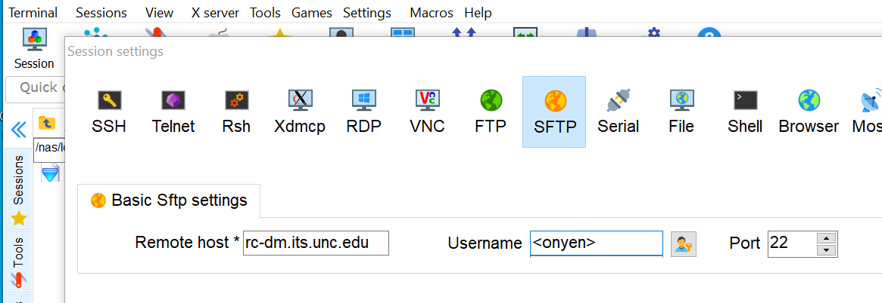
FTP site to rc-dm.its.unc.edu
File list located on or will be put in a drive on your computer.
Open MobaXTerm, XQuartz or other sfp program/app on your computer:
1
2
3
4
5
Drag'n'drop
To copy
Click to Move Around

Slide 72
SSH to SFTP to rc-dm.its.unc.edu
File list located on an ftp server & you have instructions. Open MobaXTerm, XQuartz or other ssh program/app on your computer:
1
2
3
4
5
6. Commands typed
Password: <type your password with eyes closed; no feedback shows>
…
<onyen>@rc-dm1 ~]$ cd /work/a/b/abc/folderfordata
<onyen>@rc-dm1 ~]$ sftp cnn.com
…
[ftp-cnn.com] $ get CapSensitiveFile.txt

Slide 73
Globus for Transferring Files!
UNC Research Computing has a GLOBUS license!
The best way to move large files between research computing and your computer (“end points”).
Some set up required, then let Globus do the work:
Point and click environment
Set up your Globus Connect Personal app and drag and drop!
Globus uses our data mover servers
Globus handles connection disruptions without starting over
Globus will let you know when it is done via email.
Set up a shared personal end point and you can share your longleaf files with another UNC-er/onyen (no longleaf account needed).
Reminder: Big files take time. Got 1T? Plan for days to transfer.
https://help.rc.unc.edu/globus-connect-file-transfer/
NEW: https://help.rc.unc.edu/globus-onedrive-collection/

Slide 74
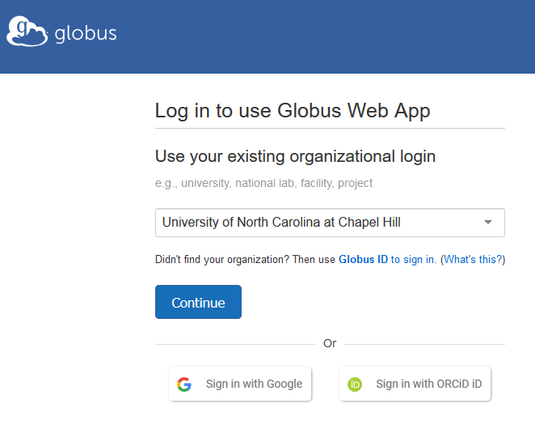
Globus: https://www.globus.org
1
2
3
4
5
5
6

Slide 75
Last Thoughts: Tips, Advice & Checklists

Slide 76
Workflow Tips/Advice
You will need to build up to submitting the job you want to run:
Debug code: Confirm code runs as desired on a small data sample
Debug submission: Submit a test job on interact partition using the submission code with little time (5 min.s) to confirm necessary modules & packages are loaded and paths to files are correct.
Add checkpoints to your code to see movement while its running.
Check that you reset time & data files after testing back to desired.
Tailor SLURM for next round of jobs based on what memory/time previously successful jobs actually used/needed.
General tips:
Only ask for resources you need in your SLURM more resources = longer wait
Know where your script and SLURM are writing files

Slide 77
More Advice
Keep each project in its own folder/set of folders.
In linux, it’s easier if your file names don’t contain a space, dot or ().
Do not put big data files your home directory; put those on /work/ or /proj/.
Manually back up your changes to /proj/ & /work/ data and scripts regularly; at least 2/year.
Be able to perfectly replicate all you did to create the results you got; document a final list of steps! [More challenging in interactive apps.]
If you are updating files, instead make new copies when there are big changes and make the file name descriptive of the change (version numbers, dates or “withX” in name). That way, if you need to, you can go back a few steps without having to completely start over.
Keep notes about different jobs in a file/app; include job id(s) and paths (if you’ve got many). That way you can answer: Did I ever run a job with X and without Y? What happened?
If you think you’ll want to share files with a labmate, keep all files for that work in your PI’s /proj/ space where all labmates
can see each other’s files.

Slide 78
OOD Interactive Apps: You Ready?
Where on Longleaf are your data files (name and paths).
Use OOD’s Files tab to check and copy locations
Before LAUNCH, have you selected the right time and added any SLURM extra settings (e.g. –mem=…)
Before Launch <app>, screenshot or copy down job id, host id and session id (you will need them later).
When you are done with your session, save any files or script files and make sure you EXIT/END your job.
Use OOD’s Jobs tab to make sure it is not still running.
Last step: Use OOD’s Cluster access to see how efficient your time and memory use was; to inform next job. Type:
seff <job id>

Slide 79
SSH SBATCH Jobs: Are You Ready?
Where on Longleaf are your data files (name and paths)?
Where on Longleaf is your app’s script (name and path)?
Test that you have correct modules loaded:
Open a new ssh connection & type: module list
Test your app’s command by typing it and hitting Cntl^C a few SECONDS later. Fix typos and not found errors.
Include full path references to files and scripts in your SLURM (e.g.: /nas/longleaf/home/myonyen/scripts/abc.py)
Use seff <job_id> command on an old jobs (yours or labmate’s) to find best memory and time settings.
Include email notifications in your SLURM (5 slides ago).
Once you type sbatch … Make a note of job id and description of what it is doing (vs your other jobs).
Last step, efficiency! Type: seff <job id>

Slide 80
Today You Practiced:
Connecting to Longleaf (log on)
Moving files to/from longleaf
Picking and managing your software “modules”
Scheduling “a job” to run on longleaf’s compute node
Monitoring the status of the job, output and results

Slide 81
SLURM: Exercise 1 (Together)
Scheduler:SLURM
Use OOD to start an interactive session of Pymol. Paste or type in:
print('Hello, world!’);
Exit job when it is done,
Check OOD Jobs tab to make sure it’s not running
and check seff for the job id.

Slide 82
SLURM: Exercise 2 (Together)
Scheduler:SLURM
2. Use OOD, Clusters…to submit sbatch job for hello.py in a command - all on one line:
cd class
module add python
sbatch -t 0-01:00:00 --mem=1g --wrap="python3 hello.py"
Check the job with squeue –j <job id> and sacct –j <job id> commands.
What’s the difference between squeue and sacct?
When its done:
Find slurm’s job output file and look at contents. What determines which folder this file is in?
Check seff. How does this efficiency compare with previous job?
How is this not “running a job on the login node”?

Slide 83
SLURM: Exercise 3 (Together)
Scheduler:SLURM
3. Use OnDemand Files to create a slurm submission file for hello.py called slurm_hello.sl:
Use OOD, Clusters, Longleaf Cluster Shell Access and type:
sbatch ~/class/slurm_hello.sl
Check the job with squeue and sacct commands.
When its done:
Find slurm’s job output file and look at contents. Where is file? Why?
Check seff. How does this efficiency compare with previous job?
#!/bin/bash
#SBATCH -t 00-01:00:00
#SBATCH --mem=1g
module add python
cd ~/class
python3 hello.py

Slide 84
Thank you for your attention today
Remaining slides are SLURM examples & other reference materials
Notes:
84

Slide 85
Examples
SLURM
Notes:
85

Slide 86
Interactive job submissions
To bring up the Matlab GUI:
srun -n1 -p interact --x11=first matlab
-singleCompThread
To bring up the Stata GUI:
salloc -n1 -p interact --x11=first xstata-se
To bring up a bash session:
srun -n1 -p interact --pty /bin/bash
Note. For the GUI to display locally you will need a X connection to the cluster (ssh -X)

Slide 87
Matlab sample job submission script #1
#!/bin/bash
#SBATCH -p general
#SBATCH -N 1
#SBATCH -t 07-00:00:00
#SBATCH --mem=10g
#SBATCH -n 1
matlab -nodesktop -nosplash -singleCompThread -r mycode -logfile mycode.out
Single CPU Matlab job
General partition, 7-day runtime limit, 10 GB memory limit
Don’t need to specify partition for general

Slide 88
Matlab sample job submission script #2
#!/bin/bash
#SBATCH -p general
#SBATCH -N 1
#SBATCH -t 02:00:00
#SBATCH --mem=3g
#SBATCH -n 24
matlab -nodesktop -nosplash -singleCompThread -r mycode -logfile mycode.out
Submits a 24-core, single node Matlab job
General partition, 2-hour runtime limit, 3 GB memory limit

Slide 89
Matlab sample job submission script #3
#!/bin/bash
#SBATCH -p gpu
#SBATCH -N 1
#SBATCH -t 30
#SBATCH --qos=gpu_access
#SBATCH --gres=gpu:1
#SBATCH -n 1
matlab -nodesktop -nosplash -singleCompThread -r mycode -logfile mycode.out
Submits a single-GPU Matlab job
GPU partition, 30 minute runtime limit.
--qos checks you against list of permitted users
--gres requests special resources

Slide 90
Matlab sample job submission script #4
#!/bin/bash
#SBATCH -p bigmem
#SBATCH -N 1
#SBATCH -t 7-
#SBATCH --qos=bigmem_access
#SBATCH -n 1
#SBATCH --mem=500g
matlab -nodesktop -nosplash -singleCompThread -r mycode -logfile mycode.out
Submits a single-cpu, single node large memory Matlab job.
bigmem partition, 7-day runtime limit, 500 GB memory limit

Slide 91
R sample job submission script #1
#!/bin/bash
#SBATCH -p general
#SBATCH -N 1
#SBATCH -t 07-00:00:00
#SBATCH --mem=10g
#SBATCH -n 1
Rscript mycode.R
Submits a single cpu R job.
general partition, 7-day runtime limit, 10 GB memory limit
Rscript generally used to execute, but can use older R CMD BATCH as well

Slide 92
R sample job submission script #2
#!/bin/bash
#SBATCH -p general
#SBATCH -N 1
#SBATCH -t 02:00:00
#SBATCH --mem=3g
#SBATCH -n 24
Rscript mycode.R
Submits a 24-core, single node R job (i.e. using one of R’s parallel libraries).
general partition, 2-hour runtime limit, 3 GB memory limit.

Slide 93
R sample job submission script #3
#!/bin/bash
#SBATCH -p bigmem
#SBATCH -N 1
#SBATCH -t 7-
#SBATCH --qos=bigmem_access
#SBATCH -n 1
#SBATCH --mem=500g
Rscript mycode.R
Submits a single-cpu, single node large R memory job.
bigmem partition, 7-day runtime limit, 500 GB memory limit

Slide 94
Python sample job submission script #1
#!/bin/bash
#SBATCH -p general
#SBATCH -N 1
#SBATCH -t 07-00:00:00
#SBATCH --mem=10g
#SBATCH -n 1
python mycode.py
Submits a single cpu Python job.
General partition, 7-day runtime limit, 10 GB memory limit
If you want to use Python 3.x module, safer to use “python3” - 2.x built into OS

Slide 95
Python sample job submission script #2
#!/bin/bash
#SBATCH -p general
#SBATCH -N 1
#SBATCH -t 02:00:00
#SBATCH --mem=3g
#SBATCH -n 24
python mycode.py
Submits a 24-core, single node Python job (i.e. using one of python’s parallel packages).
general partition, 2-hour runtime limit, 3 GB memory limit.

Slide 96
Python sample job submission script #3
#!/bin/bash
#SBATCH -p bigmem
#SBATCH -N 1
#SBATCH -t 7-
#SBATCH --qos=bigmem_access
#SBATCH -n 1
#SBATCH --mem=500g
python mycode.py
Submits a single-cpu, single node large Python memory job.
bigmem partition, 7-day runtime limit, 500 GB memory limit

Slide 97
Stata sample job submission script #1
#!/bin/bash
#SBATCH -p general
#SBATCH -N 1
#SBATCH -t 07-00:00:00
#SBATCH --mem=10g
#SBATCH -n 1
stata-se -b do mycode.do
Submits a single cpu Stata job.
General partition, 7-day runtime limit, 10 GB memory limit

Slide 98
Stata sample job submission script #2
#!/bin/bash
#SBATCH -p general
#SBATCH -N 1
#SBATCH -t 02:00:00
#SBATCH --mem=3g
#SBATCH -n 8
stata-mp -b do mycode.do
Submits a 8-core, single node Stata/MP job.
General partition, 2-hour runtime limit, 3 GB memory limit
# of possible cores limited by our Stata license – check with us for details

Slide 99
Stata sample job submission script #3
#!/bin/bash
#SBATCH -p bigmem
#SBATCH -N 1
#SBATCH -t 7-
#SBATCH --qos=bigmem_access
#SBATCH -n 1
#SBATCH --mem=500g
stata-se -b do mycode.do
Submits a single-cpu, single node large Stata memory job.
bigmem partition, 7-day runtime limit, 500 GB memory limit

Slide 100
Printing Job Info at end (using Matlab script #1)
#!/bin/bash
#SBATCH -p general
#SBATCH -N 1
#SBATCH -t 07-00:00:00
#SBATCH --mem=10g
#SBATCH -n 1
matlab -nodesktop -nosplash -singleCompThread -r mycode -logfile mycode.out
sacct -j $SLURM_JOB_ID --format='JobID,user,elapsed, cputime, totalCPU,MaxRSS,MaxVMSize, ncpus,NTasks,ExitCode'
sacct command at the end prints out some useful information for this job. Note the use SLURM environment variable with the jobid
The format picks out some useful info. See “man sacct” for a complete list of all options.

Slide 101
Email example
#!/bin/bash #SBATCH --partition=general #SBATCH --nodes=1 #SBATCH --time=04-16:00:00 #SBATCH --mem=6G #SBATCH --ntasks=1
# comma separated list #SBATCH --mail-type=BEGIN, END #SBATCH --mail-user=YOURONYEN@email.unc.edu # Here are your mail-type options: NONE, BEGIN, END, FAIL,
# REQUEUE, ALL, TIME_LIMIT, TIME_LIMIT_90, TIME_LIMIT_80,
# ARRAY_TASKS date hostname echo "Hello, world!"

Slide 102
Dependencies
Job 1: #!/bin/bash #SBATCH --job-name=My_First_Job #SBATCH --partition=general #SBATCH --nodes=1 #SBATCH --time=04:00:00 #SBATCH --ntasks=1 sleep 10 Job 2: -bash-4.2$ cat job2.sbatch #!/bin/bash #SBATCH --job-name=My_Second_Job #SBATCH --partition=general #SBATCH --nodes=1 #SBATCH --time=04:00:00 #SBATCH --ntasks=1 sleep 10
% sbatch job1.sbatch Submitted batch job 5405575 % sbatch --dependency=after:5405575 job2.sbatch Submitted batch job 5405576 Other options: sbatch --dependency=after:5405575 job2.sbatch sbatch --dependency=afterany:5405575 job2.sbatch sbatch --dependency=aftercorr:5405575 job2.sbatch sbatch --dependency=afternotok:5405575 job2.sbatch sbatch --dependency=afterok:5405575 job2.sbatch sbatch --dependency=expand:5405575 job2.sbatch sbatch --dependency=singleton job2.sbatch

Slide 103
Scaling up workflow
Use SLURM job arrays (Matlab example):
#!/bin/bash
#SBATCH -N 1
#SBATCH -n 1
#SBATCH -p general
#SBATCH -t 1-
#SBATCH --array=1-30
matlab -nodesktop -nosplash -singleCompThread -r 'main('$SLURM_ARRAY_TASK_ID’)’
Need more? Review web search results for: slurm sbatch job array

Slide 104
Supplemental Material

Slide 105
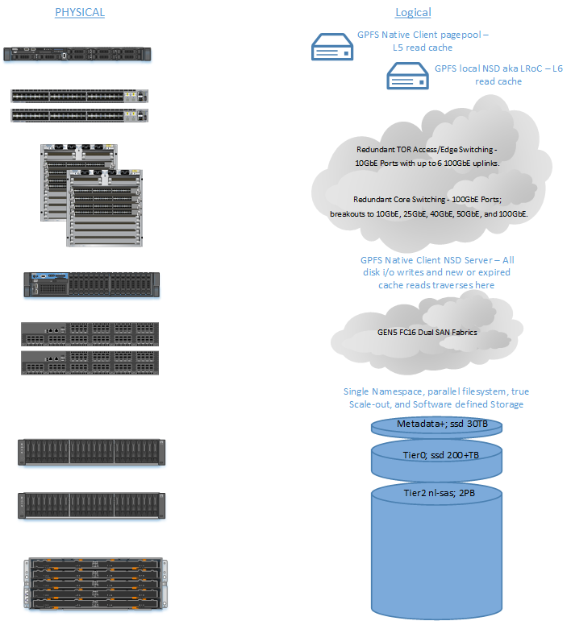
Tiered storage on Longleaf

Slide 106
Getting an account:
To apply for your Longleaf or Dogwood cluster account, follow instructions:
https://help.rc.unc.edu/request-a-cluster-account/
Turn around is usually one business day.

Slide 107
Links
Longleaf page with links
https://help.rc.unc.edu/longleaf-cluster/
Longleaf SLURM examples
https://help.rc.unc.edu/longleaf-slurm-examples/
Linux cheat sheet:
https://files.fosswire.com/2007/08/fwunixref.pdf
Basic Linux tutorial:
http://faculty.washington.edu/rjl/uwhpsc-coursera/unix.html
Advanced Linux tutorial (very well written!):
http://linuxcommand.org/lc3_learning_the_shell.php
Emacs reference:
https://www.gnu.org/software/emacs/refcards/pdf/refcard.pdf

