Slide 1
Overview of Research Computing
ITS Research Computing
Sandeep Sarangi and Mark Reed

Slide 2
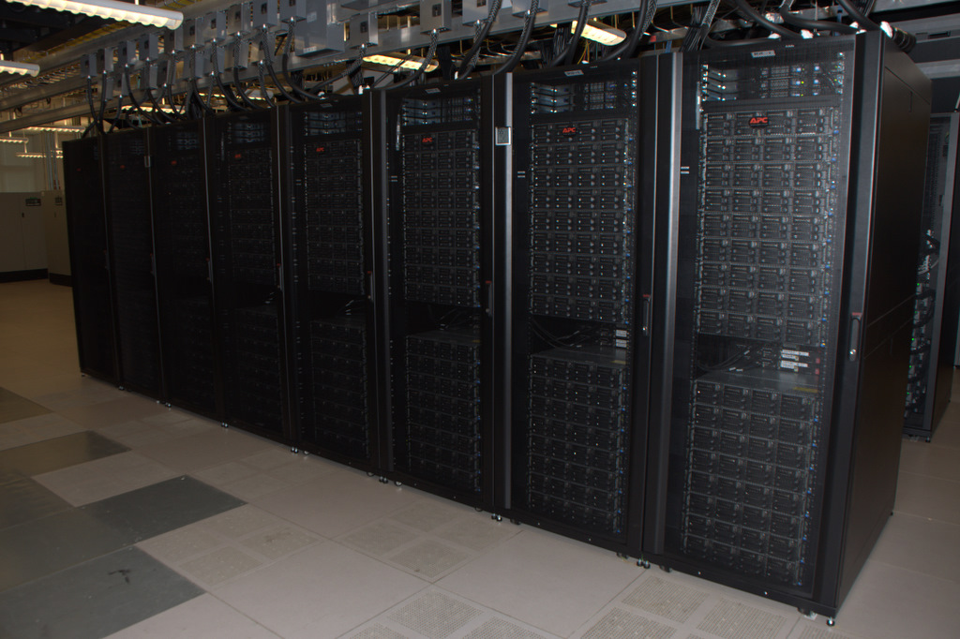

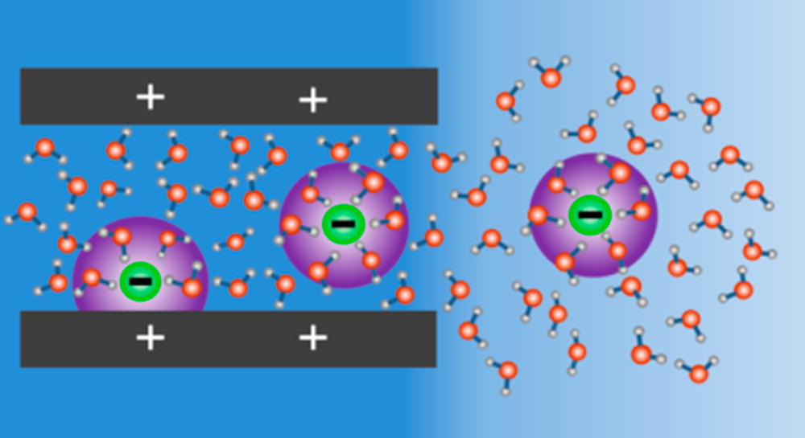
Overview – Research Computing
Resources
Services
Projects

Slide 3
ReCo Resources
Computational Resources
  compute clusters: Longleaf, Dogwood (Killdevil)
  Special purpose servers:
    galaxy, bioapps, zorro, ICISS, …
  Cloud Computing
  VM’s, SRW
Software
  licensed
  open source
Data Storage
Virtual Computing Lab (VCL)
Access to National Resources

Slide 4
ReCo Services
Technical Support
Training and Development
Engagement and Collaboration
Secure Research Workspaces
Research Database Support
Secure Data Exchange
Desktop Support – THL

Slide 5
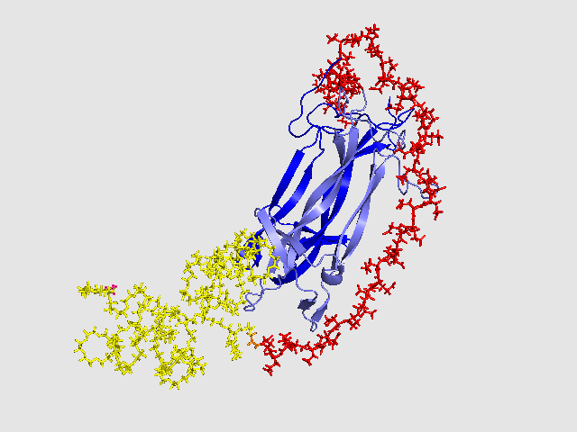
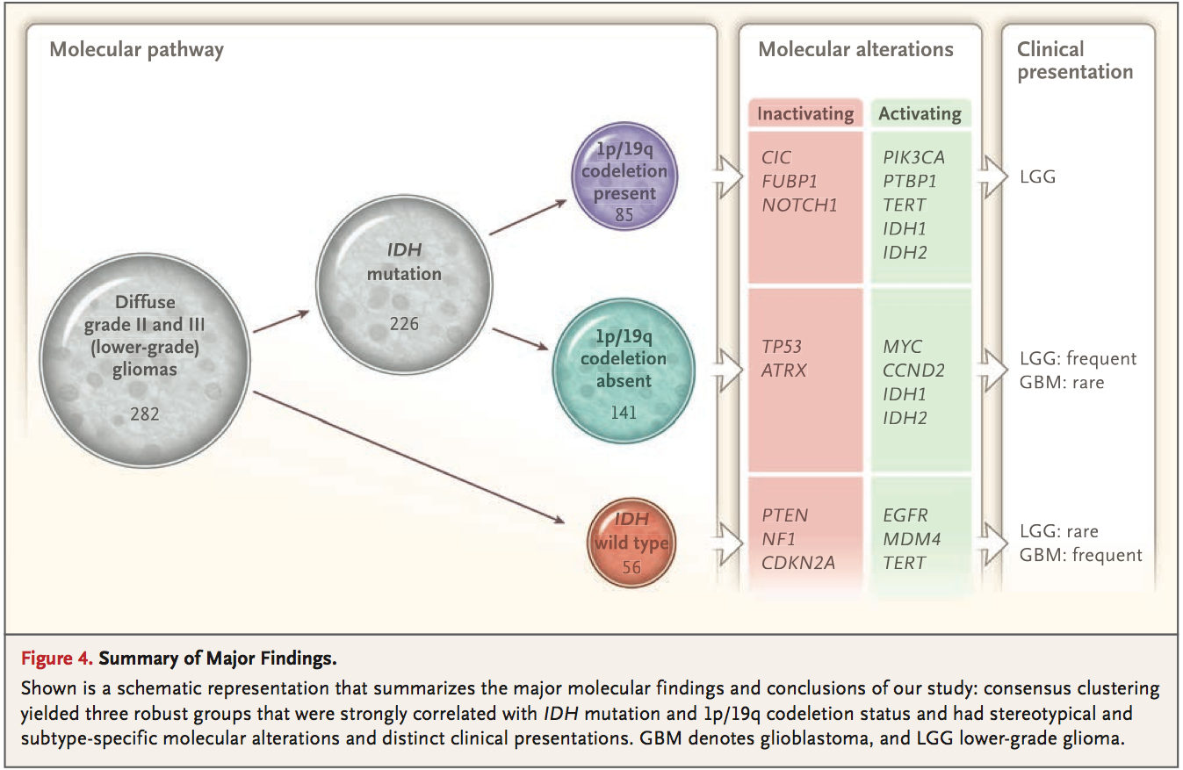
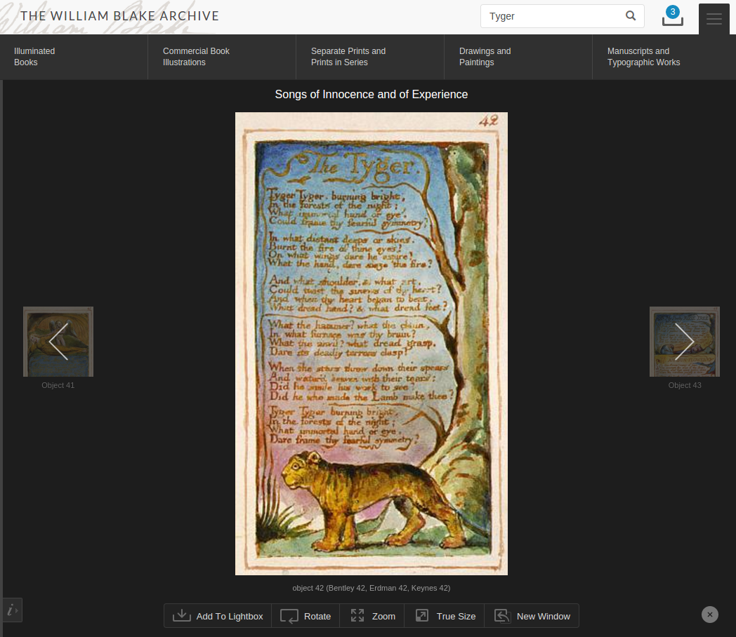
ReCo Projects
Computational Chemistry
Genomics
Digital Humanities

Slide 6
Resources

Slide 7
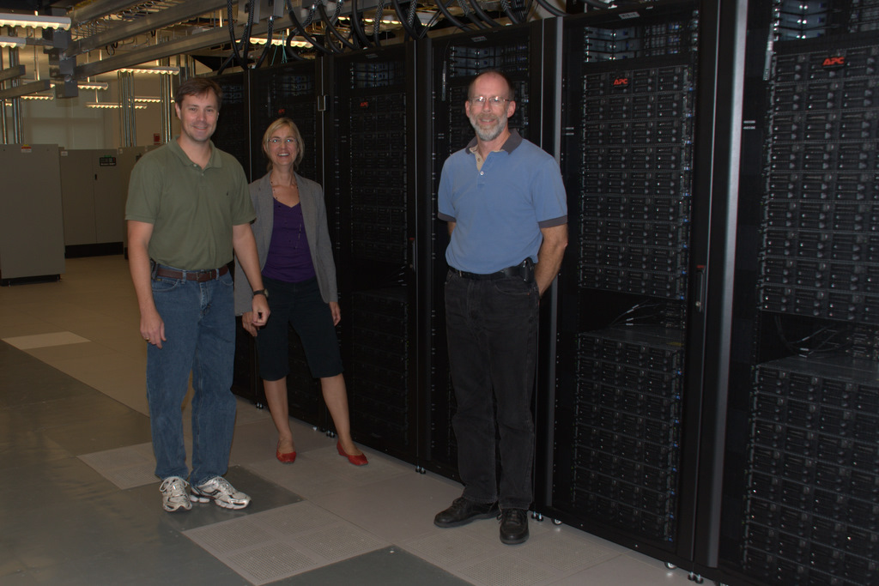
Compute Cluster Advantages
fast interconnect, tightly coupled
aggregated resources
  compute cores
  memory
installed software base
high availability
large (scratch) file spaces
scheduling and job management
data backup

Slide 8
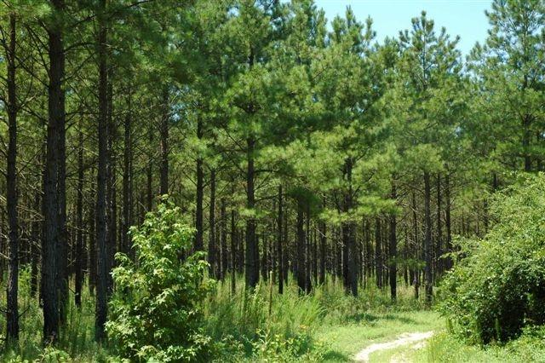
Longleaf
Geared towards HTC
  Focus on large numbers
  of serial and single node
  jobs
  Data Intensive Science
Large Memory
High I/O requirements
What’s in a name?
  The pine tree is the official state tree and 8 species of pine are native to NC including the longleaf pine.

Slide 9
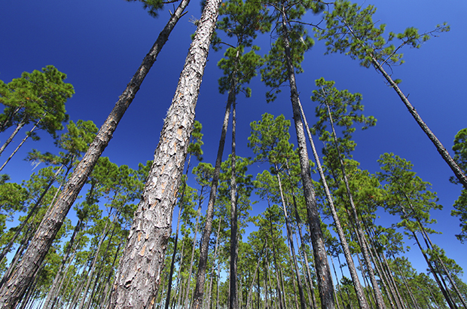
Longleaf Nodes
Four types of nodes:
  General compute nodes
  Big Data, High I/O
  Very large memory nodes
  GPGPU nodes
  …

Slide 10
Longleaf Nodes
190 general purpose nodes
  Xeon E5-2680 2.50 GHz
  Dual Socket, 24 physical cores (48 logical cores)
  256 GB RAM
30 big data nodes
  Xeon E5-2643 3.40GHz
  Dual Socket, 12 physical cores (24 logical cores)
  256 GB RAM
5 extreme memory nodes
  Xeon E7-8867 2.50GHz, 64 physical cores (128 logical cores)
  3 TB RAM

Slide 11
Longleaf Nodes
5 GPU nodes, each node has 8 gpus (Nvidia GeForce GTX 1080)
    Pascal GPU architecture
    2560 CUDA Cores
14 Volta nodes, each has 4 gpus
  Volta GPU architecture (Pascal successor)
  5120 CUDA Cores
  Now with 8 Tensor Cores (for DL/ML)
Everyone by default can access the general purpose nodes, but access to the bigdata, bigmem, and gpu nodes needs to be requested (send an email to research@unc.edu).

Slide 12
Longleaf Storage
Your home directory: /nas/longleaf/home/<onyen>
  Quota: 50 GB soft, 75 GB hard
Your /scratch space: /pine/scr/<o>/<n>/<onyen>
  Quota: 30 TB soft, 40 TB hard
  36-day file deletion policy
Pine is a high-performance and high-throughput parallel filesystem (GPFS; a.k.a., “IBM SpectrumScale”).
The Longleaf compute nodes include local SSD disks for a GPFS Local Read-Only Cache (“LRoC”) that optimizes the most frequent metadata data/file requests to the node itself, thus eliminating traversals of the network fabric and disk subsystem.

Slide 13
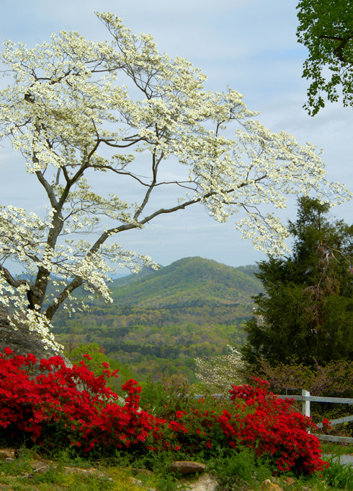
Dogwood - HPC Cluster
High Performance Computing
  Large parallel jobs,
  high bandwidth/low latency fabric
183 Nodes originally
  50 Skylake nodes added
512 GB Memory
Intel E5-2699Av4 chips
  Dual socket, 22 cores/socket
  2.4 GHz
Infiniband EDR fabric
Dedicated scratch file system

Slide 14

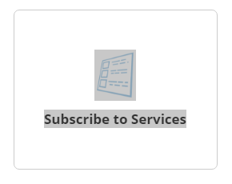
Getting an account:
For Longleaf and Dogwood
http://onyen.unc.edu
Subscribe to Services
For now, email research@unc.edu
Coming soon (next week?) a new solution from Service Now

Slide 15



Exploring Cloud Computing
Investigating suitability of cloud computing for special projects

Slide 16




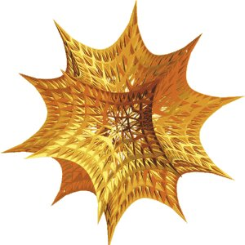

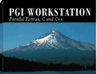




Resources: Available Software

Slide 17
Licensed Software
over 20 licensed software applications (some are site or volume licensed, others restricted)
  SAS, Matlab, Maple, Mathematica, Gaussian, Accelrys Materials Studio and Discovery Studio modules, Sybyl, Schrodinger, Stata, Esri ArcGIS, IMSL, Totalview, Envi/IDL, JMP, and JMP Genomics, COMSOL
compilers (licensed and otherwise)
  intel, PGI, gnu, CUDA compiler

Slide 18
Large Installed Software Base
Numerous other packages provided for research and technical computing
  including BLAST, PyMol, SOAP, PLINK, NWChem, R, Cambridge Structural Database, Amber, Gromacs, Petsc, Scalapack, Netcdf, Babel, Qt, Ferret, Gnuplot, Grace, iRODS, XCrySDen, galaxy, gamess and many more.
Over 300 distinct packages installed on Longleaf

Slide 19

Mass Storage
long term archival storage
easy to access and use
“limitless” capacity
  2 TB free
looks like ordinary disk file system – data is actually stored on tape
data is backed up
“To infinity … and beyond” - Buzz Lightyear

Slide 20
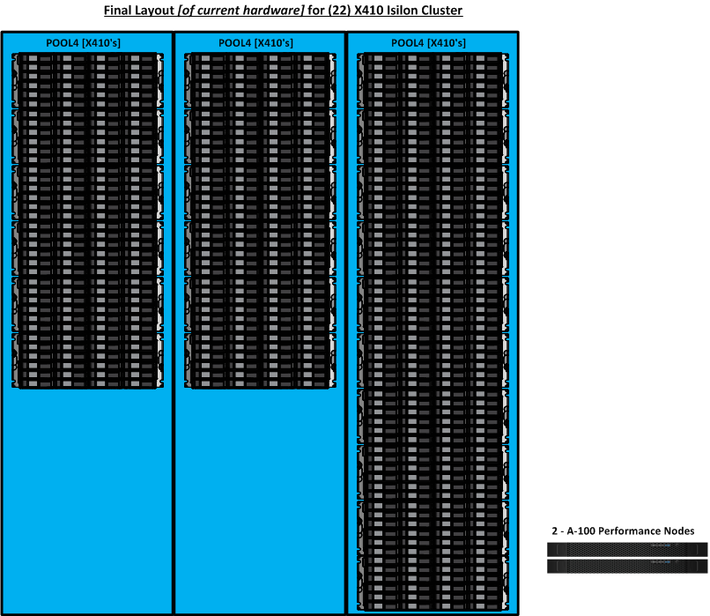
(Big) Data Storage
Near Line Isilon Storage
5.1 Petabytes of storage
  Largest data store in UNC system
  Mostly dedicated to genomics/life sciences
Updated in 2016
  Same capacity initially
  6X increase in bandwidth
  5-21X increase in memory on
  data nodes

Slide 21
CIFS Shares
RC is bringing online CIFS (Windows) data storage to present to the campus.
Intended to support research projects that are fairly broad in scope and require resources beyond the normal extent of department or organizational abilities
Administrative support would be provided by the department or organization

Slide 22
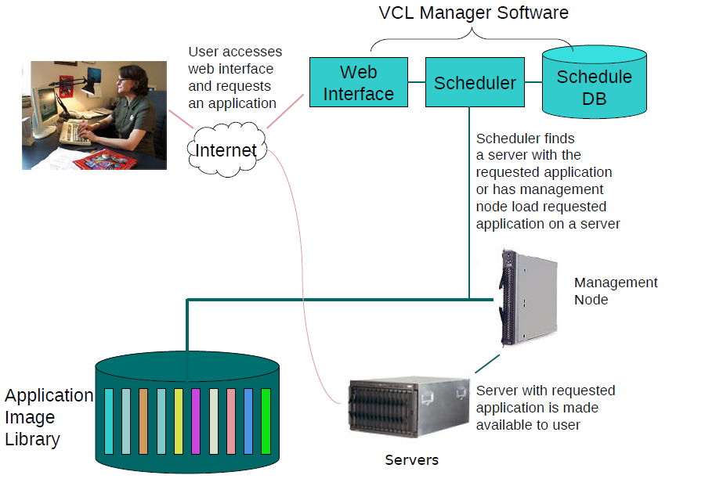
Virtual Computing Lab (VCL)
  Collaboration with NC State to establish VCL infrastructure for UNC.
  VCL provides on-demand access to high-end computing resources, via highly customized, virtual Windows and Linux machines.

Slide 23

Virtual Computing Lab (VCL)
Users can log on from anywhere at any time to make a reservation to use a machine
Lots of software available!
  ArcGIS
  SAS
  MATLAB
  Adobe
  MS Office
  LaTEX
  SigmaPlot
  MUCH MORE!
Go to http://vcl.unc.edu to sign on
For help, see
“Getting Started on VCL” webpage http://help.unc.edu/CCM3_007680

Slide 24



Access to National Resources
XSEDE – NSF funded leadership class infrastructure at 11 partner sites.
Open Science Grid – national shared computing and storage resources in a common grid infrastructure

Slide 25



XSEDE
Led by the University of Illinois' National Center for Supercomputing Applications (NCSA) along with 19 partner institutions
HPC, HTC, Visualization, Data Intensive computing, Clouds
New Services:
  Comet
  Bridges
  Jetstream

Slide 26
Services

Slide 27
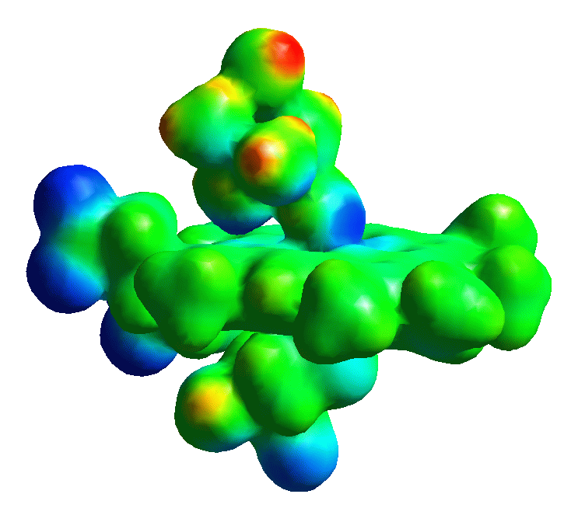
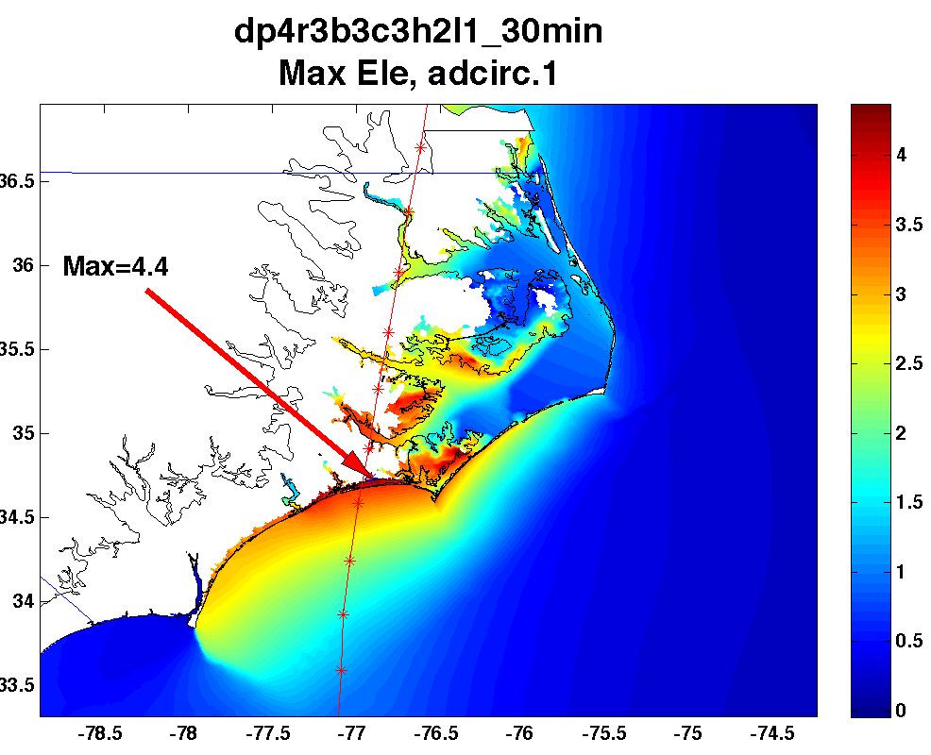
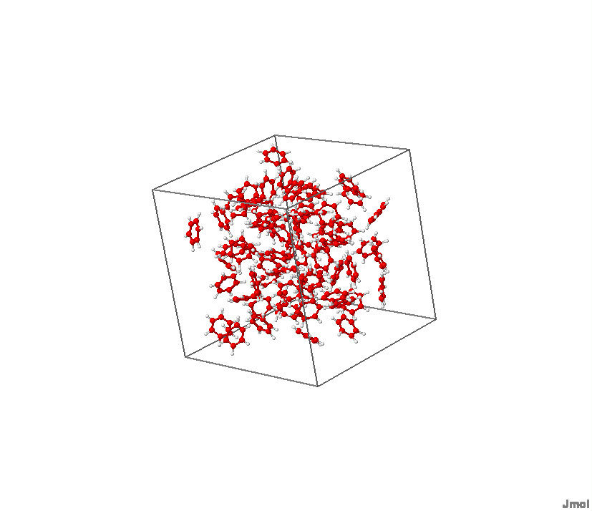
Engagement, Support and Collaboration
Research scientists with experience in computational chemistry, physics, grid computing, environmental modeling, mathematics, parallel computing, statistics and the life sciences are available for consultation and collaboration.
Programming and development support for projects with well defined scope

Slide 28
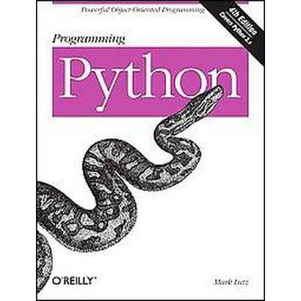
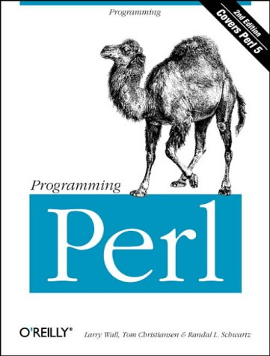
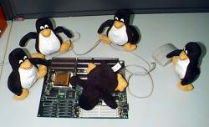
Services: Training
Courses are offered in the following areas:
  Introductions to HPC resources
  Research Applications
  Linux
  General Computing
  Parallel Programming
Courses are taught throughout year by Research Computing, for listings and details, go to:
  http://learnit.unc.edu/workshops
  http://help.unc.edu/CCM3_008194

Slide 29
Services: Technical Support
Technical support in using RC resources is available
  Support in compiling, porting, using tools, submitting jobs, using software packages, storage and data management, …
email research@unc.edu
personal consultation
online web forms
962-HELP (962-4357) (this is general ITS support)

Slide 30
Secure Research Workspace (SRW)
The Problem:
  Enabling access to protected data/information (whether by statute, data-use agreement, or other, e.g. PHI, HIPAA)
  Preventing data/information from being transferred to external systems
  Facilitating desktop-class analyses on those data

Slide 31
SRW - cont
The Solution:
  Build virtual desktop environment
  Dedicated, and isolated, file/data storage
  Tight Controls:
    User authentication and authorization, 2 factor ID with Duo
    Network Segmentation
    Incoming/Outgoing firewall rules
    Operating System patching
    Software installed and applications
  Splunk monitoring to audit and track users and data
  Maximize usability

Slide 32
Secure Research Workspace (SRW)

Slide 33
Desktop Computing –TarHeel Linux
Linux Image Pull
Desktop/Laptop Campus Machines
Build desktop machines tailored for the RC environment with additional customization by user.
Based on CentOS
Security Approved Build
  nightly updates
Onyen
OpenAFS
Customized Applications
Firewall
http://tarheellinux.unc.edu
Kickstart Server for Linux Distribution in ITS Manning Machine Room

Slide 34






Services: Research Database Support
Full time DB admin to support UNC research databases
over 20 UNC Research Databases for research production, training and development
  clients include School of Pharmacy, Lineberger Comprehensive Cancer Center (LCCC), Computer Science, SILS, Renci, Bioinformatics, Institute for the Environment, …

Slide 35

Services: Secure Data Exchange
Capability to share secure and sensitive data using a secure “drop box” mechanism for anonymous or non-Onyen users or full FTP access for trusted Onyen accounts
Computing - challenges of flexibility needed for research and realities of cyber attacks
Networking – maximizing bandwidth for research endeavors vs. IPS/IDS inspection
Data – compliance requirements, data sharing, privacy, etc.

Slide 36

Globus
Globus– good for transferring large files or large numbers of files. A client is available for Linux, Mac, and Windows.
  http://help.unc.edu/?s=globus
  https://help.unc.edu/help/getting-started-with-globus-connect/
  https://www.globus.org

Slide 37
Projects

Slide 38
Force Field Parameterization of Condensed Phase
Using Amoeba Force Field with Polarization
Reproducing physical properties, such as density, heat of vaporization
Computing radial and spatial distribution functions
Computing Pair Correlation Function
Samulski, E. T., Poon, C.-D., Heist, L. M. & Photinos, D. J. Liquid-State Structure via Very High-Field Nuclear Magnetic Resonance Discriminates among Force Fields. J. Phys. Chem. Lett. 3626–3631 (2015).
Heist, L. M., Poon, C.-D., Samulski, E. T., Photinos, D. J., Kokisaari, J., Vaara, J., Emsley, J. W., Mamone, S. & Lelli, M. Benzene at 1GHz. Magnetic field-induced fine structure. J. Magn. Reson. 258, 17–24 (2015).
MD simulation of Benzene

Slide 39
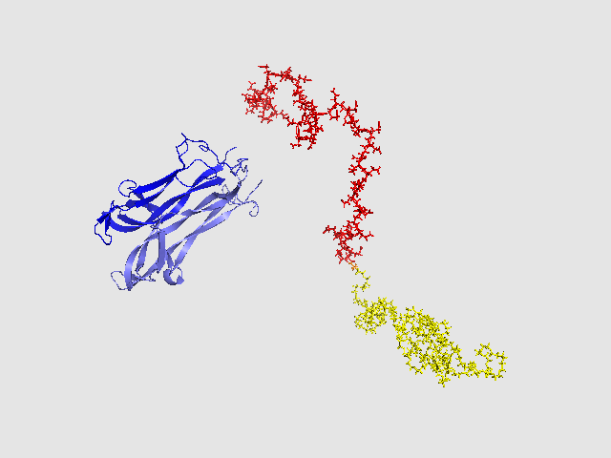
Molecular Dynamics of Protein–Polymer Interaction
100ns
Modeling drug delivery with School of Pharmacy
Using OPLSAA Force Field in Gromacs
Protein-Polymer bonded or non-bonded
Yi, X., Yuan, D., Farr, S. A., Banks, W. A., Poon, C.-D. & Kabanov, A. V. Pluronic modified leptin with increased systemic circulation, brain uptake and efficacy for treatment of obesity. J. Control. Release 191, 34–46 (2014).

Slide 40
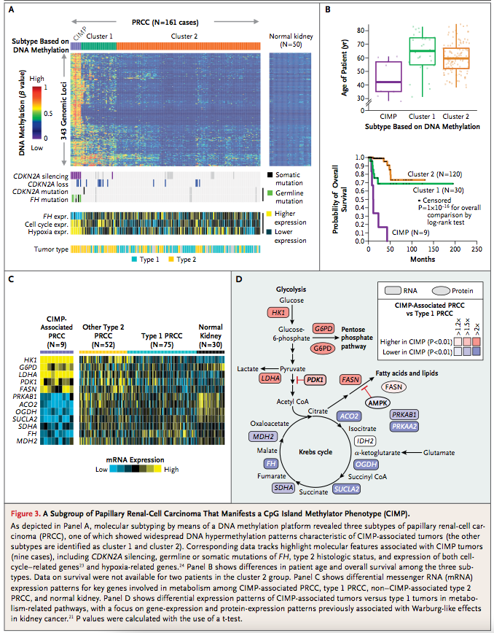
Next Generation Sequencing Bioinformatics Support
Isilon file storage for over 130 labs on campus
Applications and pipelines:
  RNASeq, DNASeq, ChIP, FAIRE, ATAK
  MiRNASeq
  16S rRNA Microbiome
Source: The Cancer Genome Atlas Research Network. Comprehensive Molecular
Characterization of Papillary Renal-Cell Carcinoma. New England J. Medicine. Nov 2015.

Slide 41
Next Generation Sequencing Bioinformatics Support
Full integration with UNC High Throughput Sequencing Facility
Bioinformatics Support of Microbiome Core Facility
Source: The Cancer Genome Atlas Research Network.
Comprehensive, Integrative Genomic Analysis of Diffuse Lower-Grade
Gliomas. New England J. Medicine. Jun 2015.
Additional consulting support: Genetics, Epidemiology, Marine Sciences, Biostatistics ...

Slide 42
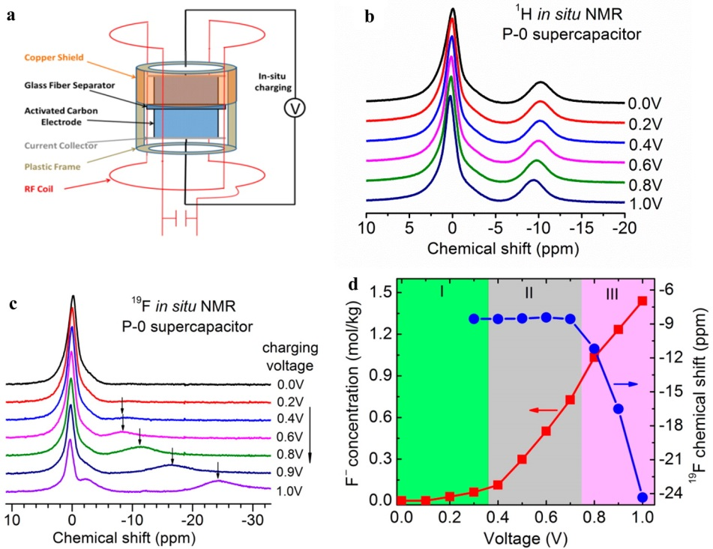
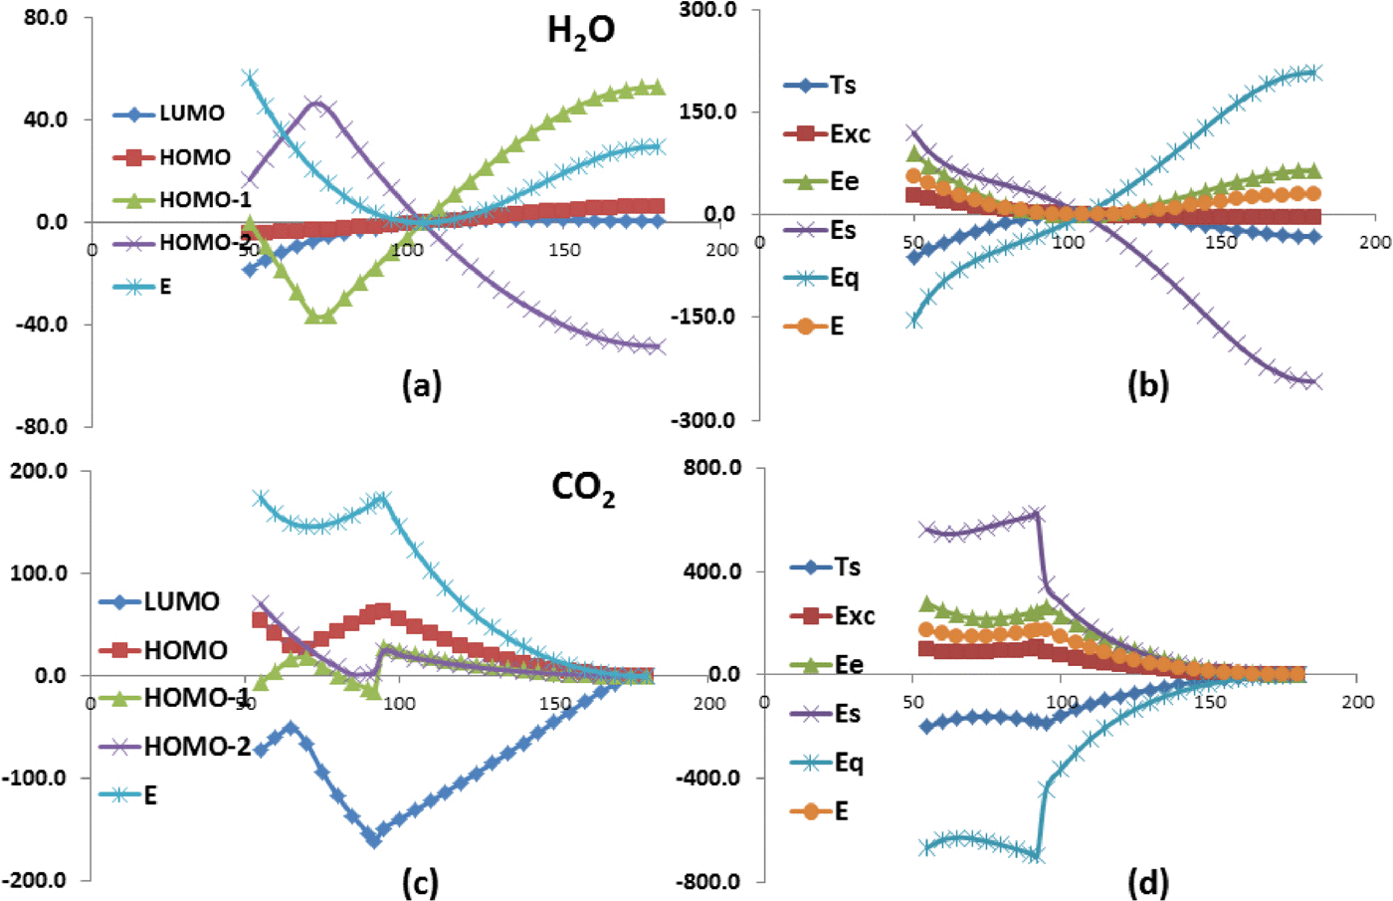
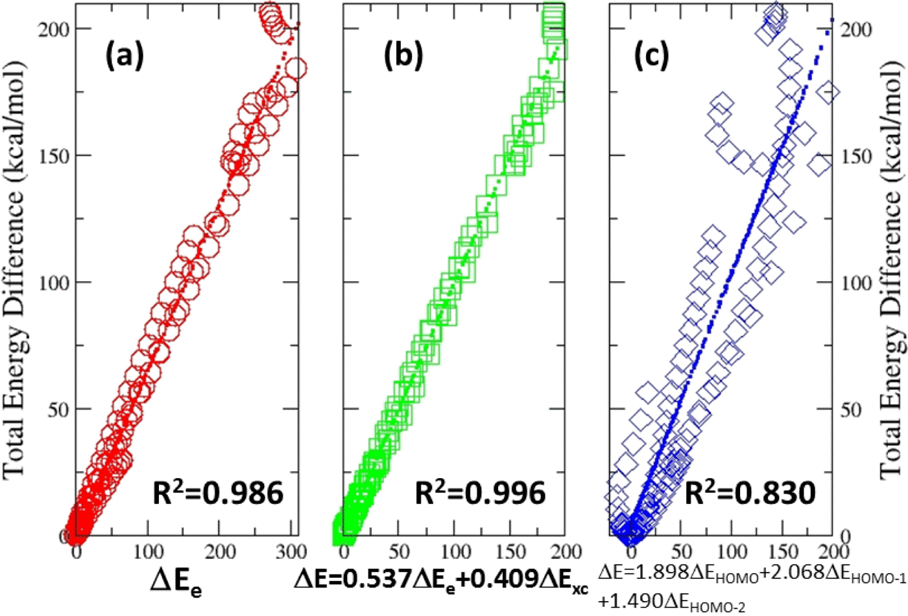
Dehydration of ions in voltage-gated carbon nanopores observed by in situ NMR,
With Yue Wu, UNC-CH physics, J. Phys. Chem. Lett. 6(24), 5022 - 5026 (2015).
Origin of molecular conformational stability,
With Cindy K. UNC-CH Schauer, chemistry, J. Chem. Phys. 142, 054107 (2015)

Slide 43
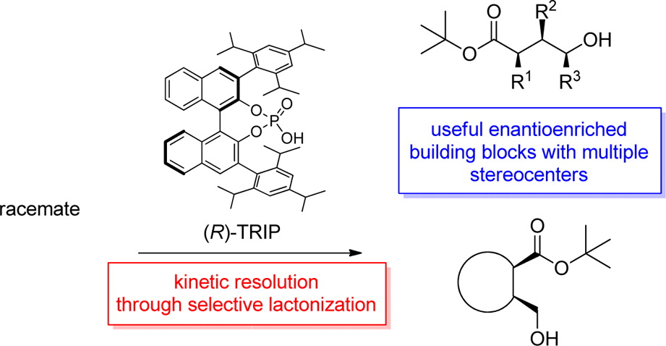
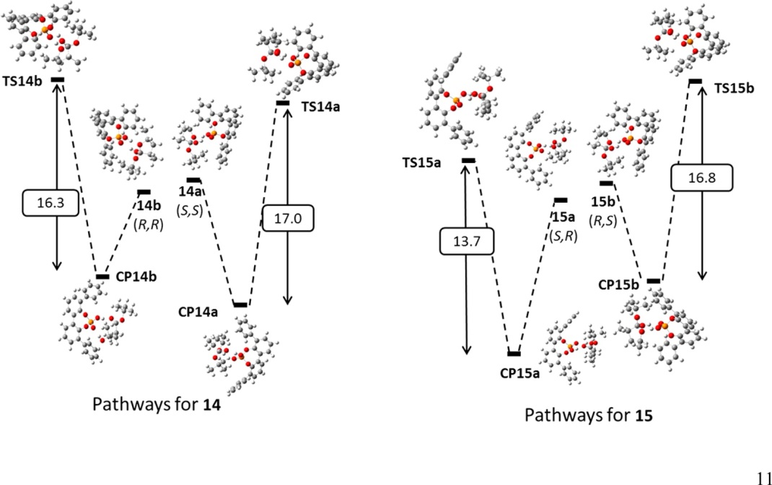
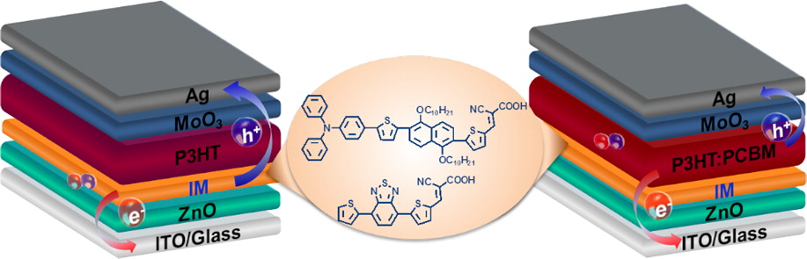
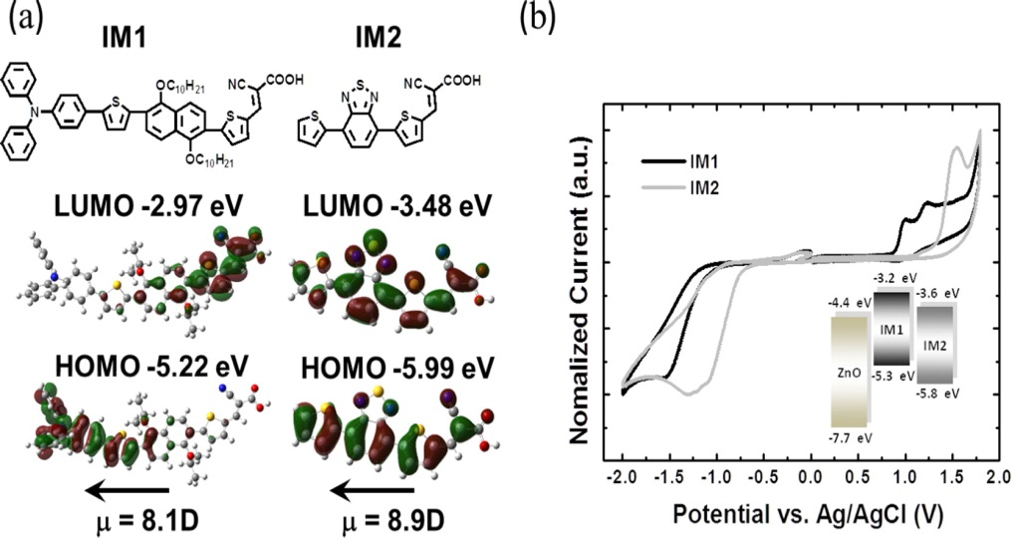
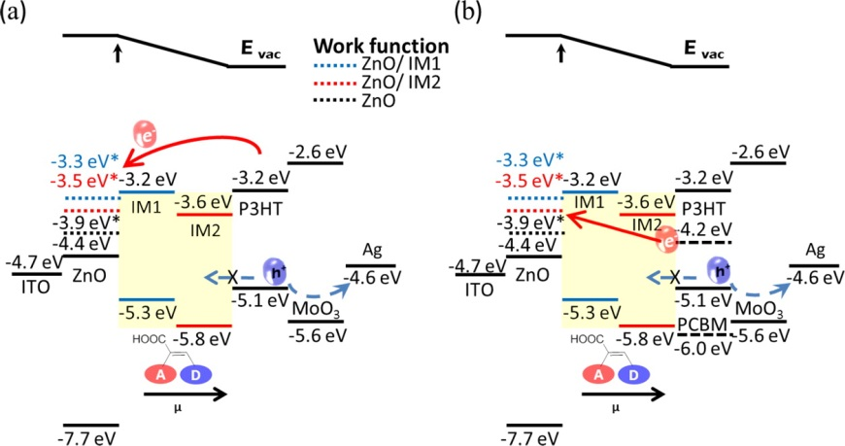
Asymmetric Synthesis of Hydroxy Esters with Multiple Stereocenters via a Chiral Phosphoric Acid Catalyzed Kinetic Resolution, with Kimberly S. Petersen, UNC chemistry, J. Org. Chem., 2015, 80 (1), pp 133–140.
Roles of Interfacial Modifiers in Hybrid Solar Cells: Inorganic/Polymer Bilayer vs Inorganic/Polymer:Fullerene Bulk Heterojunction, with Wei You, UNC chemistry, ACS Appl. Mater. Interfaces, 2014, 6 (2), pp 803–810

Slide 44
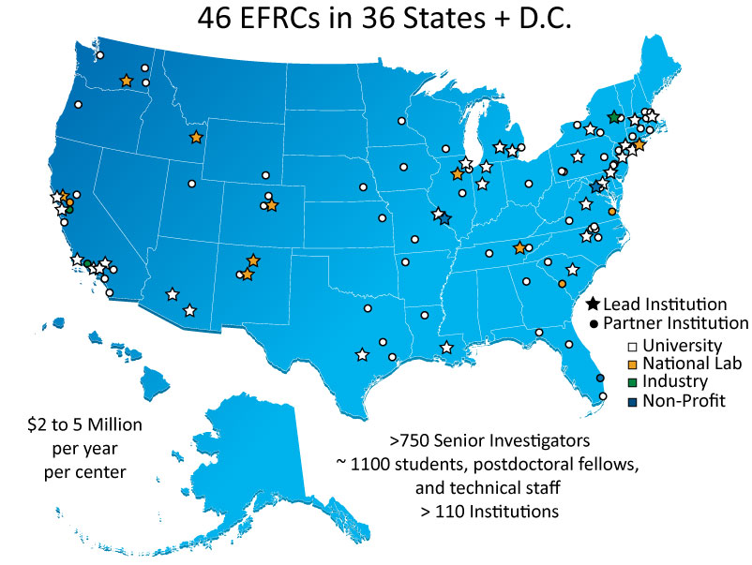

Energy Frontier Research Centers
http://www.er.doe.gov/bes/EFRC/index.html

Slide 45
Chemical Approaches to Artificial Photosynthesis. Modular Approach
Light absorption, sensitization
Electron transfer quenching
Vectorial electron/proton transfer, redox splitting
Catalysis of water oxidation and reduction
Photosystem II
Meyer, Accounts of Chemical Research 1989, 22, 163.
Meyer, et. al. Inorg. Chem. 2005, 6802; Acc. Chem Res 1989, 163.

Slide 46

High Throughput Deep Sequencing Infrastructure
Data Collection Infrastructure
Isilon
1.7 PB
Aggregation Server
Compute Nodes
MaPSeq meta scheduler running multiple pipelines
Pipeline
Manager
Processing Pipeline

Slide 47

TCGA was a 5 year project to catalog genetic mutations responsible for cancer. UNC is one of twelve national centers
Processed over 10,000 tumor samples in support of TCGA
At the high point the Bioinformatics pipeline processed over 700 sequencing runs in a week
Information has all been uploaded several national data repositories.
Project successfully completed in 2015

Slide 48
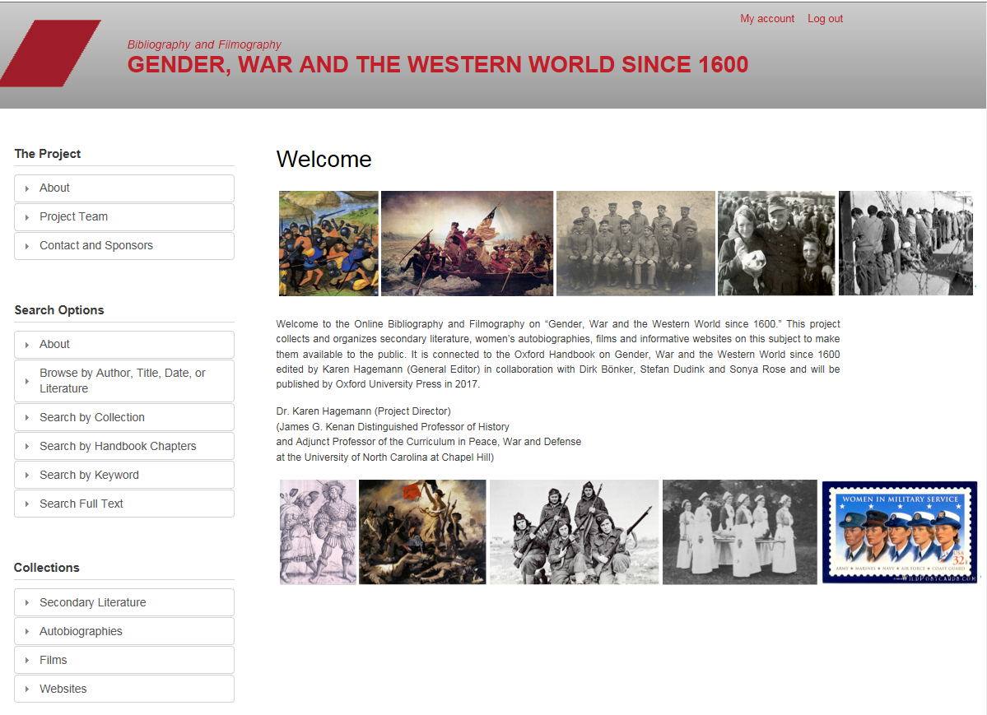
Gender, War and the Western World since 1600
Prof. Karen Hagemann,
UNC-CH, History
Prof. Stefan Dudink,
Radboud Univ., Netherlands, Gender Studies
The online companion to The Oxford Handbook on Gender, War and the Western World since 1600.

Slide 49
William Blake Archive
DH project sustained since 1996.
Provides high resolution digital reproductions of the various works of Blake, alongside annotation, commentary and related scholarly materials.
Has specialized search, compare and virtual light box features.
This is a major re-working and updating of the web site.
Editors:
Morris Eaves
U. of Rochester
Robert Essick
U. of California, Riverside
Joseph Viscomi
UNC at Chapel Hill

Slide 50
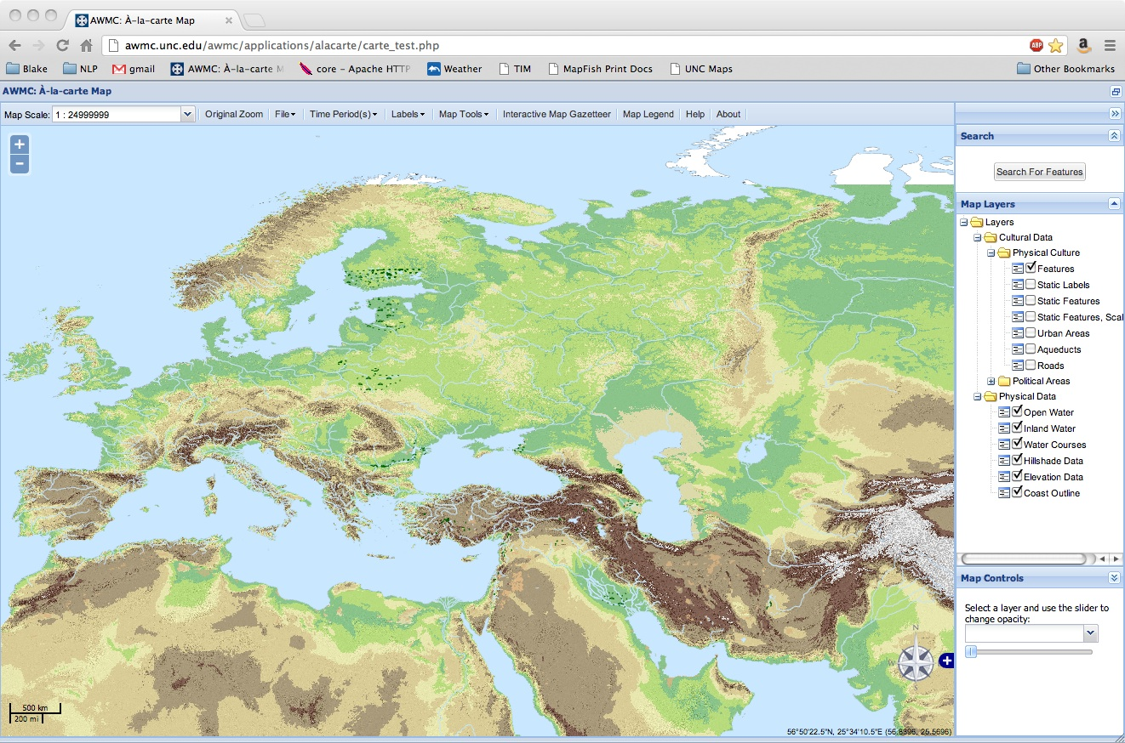
Ancient World Mapping Application

Slide 51
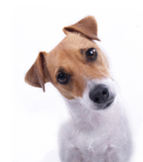
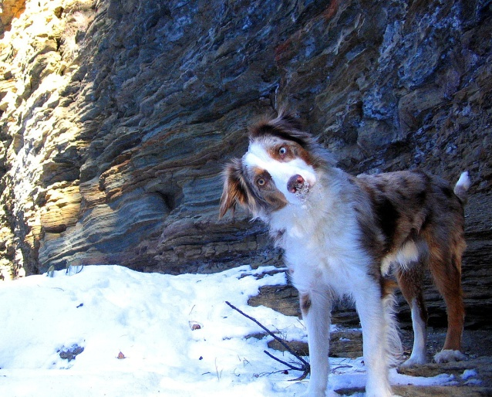

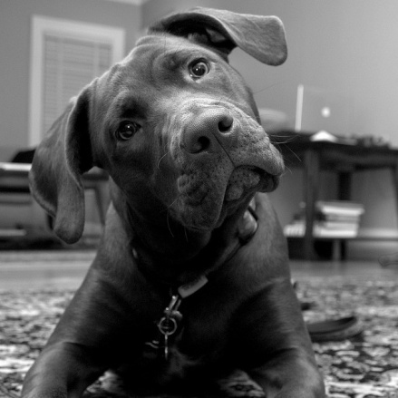
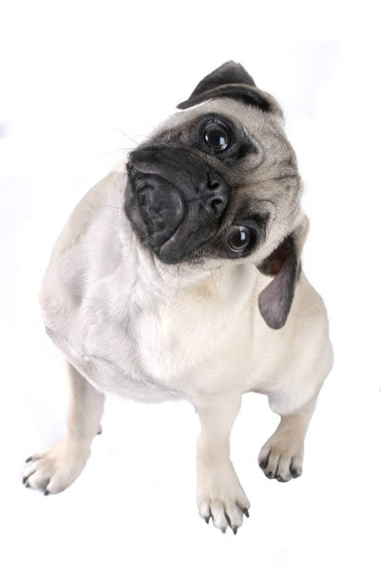
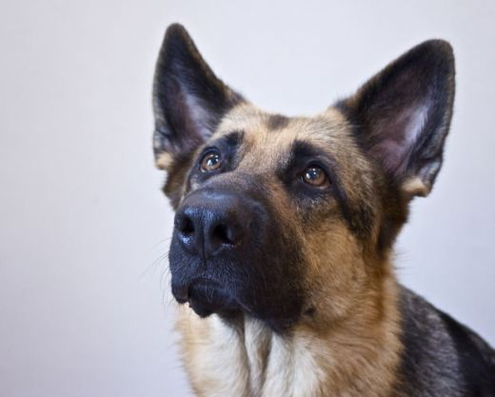
Questions and Comments?
For assistance with any of our services, please contact Research Computing
  Email: research@unc.edu
  Phone: 919-962-HELP
  Submit help ticket at http://help.unc.edu

