Slide 1

Parallel & GPU computing in MATLAB
ITS Research Computing
Mark Reed
markreed@unc.edu

Slide 2

Objectives
Introductory level MATLAB course for people who want to learn parallel or GPU computing in MATLAB.
Help participants determine when to use parallel computing and how to use MATLAB parallel & GPU computing on their local computer & on the Research Computing clusters

Slide 3
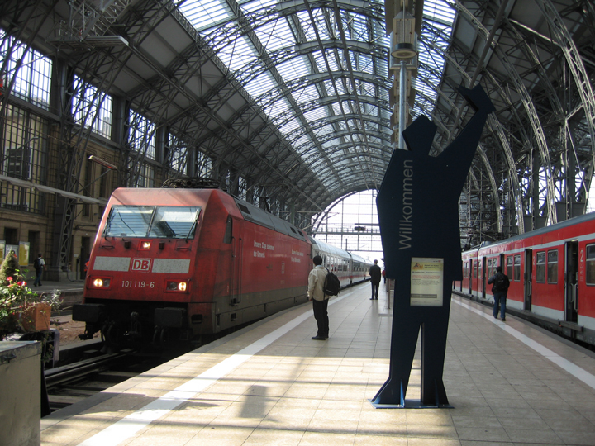
Logistics
Course Format
Overview of MATLAB topics
UNC Research Computing
  http://its.unc.edu/research

Slide 4

Agenda
Parallel computing
  What is it?
  Why use it?
  How to write MATLAB code in parallel
GPU computing
  What is it & why use it?
  How to write MATLAB code in for GPU computing
How to run MATLAB parallel & GPU code on the UNC cluster
  Quick introduction to the UNC clusters (Dogwood, Longleaf)
  sbatch commands and what they mean
Questions

Slide 5
Parallel Computing

Slide 6
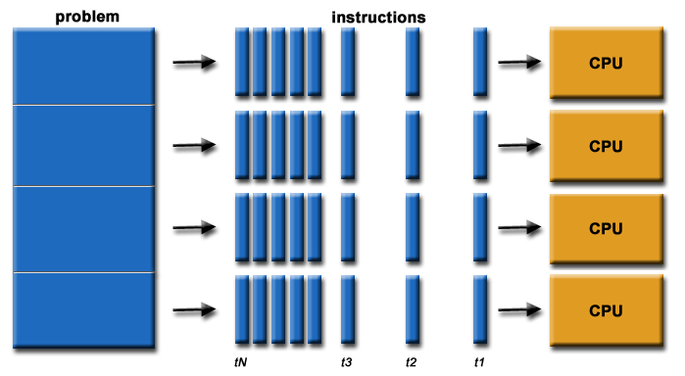
What is Parallel Computing?
Parallel Computing: Using multiple computer processing units (CPUs) to solve a problem at the same time
The compute resources might be: computer with multiple processors or networked computers
Source: https://computing.llnl.gov/tutorials/parallel_comp/
Notes:
In the simplest sense, parallel computing is the simultaneous use of multiple compute resources to solve a computational problem:
To be run using multiple CPUs
A problem is broken into discrete parts that can be solved concurrently
Each part is further broken down to a series of instructions
Instructions from each part execute simultaneously on different CPUs

Slide 7
Parallel Code
Why?
  Faster time to solution
  Solve bigger problems
The computational problem should be able to:
  Be broken into discrete parts that can be solved simultaneously and independently
  Be solved in less time with multiple compute resources than with a single compute resource.

Slide 11
Parallel Computing in MATLAB

Slide 12
3 Levels of Parallel Computing
Built-in multithreading
  shared memory, single node
Parallel Computing Toolbox (PCT)
  shared memory, single node
  parfor
Matlab Distributed Computing Server (MDCS)
  distributed computing across nodes
  spmd or parfor

Slide 13
Built-in Multithreading
Operations in the algorithm carried out by the function are easily partitioned into sections that can be executed concurrently, and with little communication or few sequential operations required.
Data size is large enough so that any advantages of concurrent execution outweigh the time required to partition the data and manage separate execution threads. For example, most functions speed up only when the array is greater than several thousand elements.
Operation is not memory-bound where the processing time is dominated by memory access time. As a general rule, more complex functions speed up better than simple functions.
http://www.mathworks.com/matlabcentral/answers/95958-which-matlab-functions-benefit-from-multithreaded-computation

Slide 14
Built-in Multithreading
Easiest to use but least effective.
Interferes with other users jobs when run in a shared environment unless you know what you are doing
-singleCompThread option disables
Use the function maxNumCompThreads to set the number of threads (default is all of them)
Make sure to submit using –n option to match maxNumCompThreads and set “–N 1”

Slide 15
Multithreading solving linear system of equations: y=A*b
Sample scaling, run on Matlab 2013a
size=10000, time=0.071195, threads=1, speedup=1.000000, efficiency=100.000000 %
size=10000, time=0.034743, threads=2, speedup=2.049190, efficiency=102.459488 %
size=10000, time=0.023221, threads=4, speedup=3.065975, efficiency=76.649369 %
size=10000, time=0.024257, threads=8, speedup=2.935029, efficiency=36.687863 %
size=10000, time=0.023156, threads=12, speedup=3.074581, efficiency=25.621509 %
size=40000, time=1.133684, threads=1, speedup=1.000000, efficiency=100.000000 %
size=40000, time=0.609896, threads=2, speedup=1.858815, efficiency=92.940764 %
size=40000, time=0.384364, threads=4, speedup=2.949506, efficiency=73.737655 %
size=40000, time=0.354435, threads=8, speedup=3.198567, efficiency=39.982084 %
size=40000, time=0.341615, threads=12, speedup=3.318601, efficiency=27.655011 %
size=50000, time=1.779888, threads=1, speedup=1.000000, efficiency=100.000000 %
size=50000, time=0.964425, threads=2, speedup=1.845543, efficiency=92.277160 %
size=50000, time=0.616930, threads=4, speedup=2.885073, efficiency=72.126822 %
size=50000, time=0.543360, threads=8, speedup=3.275707, efficiency=40.946334 %
size=50000, time=0.532957, threads=12, speedup=3.339647, efficiency=27.830388 %

Slide 16
Matrix Multiply code from implicit multi-threading example
% create a list of thread counts and sizes, then loop over sizes
nthreads = { 1, 2, 4, 8, 12 };
sizes = [1000 2000 4000];
for s=1:3
n = sizes(s); % set matrix size
A = rand(n); % create random matrix
B = rand(n); % create another random matrix
for i=1:5 % vector implementation (may trigger multithreading)
nt=nthreads{i};
lastnt=maxNumCompThreads(nt); % set the thread count
tic % starts timer
C = A * B; % matrix multiplication
walltime(i) = toc; % wall clock time
Speedup = walltime(1)/walltime(i);
Efficiency = 100*Speedup/nt;
printstring=sprintf (['size=%d time=%8.4f threads=%2d speedup=%4.1f
efficiency=%5.1f %%'], n, walltime(i), nt, Speedup, Efficiency);
disp(printstring);
end
disp(' ');
end % end for size j

Slide 17
Multithreading matrix multiply: C=A*B
size=1000 time= 0.1893 threads= 1 speedup= 1.0 efficiency=100.0 %
size=1000 time= 0.0946 threads= 2 speedup= 2.0 efficiency=100.0 %
size=1000 time= 0.0494 threads= 4 speedup= 3.8 efficiency= 95.8 %
size=1000 time= 0.0261 threads= 8 speedup= 7.3 efficiency= 90.8 %
size=1000 time= 0.0235 threads=12 speedup= 8.1 efficiency= 67.2 %
size=2000 time= 1.4376 threads= 1 speedup= 1.0 efficiency=100.0 %
size=2000 time= 0.7297 threads= 2 speedup= 2.0 efficiency= 98.5 %
size=2000 time= 0.3731 threads= 4 speedup= 3.9 efficiency= 96.3 %
size=2000 time= 0.1946 threads= 8 speedup= 7.4 efficiency= 92.3 %
size=2000 time= 0.1349 threads=12 speedup=10.7 efficiency= 88.8 %
size=4000 time= 11.4206 threads= 1 speedup= 1.0 efficiency=100.0 %
size=4000 time= 5.7619 threads= 2 speedup= 2.0 efficiency= 99.1 %
size=4000 time= 2.9057 threads= 4 speedup= 3.9 efficiency= 98.3 %
size=4000 time= 1.4557 threads= 8 speedup= 7.8 efficiency= 98.1 %
size=4000 time= 1.0311 threads=12 speedup=11.1 efficiency= 92.3 %
YMMV. Some work better than others!

Slide 18
Parallel Computing in MATLAB
MATLAB Parallel Computing Toolbox (available for use at UNC)
  Workers limited only by resources on the node, see parallel preferences for the default. Typically the entire node.
  Built in functions for parallel computing
    parfor loop (for running task-parallel algorithms on multiple processors)
    spmd (handles large datasets and data-parallel algorithms)

Slide 19
Matlab Distributed Computing Toolbox
Allows MATLAB to run as many workers on a remote cluster of computers as licensing allows.
  ReCo has 256 licenses
  A single user can check out up to 64 (this will be changed for Dogwood)
Note the key word “distributed” meaning it will run between nodes

Slide 20
Primary Parallel Commands
parpool (prior to Matlab 2013b this was matlabpool)
  mypool = parpool(4)
  … do work …
  delete(mypool)
parfor (for loop)
spmd (distributed computing for datasets)

Slide 21
parpool
Use parpool to open a pool of “workers” to execute code on other compute cores.
In Matlab parlance these are called workers, think of them like threads or processes
You can open these workers locally (on the same node) or remotely
Local access is enabled by the Parallel Computing Toolkit, remote access is enabled via MDCS (Matlab Distributed Computing Server)

Slide 22
Starting a parpool
mypool = parpool (‘local’,4);
mypool = parpool(4);
  Opens 4 workers locally on the same node
  Communication is fastest within a node
  Make sure you submitted your Matlab job with “-n X” where X matches the number of workers you open!!!
  And use –N 1 to ensure the slots are all on the same node (i.e. local)
Use display(mypool) to show information about the pool

Slide 23
Closing a parallel pool
Use delete(mypool) to end parallel session
If you didn’t save the name you can use
  delete (gcp(‘nocreate’));

Slide 24
Parallel for Loops (parfor)
parfor loops can execute for loop like code in parallel to significantly improve performance
Must consist of code broken into discrete parts that can be solved simultaneously, each iteration is independent (task independent)
No guaranteed order of iterations
  i.e. order independent
Scalar values defined outside of the loop but used inside of it are broadcast to all workers

Slide 25
Parfor example
  Will work in parallel, loop increments are not dependent on each other:
  mypool =parpool(2)
  j=zeros(100,1); %pre-allocate vector
  parfor i=1:100;
  j(i,1)=5*i;
  end;
  delete (mypool);
Makes the loop run in parallel

Slide 26
Serial Loop example
Won’t work in parallel- it’s serial:
  j=zeros(100,1); %pre-allocate vector
  j(1)=5;
  for i=2:100;
  j(i,1)=j(i-1)+5;
  end;
j(i-1) needed to calculate j(i,1) → serial!!!

Slide 27
Classifying Variables in parfor Loop
A parfor-loop variable is classified into one of several categories. A parfor-loop generates an error if it contains any variables that cannot be uniquely categorized or if any variables violate their category restrictions.

Slide 28
Parfor Loop Variables
Loop Variables
  Loop index
Sliced Variables
  Arrays whose segments are operated on by different iterations of the loop
Broadcast Variables
  Variables defined before the loop whose value is required inside the loop, but never assigned inside the loop.
  Consider whether it is faster to create them on workers
Reduction Variables
  Variables that accumulate a value across iterations of the loop, regardless of iteration order
Temporary Variables
  Variables that accumulate a value across iterations of the loop, regardless of iteration order

Slide 29
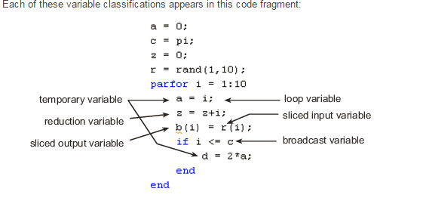
Parfor Variable Types - Example
https://www.mathworks.com/help/distcomp/classification-of-variables-in-parfor-loops.html

Slide 30
Constraints
The loop variable cannot be used to index with other variables
No inter-process communication. Therefore, a parfor loop cannot contain:
  break and return statements
  global and persistent variables
  nested functions
  changes to handle classes
Transparency
  Cannot “introduce” variables (e.g. eval, load, global, etc.)
  Unambiguous Variables Names
No nested parfor loops or spmd statement
Slide from Raymond Norris, Mathworks

Slide 31
Parallel for Loops (parfor)
There is overhead in creating workers and partitioning work to them, and collecting work from them
Loops need to be computationally intensive to offset this overhead

Slide 32
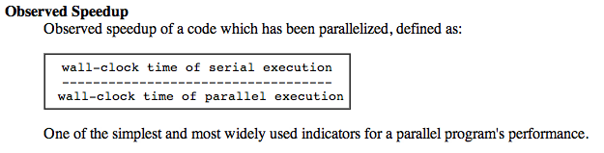
Test the efficiency of your parallel code
Use MATLAB’s tic & toc functions
  Tic starts a timer
  Toc tells you the number of seconds since the tic function was called

Slide 33
Tic & Toc
Simple Example
tic;
parfor i=1:10
z(i)=10;
end;
toc

Slide 34
rand in parfor loops
MATLAB has a repeatable sequence of random numbers
When workers are started up, rather than using this same sequence of random numbers, the labindex is used to seed the RNG

Slide 35
spmd
Single Program Multiple Data model
Used to create parallel regions of code
Values returning from the body of an spmd statement are converted to Composite objects
A Composite object contains references to the values stored on the remote MATLAB workers, and those values can be retrieved using cell-array indexing.
The actual data on the workers remains available on the workers for subsequent spmd execution, so long as the Composite exists on the client and the parallel pool remains open.

Slide 36
spmd
spmd distributes the array among MATLAB workers (each worker contains a part of the array) but can still operate on entire array as 1 entity
Inside the body of the spmd statement, each MATLAB worker has a unique value of labindex, while numlabs denotes the total number of workers executing the block in parallel.
Data automatically transferred between workers when necessary
Within the body of the spmd statement, communication functions for communicating jobs (such as labSend and labReceive) can transfer data between the workers.

Slide 37
Spmd Format
Format
parpool (4)
spmd
statements
end
Simple Example
parpool(4)
spmd
j=zeros(1e7,1);
end;

Slide 38

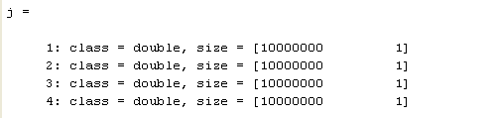
Spmd Examples
Result j is a Composite with 4 parts!

Slide 39
MATLAB Composites
Its an object used for data distribution in MATLAB
A Composite object has one entry for each worker
  parpool(12) creates?
  parpool(6) creates?
12X1 composite
6X1 composite

Slide 40
MATLAB Composites
You can create a composite in two ways:
  spmd
  c = Composite();
    This creates a composite that does not contain any data, just placeholders for data
    Also, one element per parpool worker is created for the composite
    Use smpd or indexing to populate a composite created this way

Slide 41
Another spmd Example- creating graphs
%Perform a simple calculation in parallel, and plot the results:
parpool(4)
spmd
% build magic squares in parallel
q = magic(labindex + 2); %labindex- index of the lab/worker (e.g. 1)
end
for ii=1:length(q)
% plot each magic square
figure, imagesc(q{ii}); %plot a matrix as an image
end
delete (gcp(‘nocreate’));

Slide 42
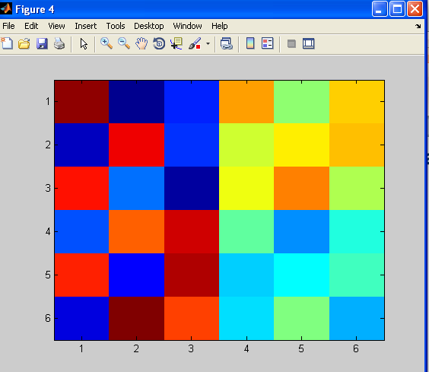
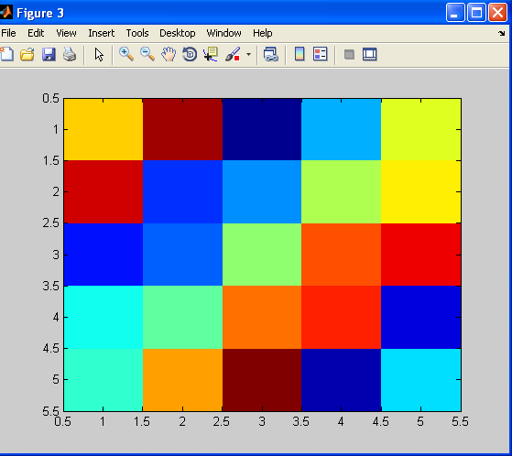
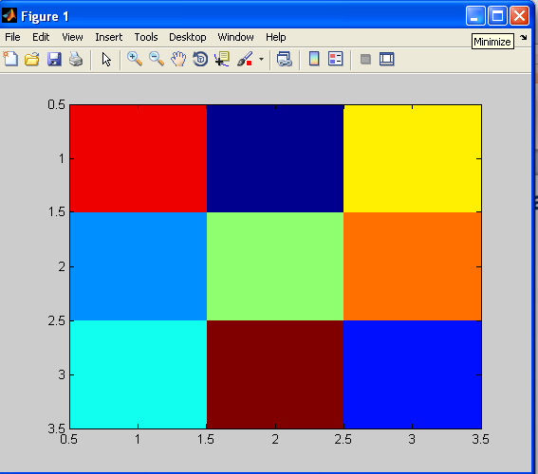
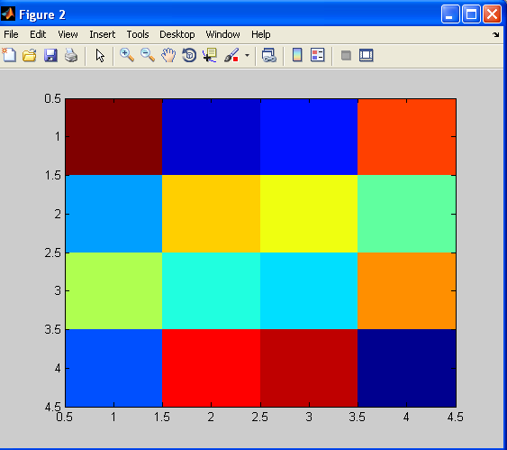
Another spmd Example- creating graphs
Results

Slide 43
spmd vs parfor
parfor is simpler to use
parfor can’t control iterations
parfor only does loops
spmd more control over iterations
spmd more control over data movement
spmd is persistent
spmd is more flexible and you can create parallel regions that do more than just loop

Slide 44
GPU Computing

Slide 45
What is GPU computing?
GPU computing is the use of a GPU (graphics processing unit) with a CPU to accelerate performance
Offloads compute-intensive portions an application to the GPU, and remainder of code runs on CPU

Slide 46
What is GPU computing?
CPUs consist of a few cores optimized for serial processing.
GPUs consist of thousands of smaller cores designed for parallel performance (i.e. more memory bandwidth and cores)
Data is moved between CPU Main Memory and GPU Device Memory via the PCIe Bus

Slide 47
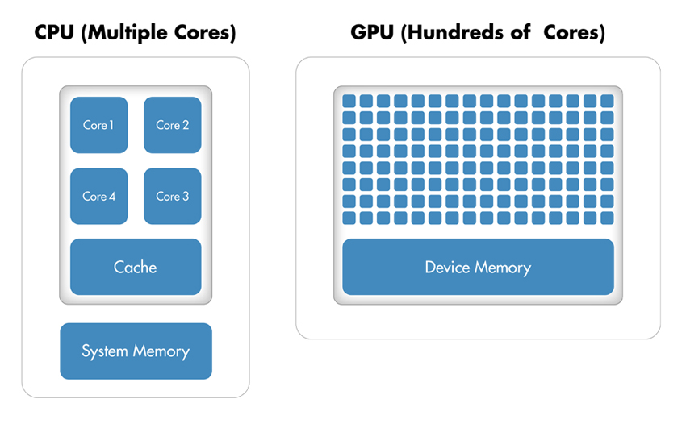
GPU Computing
PCIe Bus

Slide 48
What/Why GPU computing?
Serial portions of the code run on the CPU while parallel portions run on the GPU
From a user's perspective, applications in general run significantly faster

Slide 49
Write GPU computing codes in MATLAB
Transfer data between the MATLAB workspace & the GPU
  Accomplished by a GPUArray
    Data stored on the GPU.
  Use gpuArray function to transfer an array from the MATLAB workspace to the GPU

Slide 50
Write GPU computing codes in MATLAB
Examples
N = 6;
M = magic(N);
G = gpuArray(M); %create array stored on GPU
G is a MATLAB GPUArray object representing magic square data on the GPU.
X = rand(1000);
G = gpuArray(X); %array stored on GPU

Slide 51
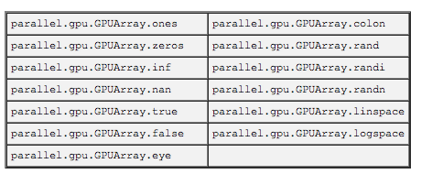
Static GPUArrays
Static GPUArrays allow users to directly construct arrays on GPUs, without transfers
Include:

Slide 52
Static Array Examples
Construct an Identity Matrix on the GPU
II = parallel.gpu.GPUArray.eye(1024,'int32');
size(II)
1024 1024
Construct a Multidimensional Array on the GPU
G = parallel.gpu.GPUArray.ones(100, 100, 50);
size(G)
100 100 50
classUnderlying(G)
Double %double is default, so don’t need to specify it

Slide 53
More Resources for GPU Arrays
For a complete list of available static methods in any release, type methods('parallel.gpu.GPUArray')
For help on any one of the constructors, type
help parallel.gpu.GPUArray/functionname
For example, to see the help on the colon constructor, type help parallel.gpu.GPUArray/colon

Slide 54
Retrieve Data from the GPU
Use gather function
  Makes data available in GPU environment, available in MATLAB workspace (CPU)
Example
G = gpuArray(ones(100, 'uint32')); %array stored only on GPU
D = gather(G); %bring D to CPU/MATLAB workspace
OK = isequal(D, ones(100, 'uint32')) %check to see if the array on the GPU is the same as the array brought to the CPU

Slide 55
Calling Functions with GPU Objects
Example uses the fft and real functions, arithmetic operators + and *.
Calculations are performed on the GPU, gather retrieves data from the GPU to workspace.
Ga = gpuArray(rand(1000, 'single'));
%array on GPU & next operations performed on GPU
Gfft = fft(Ga);
Gb = (real(Gfft) + Ga) * 6;
G = gather(Gb); brings G to the CPU

Slide 56
Calling Functions with GPU Objects
The whos command is instructive for showing where each variable's data is stored.
whos
All arrays are stored on the GPU (GPUArray), except G, because it was “gathered”
Name | Size | Bytes | Class
G | 1000x1000 | 4000000 | single
Ga | 1000x1000 | 108 | parallel.gpu.GPUArray
Gb | 1000x1000 | 108 | parallel.gpu.GPUArray
Gfft | 1000x1000 | 108 | parallel.gpu.GPUArray

Slide 57
2D Wave Equation Example
Highlights are the only differences between GPU and regular code
function vvg = WaveGPU(N,Nsteps)
% From http://blogs.mathworks.com/loren/2012/02/06/using-gpus-in-matlab/
%
%% Solving 2nd Order Wave Equation Using Spectral Methods
% This example solves a 2nd order wave equation: utt = uxx + uyy, with u =
% 0 on the boundaries. It uses a 2nd order central finite difference in
% time and a Chebysehv spectral method in space (using FFT).
%
% The code has been modified from an example in Spectral Methods in MATLAB
% by Trefethen, Lloyd N.
% Points in X and Y
x = cos(pi*(0:N)/N); % using Chebyshev points
% Send x to the GPU
x = gpuArray(x);
y = x';
% Calculating time step
dt = 6/N^2;

Slide 58
2D Wave Example Cont.
% Setting up grid
[xx,yy] = meshgrid(x,y);
% Calculate initial values
vv = exp(-40*((xx-.4).^2 + yy.^2));
vvold = vv;
ii = 2:N;
index1 = 1i*[0:N-1 0 1-N:-1];
index2 = -[0:N 1-N:-1].^2;
% Sending data to the GPU
dt = gpuArray(dt);
index1 = gpuArray(index1);
index2 = gpuArray(index2);
% Creating weights used for spectral differentiation
W1T = repmat(index1,N-1,1);
W2T = repmat(index2,N-1,1);
W3T = repmat(index1.',1,N-1);
W4T = repmat(index2.',1,N-1);
WuxxT1 = repmat((1./(1-x(ii).^2)),N-1,1);
WuxxT2 = repmat(x(ii)./(1-x(ii).^2).^(3/2),N-1,1);
WuyyT1 = repmat(1./(1-y(ii).^2),1,N-1);
WuyyT2 = repmat(y(ii)./(1-y(ii).^2).^(3/2),1,N-1);
% Start time-stepping
n = 0;
while n < Nsteps
[vv,vvold] = stepsolution(vv,vvold,ii,N,dt,W1T,W2T,W3T,W4T,...
WuxxT1,WuxxT2,WuyyT1,WuyyT2);
n = n + 1;
end
% Gather vvg back from GPU memory when done
vvg = gather(vv);

Slide 59
Running Functions on GPU
Call arrayfun with a function handle to the MATLAB function as the first input argument:
result = arrayfun(@myFunction, arg1, arg2);
Subsequent arguments provide inputs to the MATLAB function.
Input arguments can be workspace data or GPUArray.
  GPUArray type input arguments return GPUArray.
  Else arrayfun executes in the CPU

Slide 60
Running Functions on GPU
Example: function applies correction to an array
function c = myCal(rawdata, gain, offset)
c = (rawdata .* gain) + offset;
Function performs only element-wise operations when applying a gain factor and offset to each element of the rawdata array.

Slide 61
Running Functions on GPU
Create some nominal measurement:
meas = ones(1000)*3; % 1000-by-1000 matrix
Function allows the gain and offset to be arrays of the same size as rawdata, so unique corrections can be applied to individual measurements.
Typically keep the correction data on the GPU so you do not have to transfer it for each application:

Slide 62
Running Functions on GPU
% Runs on the GPU because the input arguments
% gn and offs are in GPU memory;
gn = gpuArray(rand(1000))/100 + 0.995;
offs = gpuArray(rand(1000))/50 - 0.01;
corrected = arrayfun(@myCal, meas, gn, offs);
% Retrieve the corrected results from the GPU to
% the MATLAB workspace;
results = gather(corrected);

Slide 63
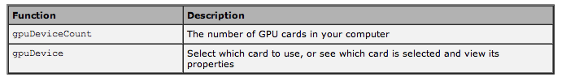
Identify & Select GPU
If you have only one GPU in your computer, that GPU is the default.
If you have more than one GPU card in your computer, you can use the following functions to identify and select which card you want to use:

Slide 64

Identify & Select GPU
This example shows how to identify and GPU a for your computations
  First, determine the number of GPU devices on your computer using gpuDeviceCount

Slide 65
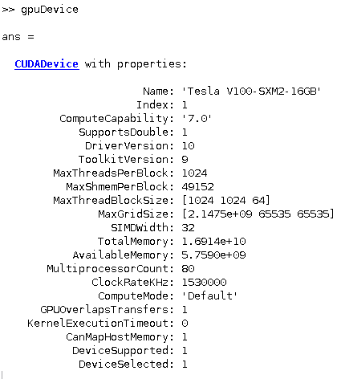
Identify & Select GPU
In this case, you have 2 devices, thus the first is the default.
  To examine it’s properties type gpuDevice
  Output from Nvidia Volta on Longleaf

Slide 66

Identify & Select GPU
If the previous GPU is the device you want to use, then you can just proceed with the default
To use another device call gpuDevice with the index of the card and view its properties to verify you want to use it. Here is an example where the second device is chosen

Slide 67
More Resources for GPU computing
MATLAB’s extensive online help documents for GPU computing
  http://www.mathworks.com/help/toolbox/distcomp/bsic3by.html

Slide 68
Parallel & GPU Computing on the cluster

Slide 69
Cluster Jargon
Node
  A standalone "computer in a box". Usually comprised of multiple CPUs/processors/cores. Nodes are networked together to comprise a cluster.
Nodes have two sockets (CPUs) each of which runs multiple cores (e.g. most Longleaf nodes have 12 cores per socket, i.e. 24 per node). Hyper-threading turned on doubles this number.
Each thread can run a process

Slide 70
Using MATLAB on the computer Cluster
What??
  UNC provides researchers and graduate students with access to extremely powerful computers to use for their research.
  Longleaf is a Linux based computing system targeted for High Throughput (HTC) and data intensive computing
  Dogwood is a Linux based computing system targeted for High Performance Computing (HPC)
Why??
  The cluster is an extremely fast and efficient way to run LARGE MATLAB programs (fewer “Out of Memory” errors!)
  You can get more done! Your programs run on the cluster which frees your computer for writing and debugging other programs!!!
  You can run a large number at the same time

Slide 71
Using MATLAB on the computer Cluster
Where and When??
  The cluster is available 24/7 and you can run programs remotely from anywhere with an internet connection!

Slide 72
Using MATLAB on the computer Cluster
Overview of how to use the computer cluster
  It would be helpful to take the following courses:
    Getting Started on Longleaf
    Getting Started on Dogwood
    Introduction to Linux
  For presentations & help documents, visit:
    Course presentations:
      http://its.unc.edu/service/research-computing-presentations/
    Help documents:
      http://help.unc.edu/help/research-computing-getting-started/

Slide 73
Parallel MATLAB on Cluster
Have access to:
  Longleaf general partition nodes have 24 physical cores and hyper-threading is on so 48 processes can be scheduled
  Dogwood supports MDCS with no limit now on the number of workers

Slide 74
Sample SLURM Matlab script
Start a cluster job with this command which gives you 1 job that is NOT parallel OR GPU
  matlab –nodesktop –nosplash –singleCompThread –r <filename>
  “filename” is the name of your Matlab script with the .m extension left off
  singleCompThread
    ALWAYS use this option unless you are requesting an entire node for a serial (i.e. not using the Parallel Computing Toolbox) Matlab job or using GPUs!!!!!!

Slide 75
Matlab sample job submission script #1
#!/bin/bash
#SBATCH -p general
#SBATCH -N 1
#SBATCH -t 07-00:00:00
#SBATCH --mem=10g
#SBATCH -n 1
matlab -nodesktop -nosplash -singleCompThread -r mycode -logfile mycode.out
Submits a single cpu Matlab job.
general partition, 7-day runtime limit, 10 GB memory limit.

Slide 76
Matlab sample job submission script #2
#!/bin/bash
#SBATCH -p general
#SBATCH -N 1
#SBATCH -t 02:00:00
#SBATCH --mem=3g
#SBATCH -n 24
matlab -nodesktop -nosplash -singleCompThread --r mycode -logfile mycode.out
Submits a 24-core, single node Matlab job (i.e. using Matlab’s Parallel Computing Toolbox).
general partition, 2-hour runtime limit, 3 GB memory limit.

Slide 77
Matlab sample job submission script #3
#!/bin/bash
#SBATCH -p gpu
#SBATCH -N 1
#SBATCH -t 30
#SBATCH --qos gpu_access
#SBATCH --gres=gpu:1
#SBATCH -n 1
matlab -nodesktop -nosplash -singleCompThread -r mycode -logfile mycode.out
Submits a single-gpu Matlab job.
gpu partition, 30 minute runtime limit.
You must request to be added to the gpu partition before you can submit jobs there

Slide 78
Matlab sample job submission script #4
#!/bin/bash
#SBATCH -p bigmem
#SBATCH -N 1
#SBATCH -t 7-
#SBATCH --qos bigmem_access
#SBATCH -n 1
#SBATCH --mem=500g
matlab -nodesktop -nosplash -singleCompThread -r mycode -logfile mycode.out
Submits a single-cpu, single node large memory Matlab job.
bigmem partition, 7-day runtime limit, 500 GB memory limit
You must request to be added to the bigmem partition before you can submit jobs there

Slide 79




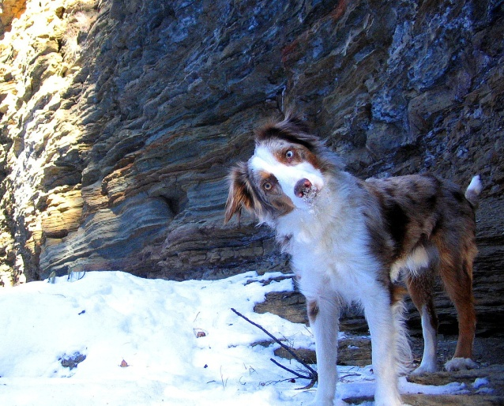

Questions and Comments?
For assistance with MATLAB, please contact the Research Computing Group:
  Email: research@unc.edu
  Phone: 919-962-HELP
  Submit help ticket at http://help.unc.edu

