Slide 1
Introduction to MATLAB
Mark Reed
Lani Clough
Research Computing Group
UNC-Chapel Hill
Notes:
The Title Slide: Add the name of the presentation, the appropriate division or presenter and date of the presentation.

Slide 2

Purpose
This course is an introductory level course for beginners.
The purpose of this course is to introduce you to some of the basic commands and features of MATLAB.
In addition, slides are included at the end of the presentation to walk you through running MATLAB jobs on the UNC computer cluster
Notes:
Basic content slide: Add slide title and slide text in the appropriate places. To create a new slide, go to “Insert > New Slide” from the main menu.

Slide 3
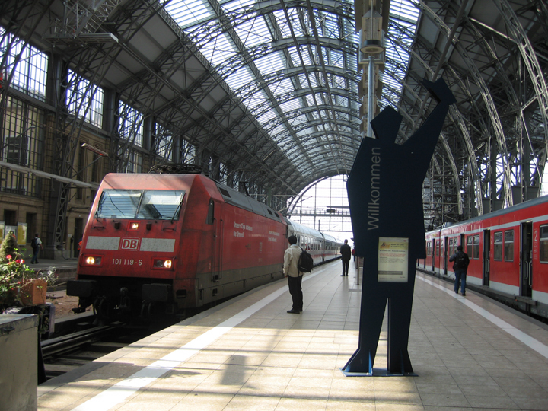
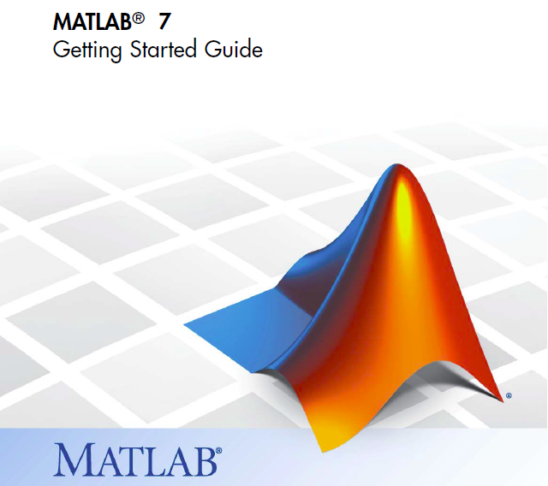
Logistics
Course Format
Overview of MATLAB
with Lab Exercises
Introduction to Kure and using MATLAB on Kure
UNC Research Computing
  http://its.unc.edu/research
See also “Getting Started Guide” from Mathworks

Slide 4
Course agenda
Introduction
Getting started
Mathematical functions
Matrix generation
Reading and writing data files
Basic plotting
Basic programming
Notes:
Basic content slide: Add slide title and slide text in the appropriate places. To create a new slide, go to “Insert > New Slide” from the main menu.

Slide 5
Introduction
The name MATLAB stands for MATrix LABoratory
  It is good at dealing with matrices
  Vendor’s website: http//:www.mathworks.com
Advantages of MATLAB
  Ease of use
  Powerful built-in routines and toolboxes (LOTS!!!)
  Good visualization of results
  Popularity in both academia and industry
Disadvantages of MATLAB
  Can be slow (MATLAB is an interpreted language)
  Must be licensed (it’s not free :)
Notes:
Basic content slide: Add slide title and slide text in the appropriate places. To create a new slide, go to “Insert > New Slide” from the main menu.

Slide 6
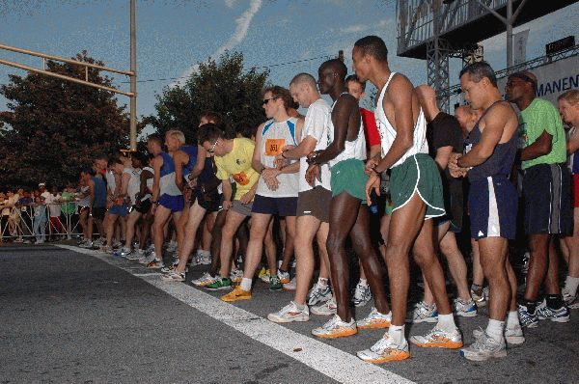
Getting Started

Slide 7
Getting Started
You can start MATLAB in either of two modes
matlab
  brings up the full GUI (assuming you can display) … see next page
matlab –nodesktop -nosplash
  command line interface only. Can still plot and create graphs (if you have a display)

Slide 8
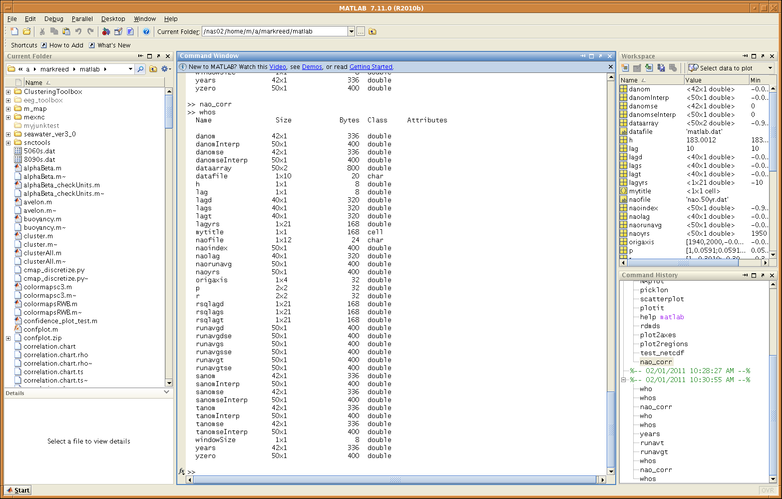
Getting started – Matlab Desktop
Current Directory
Workspace
Current Folder
Command Window
Command History
m file comment
Notes:
Basic content slide: Add slide title and slide text in the appropriate places. To create a new slide, go to “Insert > New Slide” from the main menu.

Slide 9
Getting started
Using MATLAB as a calculator
  >> pi
  ans =
    3.1416
  More examples:
  >> sin(pi/4)
  >> 2^(log(4))
  >> sqrt(9)
Notes:
Basic content slide: Add slide title and slide text in the appropriate places. To create a new slide, go to “Insert > New Slide” from the main menu.

Slide 10
Getting started
Assign values to output variables
  >> x=5
  x=
  5
  >> y = 'Bob'
  y =
  Bob
Notes:
Basic content slide: Add slide title and slide text in the appropriate places. To create a new slide, go to “Insert > New Slide” from the main menu.

Slide 11
Getting started
Suppressing output
  You can suppress the numerical output by putting a semicolon (;) at the end of the line
  >> t=pi/3 VS >> t=pi/3;
Case sensitive
  Example: “time” and “Time” are different variables
  >> time=61;
  >> Time=61;
Notes:
Basic content slide: Add slide title and slide text in the appropriate places. To create a new slide, go to “Insert > New Slide” from the main menu.

Slide 12
Getting started
Managing the workspace
  The results of one problem may have an effect on the next one
  Use whos to list current variables and give information on size, shape, type etc.
  Issue a clear command at the start of each new independent calculation to remove variables and functions from memory (and the workspace)
  clear t
    clears variable t
  clear
    clears all variables
  clear all
    clears all variables, globals, functions, and MEX links
Notes:
Basic content slide: Add slide title and slide text in the appropriate places. To create a new slide, go to “Insert > New Slide” from the main menu.

Slide 13
Getting started
Miscellaneous commands
  To clear the Command Window
  >> clc
  To clear the current figure
  >> clf
  To abort a MATLAB computation
  ctrl-C
  To continue a line
  …
  To recall previous commands Up arrow ( ), ctrl-p or double click command history pane
Notes:
Basic content slide: Add slide title and slide text in the appropriate places. To create a new slide, go to “Insert > New Slide” from the main menu.

Slide 14
Getting started
Use Early and Often!
Getting help
  Use help to request info on a specific topic
    displays help in the command window
  >> help sqrt
  Use doc function to open the help browser window
  >> doc plot
  Use lookfor to find function by keywords
  >> lookfor regression
Notes:
Basic content slide: Add slide title and slide text in the appropriate places. To create a new slide, go to “Insert > New Slide” from the main menu.

Slide 15

Mathematical Functions

Slide 16
Mathematical functions
Lists of built-in mathematical functions
  Elementary functions
  >> help elfun
  Special functions
  >> help specfun
  Such as
  sin(x), cos(x), tan(x), e^{x}, ln(x)
Notes:
Basic content slide: Add slide title and slide text in the appropriate places. To create a new slide, go to “Insert > New Slide” from the main menu.

Slide 17
Mathematical functions
Example 1
Calculate z=e^{-a}sin(x)+10 for a=5, x=2, y=8
  >> a=5; x=2; y=8;
  >> z=exp(-a)*sin(x)+10*sqrt(y)
  z=
  28.2904
Example 2
log(142), log10(142)
Notes:
Basic content slide: Add slide title and slide text in the appropriate places. To create a new slide, go to “Insert > New Slide” from the main menu.

Slide 18

Matrix Generation

Slide 19
Matrix generation
The name MATLAB is taken from ”MATrix LABoratory.” It is good at dealing with matrices.
Actually all variables in MATLAB are matrices.
  Scalars are 1-by-1 matrices
  vectors are N-by-1 (or 1-by-N) matrices.
  You can see this by executing
>> size(x)
Notes:
Basic content slide: Add slide title and slide text in the appropriate places. To create a new slide, go to “Insert > New Slide” from the main menu.

Slide 20
Matrix generation
Entering a matrix
  Begin with a square bracket, [
  Separate elements in a row with spaces or commas (,)
  Use a semicolon (;) to separate rows
  End the matrix with another square bracket, ]
Notes:
Basic content slide: Add slide title and slide text in the appropriate places. To create a new slide, go to “Insert > New Slide” from the main menu.

Slide 21
Matrix generation
  Entering a matrix: A typical example
  >> A=[1 2 3; 4 5 6; 7 8 9]
  >> A=
  1 2 3
  4 5 6
  7 8 9
Notes:
Basic content slide: Add slide title and slide text in the appropriate places. To create a new slide, go to “Insert > New Slide” from the main menu.

Slide 22
Matrix generation
Matrix indexing
  View a particular element in a matrix
  For example, A(1,3) is an element of first row and third column
  >>A(1,3)
  >>ans =
  3
Notes:
Basic content slide: Add slide title and slide text in the appropriate places. To create a new slide, go to “Insert > New Slide” from the main menu.

Slide 23
Matrix generation
Colon operator in a matrix
  Colon operator is very useful in the usage of MATLAB
  For example, A(m:n,k:l) specifies portions of a matrix A: rows m to n and column k to l.
  Examples:
  A(2:3, 2:3)
  A(2, :) note: just colon means all elements
  A(2:end, :) note use of end keyword
Notes:
Basic content slide: Add slide title and slide text in the appropriate places. To create a new slide, go to “Insert > New Slide” from the main menu.

Slide 24
Matrix generation
Transposing a matrix
The transposing operation is a single quote (’)
  >>A’
Concatenating matrices
  Matrices can be made up of sub-matrices
  This matrix consists of four 3x3 sub-matrices.
  >>B= [A 10*A; -A [1 0 0; 0 1 0; 0 0 1]]
  Hint: note spaces to separate elements.
Notes:
Basic content slide: Add slide title and slide text in the appropriate places. To create a new slide, go to “Insert > New Slide” from the main menu.

Slide 25
Matrix generation
Generating vectors: colon operator
  Suppose we want to enter a vector x consisting of points (0, 0.1, 0.2, 0.3,…,5)
  >>x=0:0.1:5;
  All the elements in between 0 and 5 increase by one-tenth
  format is begin:stride:end
Notes:
Basic content slide: Add slide title and slide text in the appropriate places. To create a new slide, go to “Insert > New Slide” from the main menu.

Slide 26
Matrix generation
Elementary matrix generators
  zeros(m,n)
  ones(m,n)
  eye(m,n)
  diag(A)
  rand(m,n)
  randn(m,n)
  logspace(a,b,n)
  linspace (a,b,n)
For a complete list of elementary matrices
  >>help elmat
  >>doc elmat
Notes:
Basic content slide: Add slide title and slide text in the appropriate places. To create a new slide, go to “Insert > New Slide” from the main menu.

Slide 27

Reading and Writing Data Files
Data reading.

Slide 28
Reading and writing data files
Save command
  Example 1, save all variables in the workspace into a binary file:
>> x = [1 3 -4];
>> y = [2 -1 7];
>> z = [3 2 3];
>> save Filename.mat
  Save only certain variables by specifying the variable names after the file name
>> save Filename.mat x y
Notes:
Basic content slide: Add slide title and slide text in the appropriate places. To create a new slide, go to “Insert > New Slide” from the main menu.

Slide 29
Reading and writing data files
Save command
  Example 2, save variables into ASCII data file
>> save Filename.dat –ascii
or
>> save Filename.txt x y –ascii
Notes:
29
Basic content slide: Add slide title and slide text in the appropriate places. To create a new slide, go to “Insert > New Slide” from the main menu.

Slide 30
Reading and writing data files
load command
  The data can be read back with the load command
>> load Filename.mat
  Load only some of the variables into memory
>> load Filename.mat x
  Load the ASCII data file back into memory
>> load Filename.dat -ascii
load tabular data, e.g. columns of numbers, access the columns
  >> dataArray = load(“myPrecious.dat”);
  >> fifthColumn = dataArray(:,5);
Notes:
Basic content slide: Add slide title and slide text in the appropriate places. To create a new slide, go to “Insert > New Slide” from the main menu.

Slide 31
Reading and writing data files
The textread function
  The load command assumes all of data is of a single type
  The textread function is more flexible, it is designed to read ASCII files where each column can be of a different type
  The command is:
>> [A,B,C,...] = textread(filename, format, n);
format string specifies conversion, looks like C
n specifies number of times to repeat the format, default is to read to the end of file
See textscan as well which will replace textread eventually
Notes:
Basic content slide: Add slide title and slide text in the appropriate places. To create a new slide, go to “Insert > New Slide” from the main menu.

Slide 32
Reading and writing data files
The textread function
  For example, if a text file “mydata.dat” contains the following lines:
tommy 32 male 78.8
sandy 3 female 88.2
alex 27 male 44.4
saul 11 male 99.6
  The command is:
>> [name,age,gender,score] = textread(‘mydata.dat’, ‘%s %d %s %f’, 4);
Notes:
Basic content slide: Add slide title and slide text in the appropriate places. To create a new slide, go to “Insert > New Slide” from the main menu.

Slide 33
Reading and writing data files
The xlsread function
  The xlsread function is to get data and text from a spreadsheet in an Excel workbook.
  The basic command is:
>> d=xlsread(‘datafile.xls’)
Notes:
33
Basic content slide: Add slide title and slide text in the appropriate places. To create a new slide, go to “Insert > New Slide” from the main menu.

Slide 34
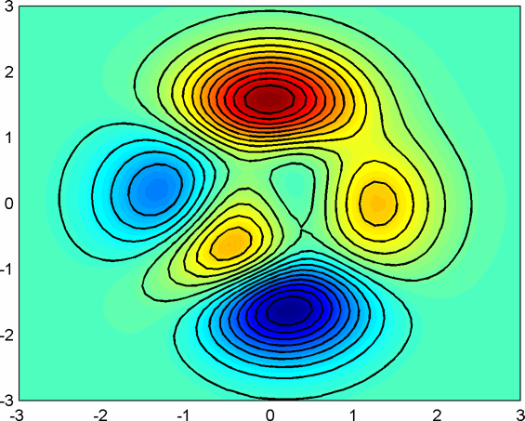
Basic Plotting

Slide 35
Basic plotting
A simple line plot
  To plot the function y=sin(x) on the interval [0, 2π]
  >>x=0:pi/100:2*pi;
  >>y=sin(x);
  >>plot(x,y)
  >>xlabel (‘x=0:2\pi’);
  >>ylabel (‘Sine of x’);
  >>title (‘Plot of the Sine Function’);
Notes:
Basic content slide: Add slide title and slide text in the appropriate places. To create a new slide, go to “Insert > New Slide” from the main menu.

Slide 36
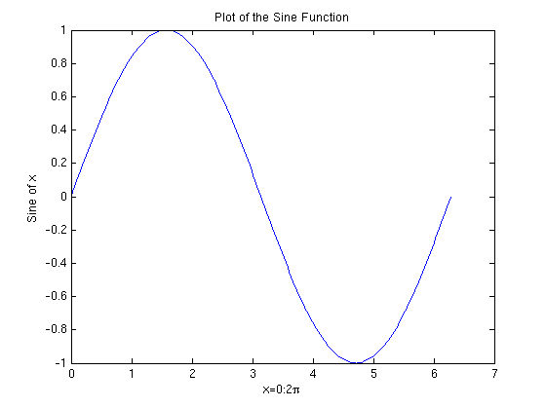
Basic plotting
Plotting elementary functions
Notes:
Basic content slide: Add slide title and slide text in the appropriate places. To create a new slide, go to “Insert > New Slide” from the main menu.

Slide 37
Basic plotting
Multiple data sets in one plot
  Several graphs may be drawn on the same figure
  For example, plot three related function of x: y₁=2cos(x),
  y₂=cos(x), and
  y₃=0.5cos(x),
  on the interval [0, 2π]
Notes:
Basic content slide: Add slide title and slide text in the appropriate places. To create a new slide, go to “Insert > New Slide” from the main menu.

Slide 38
Basic plotting
Multiple data sets in one plot
>> x = 0:pi/100:2*pi;
>> y1 = 2*cos(x);
>> y2 = cos(x);
>> y3 = 0.5*cos(x);
>> plot(x,y1,‘--’,x,y2,‘-’,x,y3,‘:’)
>> xlabel(‘0 \leq x \leq 2\pi’)
>> ylabel(‘Cosine functions’)
>> legend(‘2*cos(x)’,‘cos(x)’,‘0.5*cos(x)’)
>> title(‘Typical example of multiple plots’)
Notes:
Basic content slide: Add slide title and slide text in the appropriate places. To create a new slide, go to “Insert > New Slide” from the main menu.

Slide 39
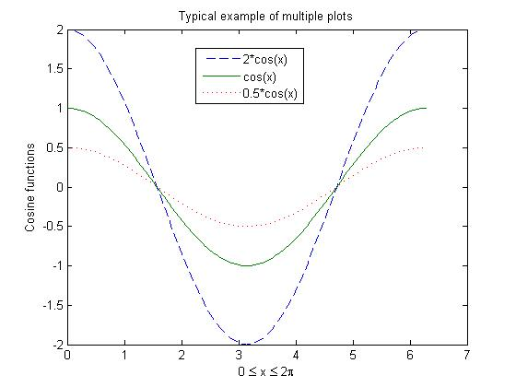
Basic plotting
Multiple data sets in one plot
Notes:
Basic content slide: Add slide title and slide text in the appropriate places. To create a new slide, go to “Insert > New Slide” from the main menu.

Slide 40
Basic plotting
Subplot
  The graphic window can be split into an m*n array of small windows.
  The windows are counted 1 to mn row-wise, starting from the top left
    subplot (m, n, p) where p = 1 to m*n
  For example, plot four related functions of x:
  y₁=sin(3πx), y₂=cos(3πx), y₃=sin(6πx), y₄=cos(6πx),
  on the interval [0, 1]
Notes:
Basic content slide: Add slide title and slide text in the appropriate places. To create a new slide, go to “Insert > New Slide” from the main menu.

Slide 41
Basic plotting
Subplot
>> x = 0:1/100:1;
>> y1 = sin(3*pi*x);
>> y2 = cos(3*pi*x);
>> y3 = sin(6*pi*x);
>> y4 = cos(6*pi*x);
>> title(‘Typical example of subplots’)
>> subplot(2,2,1), plot(x,y1)
>> xlabel(‘0 \leq x \leq 1’), ylabel(‘sin(3 \pi x)’)
>> subplot(2,2,2), plot(x,y2)
>> xlabel(‘0 \leq x \leq 1’), ylabel(‘cos(3 \pi x)’)
>> subplot(2,2,3), plot(x,y3)
>> xlabel(‘0 \leq x \leq 1’), ylabel(‘sin(6 \pi x)’)
>> subplot(2,2,4), plot(x,y4)
>> xlabel(‘0 \leq x \leq 1’), ylabel(‘cos(6 \pi x)’)
Notes:
Basic content slide: Add slide title and slide text in the appropriate places. To create a new slide, go to “Insert > New Slide” from the main menu.

Slide 42
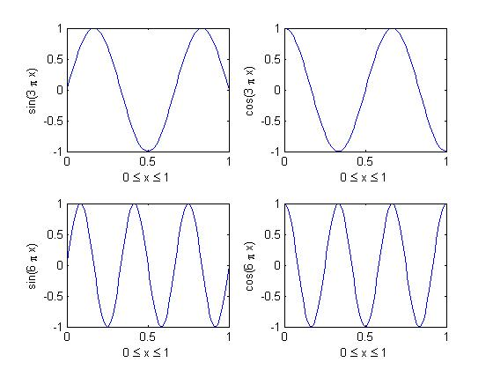
Basic plotting
Subplot
Notes:
Basic content slide: Add slide title and slide text in the appropriate places. To create a new slide, go to “Insert > New Slide” from the main menu.

Slide 43
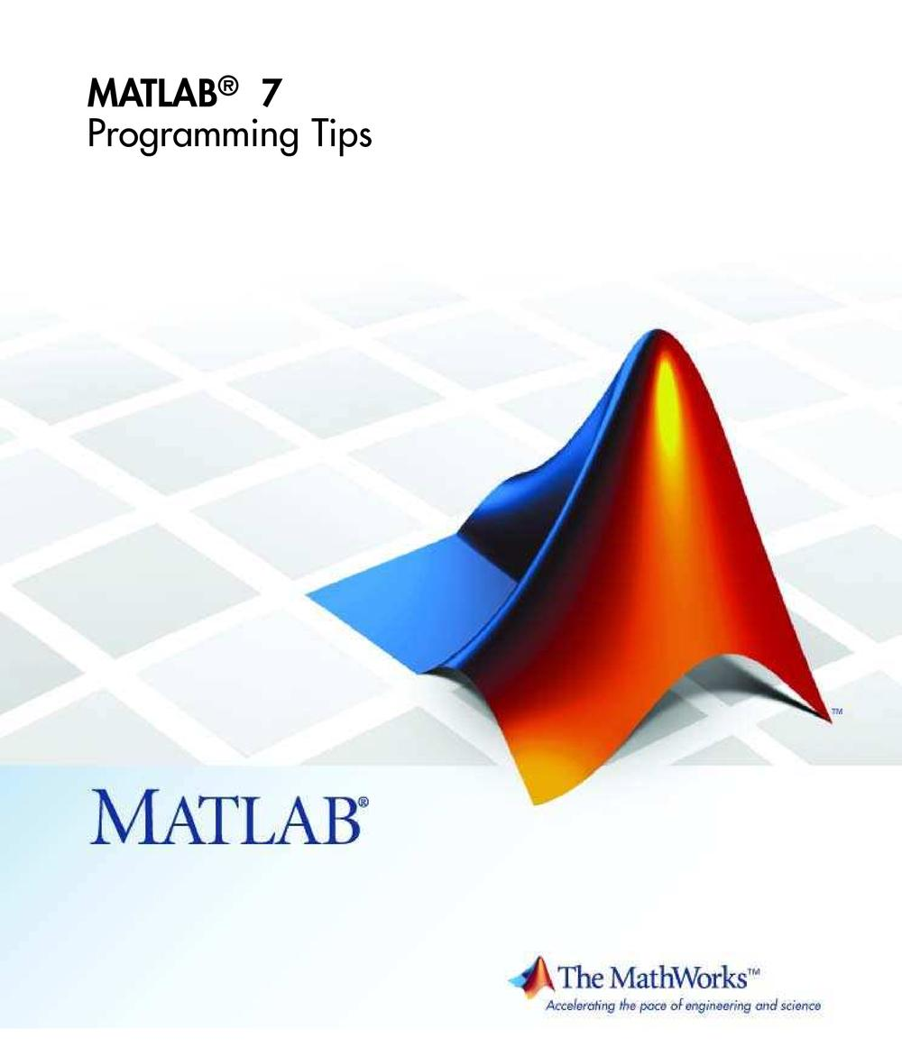

Matlab Programming
See Loren Shure’s blog on
the art of Matlab
http://blogs.mathworks.com/loren/
http://blogs.mathworks.com/loren/2009/04/21/learning-matlab/

Slide 44
MATLAB Programming
scripts
  simplest form of MATLAB programming
  stored in “.m” file
  a collection of commands executed in sequence
  no input or output arguments
  behaves just as if you typed the lines in at the command prompts (e.g. variables are in the workspace)
functions
  stored in “.m” file
  accepts input and returns output to the caller
  begin with function definition line containing the “function” keyword, and exit with matching end statement
  functions operate on variables within their own function workspace (scope)

Slide 45
Programming in MATLAB
m-File scripts
  In order to repeat any calculation and/or make any adjustments, it is simpler to create a file with a list of commands.
  “File→ New → M-file”
    (or use your favorite editor/text processor)
  For example, put the commands for plotting soil temperature into a file called scriptexample.m
Notes:
Basic content slide: Add slide title and slide text in the appropriate places. To create a new slide, go to “Insert > New Slide” from the main menu.

Slide 46
Programming in MATLAB
m-File scripts
  Run the file by typing scriptexample
Notes:
Basic content slide: Add slide title and slide text in the appropriate places. To create a new slide, go to “Insert > New Slide” from the main menu.

Slide 47
Programming in MATLAB
m-File scripts
  MATLAB treats anything that appears after the % on a line as comments and these line will be ignored when the file runs
% -------------------------------------------------------
% scriptexample.m is to display soil temperature in the morning and
% the afternoon.
% -------------------------------------------------------
The first contiguous comment becomes the script’s help file
Notes:
Basic content slide: Add slide title and slide text in the appropriate places. To create a new slide, go to “Insert > New Slide” from the main menu.

Slide 48
Programming in MATLAB
m-File functions
  Functions are routines that are general and applicable to many problems.
  To define a MATLAB function:
    Decide a name for the function, making sure that it does not conflict a name that is already used by MATLAB. If you give your function the same name as am existing MATLAB function, MATLAB will use your function instead of its own.
      Type help nameofyourfunction to see if a function with the same name already exists
        i.e. >>help c2f >>c2f not found.
    Document the function- comment lines which describe the function for other users
    The first command line of the file must have this format:
    function[list of outputs]=functionname(list of inputs)
    …….
    Save the function as a m-file
    Call the function using the filename (not the function name). For this reason they are generally the same but are not required to be.
Notes:
Basic content slide: Add slide title and slide text in the appropriate places. To create a new slide, go to “Insert > New Slide” from the main menu.

Slide 49
Programming in MATLAB
m-File functions
  Consider an example to plot the piecewise defined function:
Notes:
Basic content slide: Add slide title and slide text in the appropriate places. To create a new slide, go to “Insert > New Slide” from the main menu.

Slide 50
Programming in MATLAB
m-File functions
  It is convenient to have a separate file which can do a specific calculation.
function [F]= eff(x)
% Function to calculate values
% Input x
% Output F
for i=1:length(x)
if x(i)<0.5
F(i)=x(i)^2;
else
F(i)=0.25;
end
end
Notes:
Basic content slide: Add slide title and slide text in the appropriate places. To create a new slide, go to “Insert > New Slide” from the main menu.

Slide 51
Programming in MATLAB
m-File functions
  To evaluate this function, a main program is needed. This main program provides input arguments
  % Main program, use function: eff.m
  x=-1:0.01:1;
  plot(x,eff(x));
grid
xlabel('x');
ylabel('F');
title('The Piecewise Defined Function:');
Notes:
Basic content slide: Add slide title and slide text in the appropriate places. To create a new slide, go to “Insert > New Slide” from the main menu.

Slide 52
Programming in MATLAB
m-File functions
  Run the main file
Notes:
52
Basic content slide: Add slide title and slide text in the appropriate places. To create a new slide, go to “Insert > New Slide” from the main menu.

Slide 53
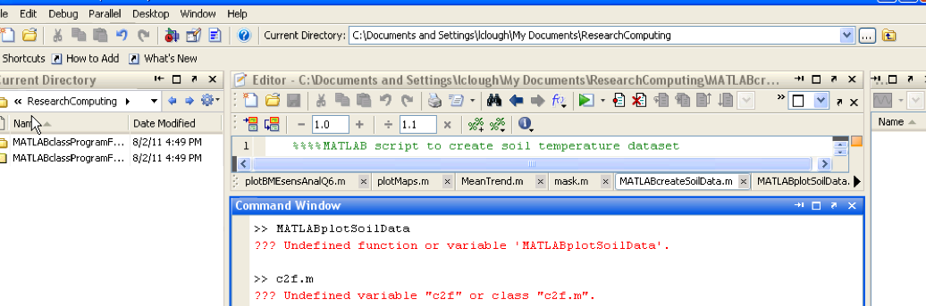
Programming in MATLAB
Create a program!
  Download the data and programs
  (http://its2.unc.edu/divisions/rc/training/scientific/ )
  Navigate to the appropriate directory
  Create a new file
  Check to make sure the names you want to save your file and
  function don’t already exist as MATLAB functions
Notes:
Basic content slide: Add slide title and slide text in the appropriate places. To create a new slide, go to “Insert > New Slide” from the main menu.

Slide 54
Programming in MATLAB
Create a MATLAB program and function! (program shown in 2 columns)
  %%MATLAB program to plot and convert soil temp
  close all;
  clear all;
  clc;
  load soilData.mat;
  %assign the variables
  Tc=soilData(:,1);
  moist=soilData(:,2);
  %create time variable
  time=(1:1:24)';
  %convert the soil temperature from Celsius to Fahrenheit using a function
  Tf=c2f(Tc);
  %plot the data
  close all;
  figure;
  plot(time,Tf,'k',time,moist,'b.');
  title('Soil Temperature and Moisture in North Carolina');
  xlabel('Time (hrs of a day)');
  ylabel('Degrees Farenheit, % Moisture Content');
  legend('Temperature','Moisture');
  %save the plots and the data
  h=figure(1);
  saveas(h,'soilPlot','jpg');
  saveas(h,'soilPlot','fig');save testData.mat Tc Tf moist time;
Notes:
Basic content slide: Add slide title and slide text in the appropriate places. To create a new slide, go to “Insert > New Slide” from the main menu.

Slide 55
Programming in MATLAB
Create a MATLAB function!
  %converts celcius to farenheit
  %Tc = temperature in degrees Celsius, Tf = temperature in degrees Fahrenheit
  function [Tf]=c2f(Tc)
  Tf = (9/5).*Tc+32;
  end
Notes:
Basic content slide: Add slide title and slide text in the appropriate places. To create a new slide, go to “Insert > New Slide” from the main menu.

Slide 56
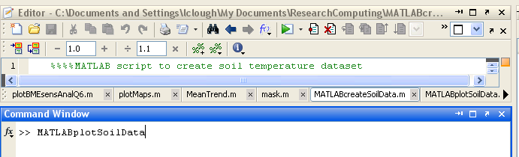
Programming in MATLAB
Run the program!
  Press type MATLABplotSoilData in the command
  window or press Run!
Can be used to debug your program
Notes:
Basic content slide: Add slide title and slide text in the appropriate places. To create a new slide, go to “Insert > New Slide” from the main menu.

Slide 57
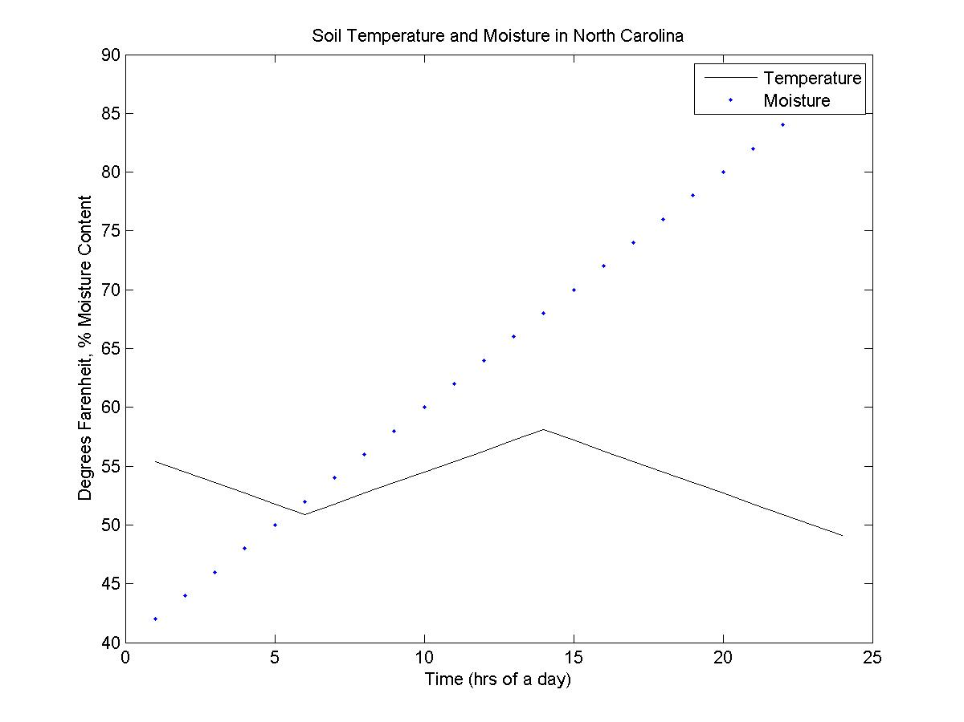
Programming in MATLAB
Results!
  Soilplot.jpg (jpg file- portable and transferable)
  Soilpot.fig MATLAB figure file, you can edit this at a later time!
Notes:
Basic content slide: Add slide title and slide text in the appropriate places. To create a new slide, go to “Insert > New Slide” from the main menu.

Slide 58
Using MATLAB on the computer Cluster
What??
  UNC provides researchers and graduate students with access to extremely powerful computers to use for their research.
  Kure is a Linux based computing system with >1,800 core processors
Why??
  The cluster is an extremely fast and efficient way to run LARGE MATLAB programs (no “Out of Memory” errors!)
  You can get more done! Your programs run on the cluster which frees your computer for writing and debugging other programs!!!
Where and When??
  The cluster is available 24/7 and you can run programs remotely from anywhere with an internet connection!

Slide 59
Using MATLAB on the computer Cluster
HOW?? Overview of how to use the computer cluster
  1. Get an account
  2. Log into the cluster using and transfer your files using a SSH client
  3. Navigate to the location where your file is stored
  4. Type bmatlab <myprogram.m>
  5. You will receive an email from LSF stating the outcome of your job

Slide 60
Using MATLAB on the computer Cluster
Overview of how to use the computer cluster
  A detailed explanation including screenshots are on the next slides
  It would be helpful to take the following courses:
    Getting Started on Kure
    Introduction to Linux
  For presentations & help documents, visit:
    Presentations: http://help.unc.edu/CCM3_015682
    Help documents: http://its2.unc.edu/divisions/rc/training/scientific/

Slide 61
Using MATLAB on the computer Cluster
Step 1: Either take the Introduction to Kure class or review the Introduction to Kure PowerPoint presentation to learn about the cluster!
      Class: http://its.unc.edu/TeachingAndLearning/learnit/index.htm (click on ITS Workshop sit for current offerings link)
      Presentations: http://help.unc.edu/CCM3_015682
      You may also want to either take the Linux class or at least review the Linux class notes as well! This presentation does provide basic Linux commands, however the class may make you feel more comfortable using the Linux cluster

Slide 62
Using MATLAB on the computer Cluster
Step 2: Request an account on Kure
  Go to: http://help.unc.edu/CCM3_015682 and follow the instructions under Getting an account OR
  Visit the Onyen Services page, click on the Subscribe to Services button and select Kure Cluster.
  Or send an email to research@unc.edu requesting an account on Kure. Please include the following information in your request:
      Onyen
      Your “@email.unc.edu” email address
      Full name
      Campus address
      Campus phone number (if any) and number where you can be reached while running jobs
      Department you are affiliated with (the one relevant to the work you will do on Kure)
      Faculty sponsor’s (PI) name (and onyen if known) if you are not a faculty member
      A description of the work you expect to do on Kure

Slide 63
Using MATLAB on the computer Cluster
Step 3: Download the SSH and VPN clients:
  Go to: http://help.unc.edu/2502t
  Under the paragraph “How do I obtain and install the VPN”, click the appropriate software for your machine
  Download and install the software

Slide 64
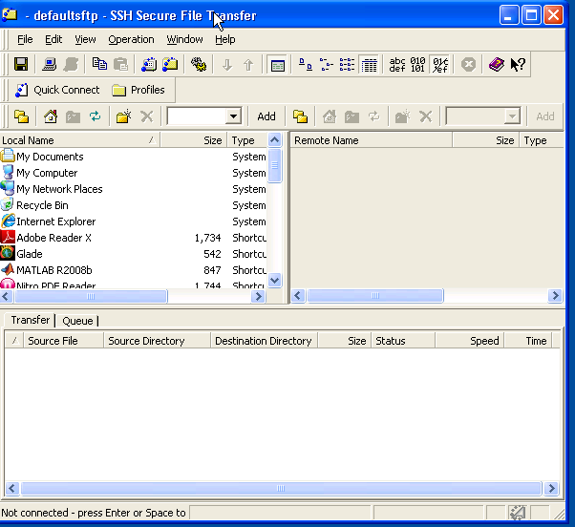
Using MATLAB on the computer Cluster
Step 4: Transfer your files for use on the cluster!
  Open the SSH Secure File Transfer Client
  Click Quick Connect!
  Navigate to the files you want to transfer from your computer to the cluster (programs & data!)
  Navigate to your folder on the space by typing in: /largefs/onyen/ and then pressing Add (Add saves this location)
  Transfer the files you want to the appropriate folder by dragging and dropping (make sure you have transferred all appropriate files and data!)

Slide 65
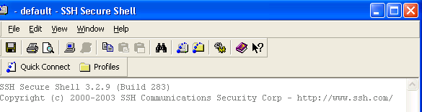
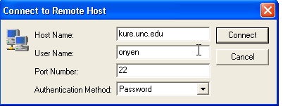

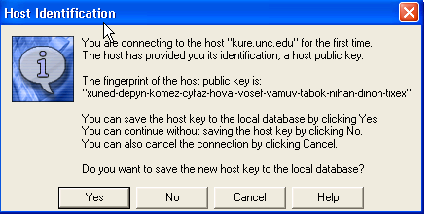
Using MATLAB on the computer Cluster
Step 5: Log in to the cluster to begin to send your jobs!
  Open the SSH Secure shell Client
  Click Quick Connect!
  Type in the information shown here and press Connect!
  You will be prompted to enter your password (enter it!)
  You will get a dialogue box for Host Identification, press Yes

Slide 66
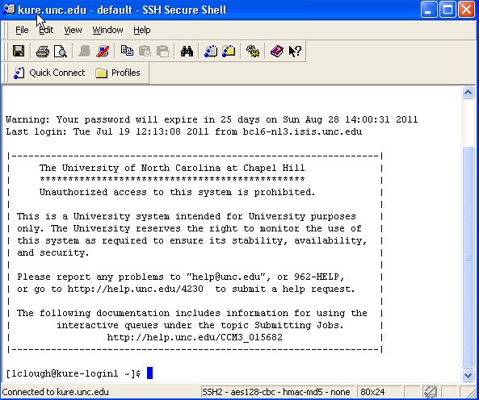
Using MATLAB on the computer Cluster
Step 5: You’re in!
  The screen will look like this when you’re in (except your oynen will be shown!

Slide 67
Using MATLAB on the computer Cluster
Step 6: Helpful commands for the cluster
  The cluster is Linux, and uses Linux commands, this slide will give you a basic overview of some of the commands you’ll want to use to run MATLAB jobs on the cluster. For more help take the Linux class from ITS Research computing, look at their PPT or search for the commands you’d like to use.

Slide 68
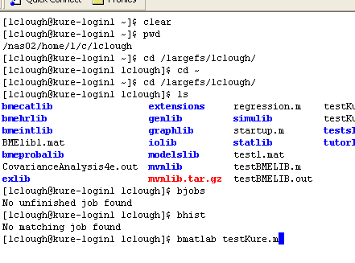
Using MATLAB on the computer Cluster
Step 6: Helpful commands for the cluster
  Clear: clears the screen
  pwd: shows you were you are (your working directory
  cd changes your working directory (cd ~ takes you back to your home directory)
  ls shows you the files in your current working directory
  bjobs shows you your current jobs
  bmatlab <myprogram.m> runs your program on the cluster
  bhist shows you the history of the jobs you are running

Slide 69
Using MATLAB on the computer Cluster
Step 7: Run your job on the cluster
  These steps will walk you through running a job on the cluster use this program as a test program to make sure the cluster is working and call it testKure.m
    x=1;
    y=1;
    a=z+x;
    Save ‘/largefs/myoynen/test1.mat’;
    Screenshot showing following is shown two slides from this slide
    1. Log in SSH file transfer client and transfer the testKure.m file from the location its save on your computer to /largefs/myoynen/
    2. Log into the SSH client
    3. Type cd /largefs/myoynen/
    4. type ls to make sure testKure.m is located in the correct folder
    5. Type bmatlab testKure.m
    Optional- to see you program running, type bhist or bjobs

Slide 70
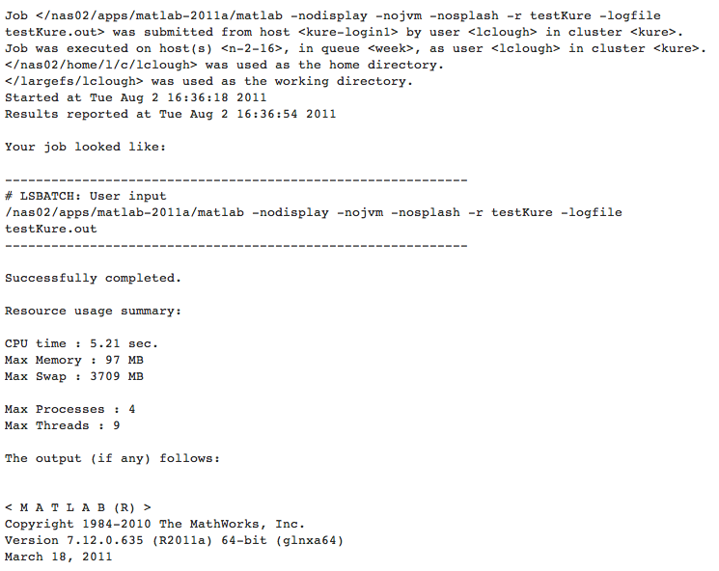
Using MATLAB on the computer Cluster
Step 7: Run your job on the cluster
    6. You will receive an email looking like this (if you did everything correctly :0) )!
    7. Type ls to make sure test1.mat is there as it should be
    8. Transfer the file using the SSH file transfer client from your largefs to your computer and delete it from the largefs space (largefs is not meant for storing files)
    9. Load the file to MATLAB and make sure everything is correct!

Slide 71
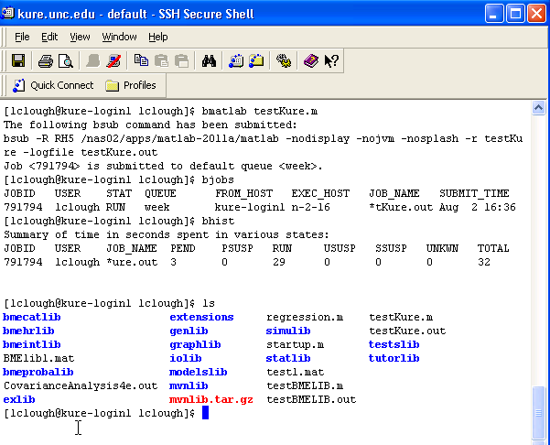
Using MATLAB on the computer Cluster
Step 7: Run your job on the cluster
    Here is what the process should have looked like!

Slide 72




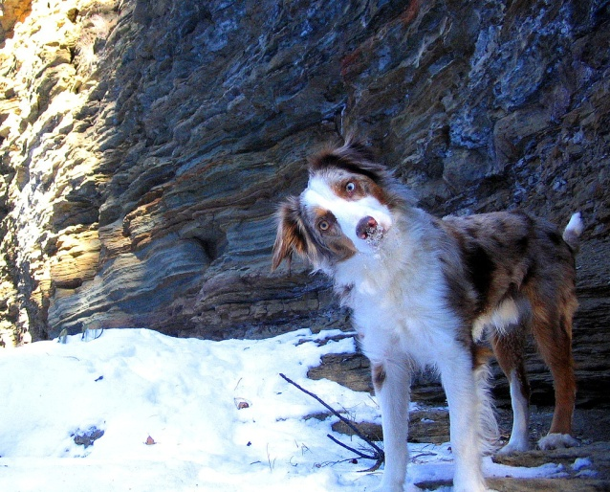

Questions and Comments?
For assistance with MATLAB, please contact the Research Computing Group:
  Email: research@unc.edu
  Phone: 919-962-HELP
  Submit help ticket at http://help.unc.edu
Notes:
Basic content slide: Add slide title and slide text in the appropriate places. To create a new slide, go to “Insert > New Slide” from the main menu.

