Slide 1
Intermediate MATLAB ITS Research Computing
Mark Reed
Lani Clough

Slide 2
Objectives
Intermediate level MATLAB course for people already using MATLAB.
Help participants go past the basics and improve the performance their MATLAB code.

Slide 3
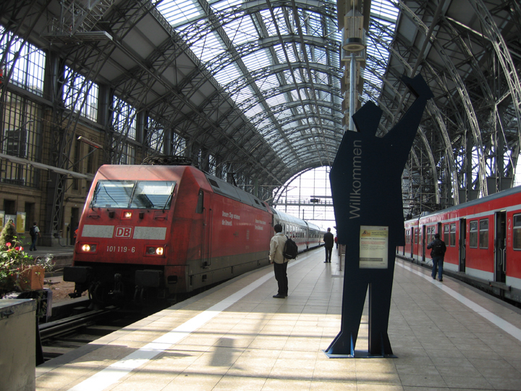
Logistics
Course Format
Overview of MATLAB topics with Lab Exercises
UNC Research Computing
http://its.help.rc.unc.edu//research

Slide 4
Agenda
NaNs
MATLAB Cell Arrays
MATLAB structures
Optimizing code
Looping, conditional statements and when to use them/vectorization
MATLAB profiler
Pre-allocation of vectors
Other optimization strategies
Intro to using MATLAB on RC clusters
Questions

Slide 5
Open On Demand (OOD)
https://ondemand.rc.unc.edu

Slide 6
MATLAB NaNs

Slide 7
What is a NaN?
The IEEE arithmetic representation for Not-a-Number
What creates a NaN?
Reading in a dataset with missing numbers
Using a MATLAB function on a dataset with a NaN
sum([0; 1; 0; NaN])=NaN
mean([0; 1; 0; NaN]) =NaN
Addition, subtraction, multiplication or division on a NaN

Slide 8
What creates a NaN (Cont.)?
Indeterminate Division
0/0, Inf/Inf
Subtraction of Inf with itself
(+Inf)+(-Inf)
(+Inf)-(+Inf)
Logical operations involving NaNs always return false, except ~=
NAN

Slide 9
What to do with NaNs?
Find them, Remove them, or Ignore them!
Find by using the isnan function
vector1=[1 1 0 NaN NaN]
idx=isnan(vector1)
idx = 0 0 0 1 1
Remove NaNs from your dataset
vector2=vector1(idx==0) vector2 =
1 1 0

Slide 10
What to do with NaNs? (cont.)
MATLAB Functions that IGNORE NaNs
vector1=([1 1 0 NaN NaN])
nanmax: find max value in dataset
nanmax(vector1)
1
nanmin: find the minimum value in a dataset
nanmin(vector1)
0

Slide 11
What to do with NaNs? (cont.)
vector1=([1 1 0 NaN NaN])
nansum: sum the values in a dataset
nansum(vector1)
2
nanmean: find mean value in dataset
nanmean(vector1)
2/3
Other functions
nanmedian, nanvar, nanstd

Slide 12
More useful information about NANs
Loren Shore Blog MATLAB
NaNs: http://blogs.mathworks.com/loren/2006/07/05/when-is-a-numeric-result-not-a-number/
MATLAB NaN page http://www.mathworks.com/help/techdoc/ref/nan.html

Slide 13
MATLAB Cell Arrays

Slide 14
MATLAB Cell Arrays: What is it?
It’s a data type that holds information indexed in containers called cells.
Cells can contain character or numeric variables and you can mix them.
They are very useful because unlike vectors, each of the cells can contain different sized numeric or character arrays.
textscan, which is very useful for reading column data of mixed type returns a cell array

Slide 15
MATLAB Cell Arrays: Creating
Create a cell array by using the {} brackets
Separate each element in the array with a comma
Examples
Generic:
{Element1,Element2,Element3}

Slide 16
MATLAB Cell Arrays: Creating
Examples
Character: UNCdeptCell={'ENVR','BIOS','STAT','MATH'};
UNCdeptCell =
'ENVR' 'BIOS' 'STAT' 'MATH'
Numeric:
DoubleCell={[10;50;100],[10;50;100;200], [10 50; 100 200], [10 50 100 200]};
DoubleCell =
[3x1 double] [4x1 double]
[2x2 double] [1x4 double]

Slide 17
MATLAB Cell Arrays: Examples
Won’t work as vectors!
NcCountiesVector=['wake';'chatham';'durham'];
NumericVector=[[1;2;3] [1;2;3;4] [1 2 3 4]];
Result:
??? Error using ==> vertcat
CAT arguments dimensions are not consistent.

Slide 18
MATLAB Cell Arrays: Indexing
Index a cell element by using cellName{element#}(row#s,col#s)
Examples: Character
UNCdeptCell={'ENVR','BIOS','STAT','MATH'};
UNCdeptCell{4}(1,:)
ans = MATH
UNCdeptCell{4}(:,1)
ans = M

Slide 19
MATLAB Cell Arrays: Indexing
Examples (cont.): Numeric
DoubleCell={[10;50;100],[10;50;100;200], [10 50; 100 200], [10 50 100 200]};
DoubleCell{3}(2,2)
ans = 200

Slide 20
MATLAB Cell Arrays: Conversion
You can convert cell arrays to MATLAB vectors
Use cell2mat
NumericCell={[1;2;3],[1;2;3;4], [1 2 3 4]};
m = cell2mat(NumericCell(1))
m = 1 2 3
Or just extract one cell into an array
myarray = NumericCell{1};

Slide 21
MATLAB Cell Arrays: Conversion
Can’t use m = cell2mat(NumericCell) because the dimensions in the cell are not the same
Result
??? Error using ==> cat
CAT arguments dimensions are not consistent.
Error in ==> cell2mat at 81
m{n} = cat(2,c{n,:});

Slide 22
MATLAB Cell Arrays: Conversion
Example: Reading in Dates from Excel
load IntMATLAB1.mat %load the file with data
%read in the dataset
%[numeric,text]=xlsread('fileName.xls');
%first line is a header, so exclude
Date=DateA(2:end,1);
%run a loop because all of the cells initially are different length character strings, which will be converted into a numeric vector
for i=1:length(Date)
Date1(i,1)=datenum(cell2mat(Date(i)));
end;

Slide 23
MATLAB Cell Arrays: Cellfun
Cells won’t accept most functions used on vectors.
Convert cells to vectors or use cellfun
http://www.mathworks.com/help/techdoc/ref/cellfun.html
cellfun(function, cell) applies a function to each cell of a cell array

Slide 24
MATLAB Cell Arrays: Cellfun
Example
Calculate the mean of each vector in the cell array
NumericCell={[1;2;3],[1;2;3;4],[1 2 3 4]};
averages = cellfun(@mean, NumericCell)
averages = 2.0000 2.5000 2.5000

Slide 25
More useful information about Cell Arrays
Loren Shore Blog MATLAB
http://blogs.mathworks.com/loren/2006/06/21/cell-arrays-and-their-contents/
MATLAB Cell Array
http://www.mathworks.com/help/techdoc/matlab_prog/br04bw6-98.html

Slide 26
MATLAB Structures

Slide 27
MATLAB Structures- What are they?
Data type that groups related data using containers called fields which can contain numeric or character variables of any size and type.

Slide 28
MATLAB Structures- What are they?
Example, store data on patients in a structure using fields name billing and test

Slide 29
MATLAB Structures- Creating
Format
structurename.firstVariable
structurename.secondVariable
structurename.thirdVariable
… for as many variables as you want

Slide 30
MATLAB Structures- Creating
Create the structure shown in the graphic
patient.name = 'John Doe';
patient.billing = 127.00;
patient.test = [79, 75, 73; 180, 178, 177.5; 172, 170, 169];
patient %show the structure

Slide 31
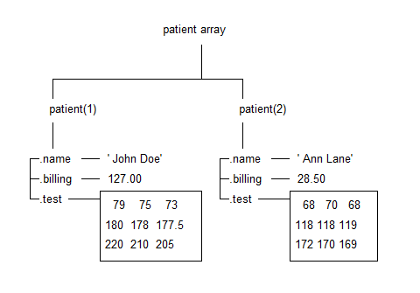
MATLAB Structures- Creating
Add many patients/elements to the array

Slide 32
MATLAB Structures- Create
Code to add another patient to the patient array
patient(2).name = 'Ann Lane';
patient(2).billing = 28.50;
patient(2).test = [68, 70, 68; 118, 118, 119; 172, 170, 169];
Add an incomplete structure element
patient(3).name = 'New Name';

Slide 33
MATLAB Structures- Indexing
Format for indexing:
structureName(field).variableName
Example
amount_due = patient(1).billing
amount_due = 127
name = patient(3).name
patient.name(3) = New Name
Does not overwrite patient.name, name & patient are unique

Slide 34
MATLAB Structures- Indexing
Ex: using a shapefile which MATLAB reads as a structure
%read in the shapefile
%shapefile = shaperead(’fileName.shp','UseGeoCoords',true);
load IntMATLAB1.mat
%turn the shapefile structure into a MATLAB cell
for i=1:length(shapefile)
polyGeo{i}={(shapefile(i).Lon)' (shapefile(i).Lat)'}; %turn the structure of the X Y coordinates into a cell;
shapefileFIPS(i,1)=shapefile(i).FIPS; %turn into a vector
sqMiArea(i,1)=shapefile(i).Area_SQ_Mi;
pop2000(i,1)=shapefile(i).POP2000;
pop2007(i,1)=shapefile(i).POP2007;
end;

Slide 35
More useful information about Structures
MATLAB Struct Function
http://www.mathworks.com/help/techdoc/ref/struct.html
Creating a Structure Array
http://www.mathworks.com/products/matlab/demos.html?file=/products/demos/shipping/matlab/strucdem.html
Overview on Structure
http://www.mathworks.com/help/techdoc/matlab_prog/br04bw6-38.html

Slide 36
Optimizing MATLAB Code

Slide 37
Optimizing MATLAB code
Overview of MATLAB loops and conditional statements
Vectorization
MATLAB profiler
Pre-allocation
Other optimization strategies (15 min)

Slide 38
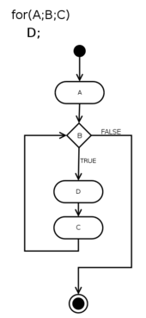
Loop Overview
For loops: execute statements for a specified number of iterations
Syntax
for variable=start:end
statement
end;
Example
for i=1:10
j(i,1)=i+5;
end;
http://www.mathworks.com/help/techdoc/ref/for.html

Slide 39
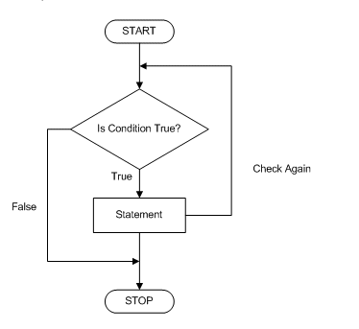
Loop Overview
While loops: execute statements while a condition is true
Syntax
while variable<value
statement
end;
Example
n=1;
nFact=1;
while nFact<1e100
n=n+1;
nFact=nFact*n;
end;
http://www.mathworks.com/help/techdoc/ref/while.html

Slide 40
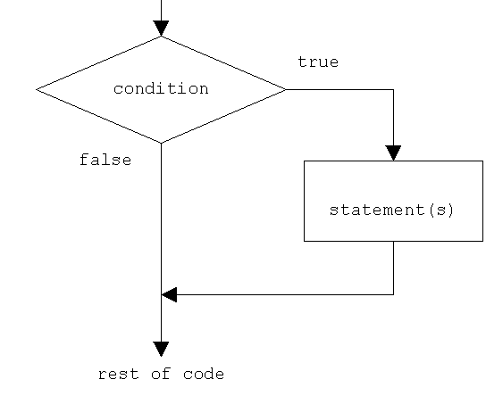
Conditional Statements
if: execute statements if condition is true
Syntax
if expression
statement
elseif expression
statement
else
statement
end;
Example
if n>1
x=2;
elseif n<1
x=3;
else
x=1;
end;
http://www.mathworks.com/help/techdoc/ref/if.html

Slide 41
Conditional Statements
If/else statements
Statement only works on a scalar
For use on a vector greater than 1x1 use a loop
Example
load IntMATLAB1.mat
for i=1:length(Z)
if (Z(i)>0)
x(i,1)=5;
else
x(i,1)=2;
end;
end;

Slide 42
Other Resources for learning about Looping and Conditional Statements
http://www.cyclismo.org/tutorial/matlab/control.html
http://amath.colorado.edu/computing/Matlab/Tutorial/Programming.html

Slide 43
Note: Loops and Conditional Statements
Loops and conditional statements can run extremely slow in MATLAB, it’s best to vectorize to get the best performance

Slide 44
Optimization: Vectorization- what is it?
Performing an operation on an entire array instead of performing an operation on an element of an array
You want to vectorize as much as possible, and use loops as little as possible! It is much more efficient!

Slide 45
Optimization: Vectorization- Example
Example
% calculate a rate for each of the elements
% With a loop:
for i=1:length(Y)
if Y==0 || N==0
rate(i,1)=0;
else
rate(i,1)=Y(i)/N(i);
end;
end;

Slide 46
Optimization: Vectorization- Example
Here is the same process using vectorization
rate=Y./N;
rate(Y==0 | N==0)=0;
Operation is performed nearly instantaneously!
Using loop, the operation takes over 10 min!

Slide 47
Optimization: Vectorization- Example
Calculate the volume of a cone
%diameter values
D = [-0.2 1.0 1.5 3.0 -1.0 4.2 3.1];
%height values
H = [ 2.1 2.4 1.8 2.6 2.6 2.2 1.8];
%the true diameter values (not measured erroneously) have D>=0
D >= 0;
% Perform the vectorized calculation
V = 1/12*pi*(D.^2).*H;
%only keep the good values
%where the diameter >=0
Vgood = V(D>=0);

Slide 48
Optimization: Vectorization- Example
Another example of vectorization
Vectorizing a double FOR loop that creates a matrix by computation:
Double For loop
A = magic(100);
B = pascal(100);
for j = 1:100
for k = 1:100;
X(j,k) = sqrt(A(j,k)) * (B(j,k) - 1);
end
end
Vectorized code
A = magic(100);
B = pascal(100);
X = sqrt(A).*(B-1);

Slide 49
Vectorization within a loop
Example- select elements only the elements from a vector which have the same coordinates as a key
The key data are contained in uniqueCent
The data we are selecting from are in vector chc

Slide 50
Vectorization within a loop
Code
load IntMATLAB1.mat
%pre-allocate the vector
targetCir=zeros(length(chc),1);
for i=1:length(uniqueCent)
targetCir=targetCir+(chc(:,1) == uniqueCent(i,1) & chc(:,2) == uniqueCent(i,2));
end;
%get the values we want
trueXvalHcir=momentsXvalH(targetCir==1,:);

Slide 51
Helpful Information: MATLAB code vectorization
http://www.mathworks.com/support/tech-notes/1100/1109.html
Improving speed of code
http://web.cecs.pdx.edu/~gerry/MATLAB/programming/performance.html#vectorize

Slide 52
Optimization Cautions!
Remember to comment! Vectorized and optimized code is short & can be cryptic
Before optimizing code consider if its worth the effort. If code will be revised or extended, the code will be re-written and time spent optimizing the original is a waste.
Only optimize where necessary, make sure there is a speed bottleneck in the code, otherwise optimization only obfuscates.

Slide 53
MATLAB profiler
A tool that helps determine where the bottlenecks are in a program
Example
function rate=calcRate(Y,N)
%rate=ones(length(Y),1);
for i=1:length(Y)
if (Y(i)==0)
rate(i,1)=0;
else
rate(i,1)=Y(i)./N(i);
end;
end;

Slide 54
MATLAB profiler
Code
profile on
profile clear
calcRate(Y(1:75000),N(1:75000));
profreport('calcRate')

Slide 55
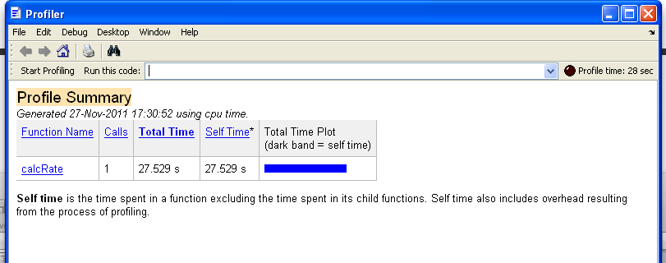
MATLAB profiler
Profiler Result

Slide 56
MATLAB profiler

Slide 57
MATLAB profiler

Slide 58
MATLAB profiler
Solutions:
Pre-allocate the rate vector
Vectorize the if statement

Slide 59
Pre-allocating Arrays
for and while loops grow with each step of the loop and increase the data structures with each step.
Resizing your arrays during loops drastically reduces performance and increases memory use. Thus, increases the time needed to execute a loop
This can be easily fixed with pre-allocation.

Slide 60
Pre-allocating Arrays
Pre-allocating is super easy and it sets aside the maximum amount of space for an array before a loop is performed.
Examples
X=zeros(100);
X=zeros(100,1);
X=zeros(length(Y),1);
X=zeros(size(Y));
X=ones(size(Y));

Slide 61
MATLAB profiler: Pre-allocation!
Calculate rate again, but this time use pre-allocation, remove the comment % on line 2
Example
function rate=calcRate(Y,N)
rate=ones(length(Y),1);
for i=1:length(Y)
if (Y(i)==0)
rate(i,1)=0;
else
rate(i,1)=Y(i)./N(i);
end;
end;

Slide 62
MATLAB profiler
New Profiler Result
Run-time is reduced from 27.529s to 0.017s!
Amazing that only pre-allocating did that!

Slide 63
MATLAB profiler

Slide 64
MATLAB profiler

Slide 65
MATLAB profiler
Solutions:
Vectorize the if statement

Slide 66
MATLAB profiler
Same example with pre-allocation AND Vectorization!
Example
function rate=calcRate1(Y,N)
rate=ones(length(Y),1);
rate=Y./N;
rate(Y==0 | N==0)=0;
end;

Slide 67
MATLAB profiler
New Profiler Result
Run-time is reduced from 27.529s to 0.07s!
Amazing a simple vectorization & pre-allocating did that!

Slide 68
MATLAB profiler

Slide 69
MATLAB profiler
More information on MATLAB profile (from MATLAB
http://www.mathworks.com/help/techdoc/ref/profile.html
Other ways to analyze program performance
http://www.mathworks.com/help/techdoc/matlab_prog/f8-790895.html

Slide 70
Other tips to improve performance
Use the || and && operators in loops rather than the | and & operators
These are the “short circuit” versions which only evaluate the first expression if possible
Use functions as much as possible! They are generally executed quicker in MATLAB!
Load and Save are faster than file I/0 functions such as fread and fwrite

Slide 71
Other tips to improve performance
Avoid having other processes running at the same time you are running your MATLAB code, this frees up your CPU time for MATLAB.
Use parallel computing (where advisable)
Use the UNC compute cluster

Slide 72
Matlab Portal
UNC Chapel Hill Portal Page: https://in.mathworks.com/academia/tah-portal/university-of-north-carolina-chapel-hill-30334062.html

Slide 73
Matlab Portal
Log in with your onyen
You also need to create a Mathworks account (free) if you don’t already have one
Can download copies of Matlab
Tutorials
Online courses
Teaching materials
More

Slide 74
Resources

Slide 75
Resources for Optimization
MATLAB’s Techniques for Improving Performance
http://www.mathworks.com/help/techdoc/matlab_prog/f8-784135.html#f8-793781
MATLAB’s What things can I do to increase the speed and memory performance of my MATLAB code?
http://www.mathworks.com/support/solutions/en/data/1-15NM7/?solution=1-15NM7
Improving the Speed of MATLAB Calculations
http://web.cecs.pdx.edu/~gerry/MATLAB/programming/performance.html

Slide 76
MATLAB’s Memory Management Guide
http://www.mathworks.com/support/tech-notes/1100/1106.html
Contents
Section 1: Why Do I Get 'Out of Memory' Errors in MATLAB?
Section 2: How Do I View Memory Usage In MATLAB?
Section 3: How Do I Defragment and Free the MATLAB Workspace Memory?
Section 4: How Does an Operating System Manage Memory?
Section 5: How Do I Set the Swap Space for My Operating System?

Slide 77
Common error and warning messages
MATLAB’s Commonly Encountered Error and Warning Messages
http://www.mathworks.com/support/tech-notes/1200/1207.html
Out of memory errors
http://www.ee.columbia.edu/~marios/matlab/Memory%20management%20guide%20(1106).pdf

Slide 78
Techniques for Debugging MATLAB m-files
http://www.ee.columbia.edu/~marios/matlab/Techniques%20for%20Debugging%20MATLAB%20M-files%20(1207).pdf

Slide 79
Other great information for MATLAB users
General MATLAB information
http://www.cyclismo.org/tutorial/matlab/
Exporting figures for publication
http://www.ee.columbia.edu/~marios/matlab/Exporting%20Figures%20for%20Publication%20B.pdf

Slide 80
MATLAB on the Cluster

Slide 81
Using MATLAB on the Compute Clusters
What??
UNC provides researchers and graduate students with access to extremely powerful computers to use for their research.
clusters: Longleaf and Dogwood
over 10,000 cores on each

Slide 82
Using MATLAB on the Compute Clusters
Why??
The cluster is an extremely fast and efficient way to run LARGE MATLAB programs (no “Out of Memory” errors!)
You can get more done! Your programs run on the cluster which frees your computer for writing and debugging other programs!!!
Run multiple instances
Where and When??
The cluster is available 24/7 and you can run programs remotely from anywhere with an internet connection!

Slide 83
Interactive job submissions
To bring up the Matlab GUI:
srun -n1 -p interact --x11=first matlab
-singleCompThred
To bring up the Stata GUI:
salloc -n1 -p interact --x11=first xstata-se
To bring up a bash session:
srun -n1 -p interact --x11=first --pty /bin/bash
Note. For the GUI to display locally you will need a X connection to the cluster.

Slide 84
Matlab sample job submission script #1
#!/bin/bash
#SBATCH -p general
#SBATCH -N 1
#SBATCH -t 07-00:00:00
#SBATCH --mem=10g
#SBATCH -n 1
matlab -nodesktop -nosplash -singleCompThread -r mycode -logfile mycode.out
Submits a single cpu Matlab job.
general partition, 7-day runtime limit, 10 GB memory limit.

Slide 85
Matlab sample job submission script #2
#!/bin/bash
#SBATCH -p general
#SBATCH -N 1
#SBATCH -t 02:00:00
#SBATCH --mem=3g
#SBATCH -n 24
matlab -nodesktop -nosplash -singleCompThread -r mycode -logfile mycode.out
Submits a 24-core, single node Matlab job (i.e. using Matlab’s Parallel Computing Toolbox).
general partition, 2-hour runtime limit, 3 GB memory limit.

Slide 86
Matlab sample job submission script #3
#!/bin/bash
#SBATCH -p gpu
#SBATCH -N 1
#SBATCH -t 30
#SBATCH --qos gpu_access
#SBATCH --gres=gpu:1
#SBATCH -n 1
matlab -nodesktop -nosplash -singleCompThread -r mycode -logfile mycode.out
Submits a single-gpu Matlab job.
gpu partition, 30 minute runtime limit.

Slide 87
Matlab sample job submission script #4
#!/bin/bash
#SBATCH -p bigmem
#SBATCH -N 1
#SBATCH -t 7-
#SBATCH --qos bigmem_access
#SBATCH -n 1
#SBATCH --mem=500g
matlab -nodesktop -nosplash -singleCompThread -r mycode -logfile mycode.out
Submits a single-cpu, single node large memory Matlab job.
bigmem partition, 7-day runtime limit, 500 GB memory limit

Slide 88
Open OnDemand
To get started, in your web browser, navigate to:
https://ondemand.rc.unc.edu
For more information see https://help.rc.unc.edu/ondemand/
Access Longleaf cluster through a browser and can launch interactive GUI’s from the OnDemand server
GUI performance should be better than over X windows

Slide 89
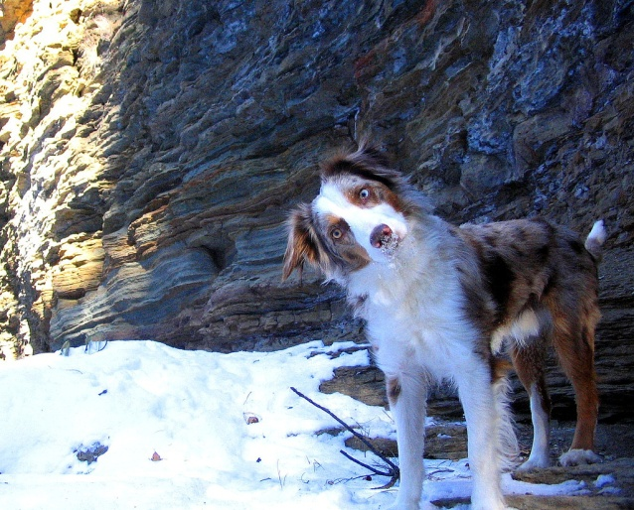
Questions and Comments?
For assistance with MATLAB, please contact the Research Computing Group:
Email: research@unc.edu
Phone: 919-962-HELP
Submit help ticket at http://help.unc.edu

