Slide 1

OpenMP
Mark Reed
UNC Research Computing
markreed@unc.edu

Slide 2

Logistics
Course Format
Lab Exercises
Breaks
UNC Research Computing
  http://its.unc.edu/research

Slide 3



Course Overview
Introduction
  Objectives, History, Overview, Motivation
Getting Our Feet Wet
  Memory Architectures, Models (programming, execution, memory, …), compiling and running
Diving In
  Control constructs, worksharing, data scoping, synchronization, runtime control

Slide 4
OpenMP Introduction

Slide 5

Course Objectives
Introduction to the OpenMP standard
Cover all the basic constructs
After completion of this course users should be ready to begin parallelizing their application using OpenMP

Slide 6
Why choose OpenMP ?
Portable
  standardized for shared memory architectures
Simple and Quick
  incremental parallelization
  supports both fine grained and coarse grained parallelism
  scalable algorithms without message passing
Compact API
  simple and limited set of directives

Slide 7
In a Nutshell
Portable, Shared Memory Multiprocessing API
  Multi-vendor support
  Multi-OS support (Unixes, Windows, Mac)
Standardizes fine grained (loop) parallelism
Also supports coarse grained algorithms
The MP in OpenMP is for multi-processing
Don’t confuse OpenMP with Open MPI! :)

Slide 8
Version History
First
  Fortran 1.0 was released in October 1997
  C/C++ 1.0 was approved in November 1998
Recent
  OpenMP 5.0 API released November 2018
  5 year major release cycle
Current – Still Active
  OpenMP 5.2 planned release November 2021
  OpenMP 6.0 scheduled November 2023

Slide 9
A First Peek: Simple OpenMP Example
Consider arrays a, b, c and this simple loop:
Fortran
C/C++
!$OMP parallel do
!$OMP& shared (a, b, c)
do i=1,n
a(i) = b(i) + c(i)
enddo
!$OMP end parallel do
#pragma omp parallel for\
shared (a,b,c)
for (i=0; i<n; i++) {
a(i) = b(i) + c(i)
}

Slide 10
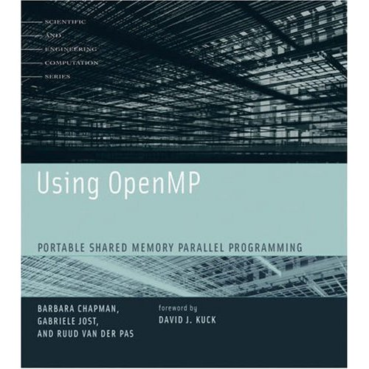
References
See online tutorial at www.openmp.org
OpenMP Tutorial from SC98
  Bob Kuhn, Kuck & Associates, Inc.
  Tim Mattson, Intel Corp.
  Ramesh Menon, SGI
SGI course materials
“Using OpenMP” book
  Chapman, Jost, and Van Der Past
Blaise Barney LLNL tutorial
  https://computing.llnl.gov/tutorials/openMP/

Slide 11

Getting our feet wet

Slide 12
Memory Types
Shared
CPU
CPU
Memory
Memory
CPU
CPU
CPU
CPU
Memory
Memory
Memory
CPU
Distributed
CPU

Slide 13
Clustered SMPs
Cluster Interconnect Network
Memory
Memory
Memory
Multi-socket and/or Multi-core

Slide 14
Distributed vs. Shared Memory
Shared - all processors share a global pool of memory
  simpler to program
  bus contention leads to poor scalability
Distributed - each processor physically has it’s own (private) memory associated with it
  scales well
  memory management is more difficult

Slide 15


Models, models, models …
No Not These!
Nor These Either!
We want programming models, execution models, communication models and memory models!

Slide 16
OpenMP - User Interface Model
Shared Memory with thread based parallelism
Not a new language
Compiler directives, library calls and environment variables extend the base language
  f77, f90, f95, C, C++
Not automatic parallelization
  user explicitly specifies parallel execution
  compiler does not ignore user directives even if wrong

Slide 17
What is a thread?
A thread is an independent instruction stream, thus allowing concurrent operation
threads tend to share state and memory information and may have some (usually small) private data
Similar (but distinct) from processes. Threads are usually lighter weight allowing faster context switching
in OpenMP one usually wants no more than one thread per core

Slide 18
Execution Model
OpenMP program starts single threaded
To create additional threads, user starts a parallel region
  additional threads are launched to create a team
  original (master) thread is part of the team
  threads “go away” at the end of the parallel region: usually sleep or spin
Repeat parallel regions as necessary
  Fork-join model

Slide 19
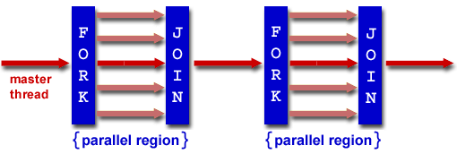
Fork – Join Model
Threads
…Time …. Progress through code …

Slide 20
Communicating Between Threads
Shared Memory Model
  threads read and write shared variables
    no need for explicit message passing
  use synchronization to protect against race conditions
  change storage attributes for minimizing synchronization and improving cache reuse

Slide 21
Storage Model – Data Scoping
Shared memory programming model: variables are shared by default
Global variables are SHARED among threads
  Fortran: COMMON blocks, SAVE variables, MODULE variables
  C: file scope variables, static
Private Variables:
  exist only within the new scope, i.e. they are uninitialized and undefined outside the data scope
  loop index variables
  Stack variables in sub-programs called from parallel regions

Slide 22
Putting the models together
- Summary
Model
Implementation
Programming
Execution
Memory
Communication
Put directives in code
create parallel regions, Fork-Join
Data scope is private or shared
Only shared variables carry information between threads

Slide 23

Creating Parallel Regions
Only one way to create threads in OpenMP API:
Fortran:
  !$OMP parallel
  < code to be executed in parallel >
  !$OMP end parallel
C
  #pragma omp parallel
  {
  code to be executed by each thread
  }

Slide 24
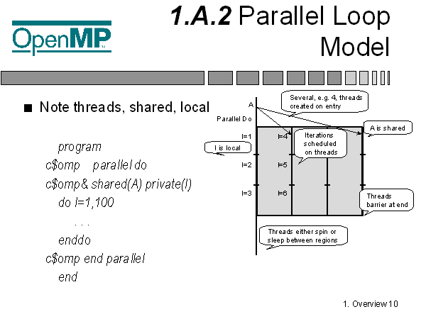

Slide 25
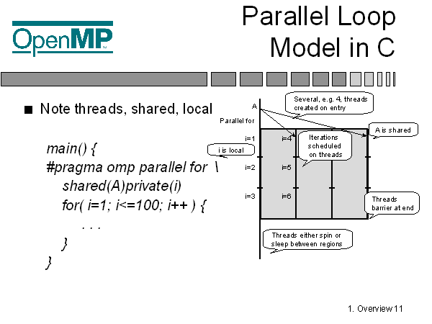

Slide 26
Comparison of Programming Models
Feature | Open MP | MPI
Portable | yes | yes
Scalable | less so | yes
Incremental Parallelization | yes | no
Fortran/C/C++ Bindings | yes | yes
High Level | yes | mid level

Slide 27



Compiling
Intel (icc, ifort, icpc)
  -qopenmp (-openmp is now deprecated)
PGI (pgcc, pgf90, pgCC, …)
  -mp
GNU (gcc, gfortran, g++)
  -fopenmp
  need version 4.2 or later
  g95 was based on GCC but branched off
    I don’t think it has Open MP support

Slide 28
Compilers
No specific Fortran 90 or C++ features are required by the OpenMP specification
Most compilers support OpenMP, see compiler documentation for the appropriate compiler flag to set for other compilers, e.g. IBM, Cray, …

Slide 29
Compiler Directives
C Pragmas
C pragmas are case sensitive
Use curly braces, {}, to enclose parallel regions
Long directive lines can be "continued" by escaping the newline character with a backslash ("\") at the end of a directive line.
Fortran
!$OMP, c$OMP, *$OMP – fixed format
!$OMP – free format
Comments may not appear on the same line
continue w/ &, e.g. !$OMP&

Slide 30
Specifying threads
The simplest way to specify the number of threads used on a parallel region is to set the environment variable (in the shell where the program is executing)
  OMP_NUM_THREADS
For example, in csh/tcsh
  setenv OMP_NUM_THREADS 4
in bash
  export OMP_NUM_THREADS=4
Later we will cover other ways to specify this

Slide 31
OpenMP – Diving In

Slide 32
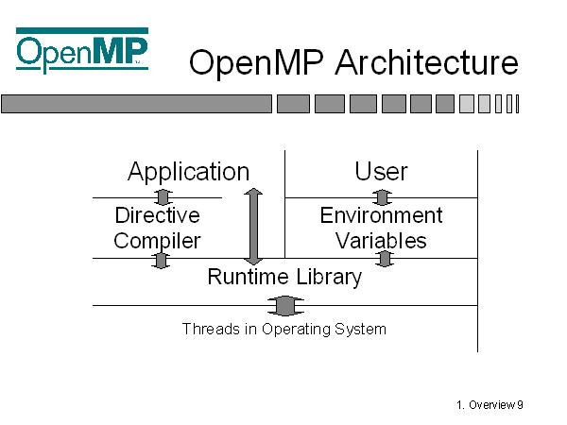

Slide 33

OpenMP Language Features
Compiler Directives – 3 categories
  Control Constructs
    parallel regions, distribute work
  Data Scoping for Control Constructs
    control shared and private attributes
  Synchronization
    barriers, atomic, …
Runtime Control
  Environment Variables
    OMP_NUM_THREADS
  Library Calls
    OMP_SET_NUM_THREADS(…)

Slide 34
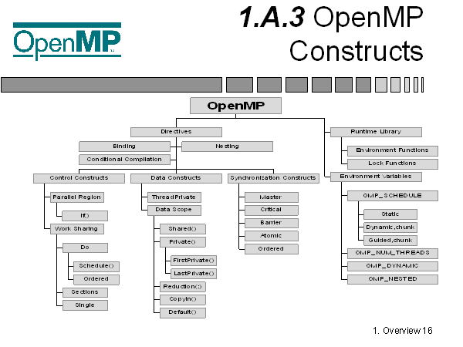
Maybe a little outdated but ...

Slide 35
Parallel Construct
Fortran
  !$OMP parallel [clause[[,] clause]… ]
  !$OMP end parallel
C/C++
  #pragma omp parallel [clause[[,] clause]… ]
  {structured block}

Slide 36
Supported Clauses for the Parallel Construct
Valid Clauses:
  if (expression)
  num_threads (integer expression)
  private (list)
  firstprivate (list)
  shared (list)
  default (none|shared|private *fortran only*)
  copyin (list)
  reduction (operator: list)

Slide 37
Data Scoping Basics
Shared
  this is the default
  variable exists just once in memory, all threads access it
Private
  each thread has a private copy of the variable
    even the original is replaced by a private copy
  copies are independent of one another, no information is shared
  variable exists only within the scope it is defined

Slide 38

Worksharing Directives
Loop (do/for)
Sections
Single
Workshare (Fortran only)
Task

Slide 39
Loop Worksharing directive
Loop directives:
  !$OMP DO [clause[[,] clause]… ] Fortran do
  [!$OMP END DO [NOWAIT]] optional end
  #pragma omp for [clause[[,] clause]… ] C/C++ for
Clauses:
  PRIVATE(list)
  FIRSTPRIVATE(list)
  LASTPRIVATE(list)
  REDUCTION({op|intrinsic}:list})
  ORDERED
  SCHEDULE(TYPE[, chunk_size])
  NOWAIT

Slide 40
All Worksharing Directives
Divide work in enclosed region among threads
Rules:
  must be enclosed in a parallel region
  does not launch new threads
  no implied barrier on entry
  implied barrier upon exit
  must be encountered by all threads on team or none

Slide 41
Loop Constructs
Note that many of the clauses are the same as the clauses for the parallel region. Others are not, e.g. shared must clearly be specified before a parallel region.
Because the use of parallel followed by a loop construct is so common, this shorthand notation is often used (note: directive should be followed immediately by the loop)
  !$OMP parallel do …
  !$OMP end parallel do
  #pragma parallel for …

Slide 42
Shared Clause
Declares variables in the list to be shared among all threads in the team.
Variable exists in only 1 memory location and all threads can read or write to that address.
It is the user’s responsibility to ensure that this is accessed correctly, e.g. avoid race conditions
Most variables are shared by default (a notable exception, loop indices)

Slide 43
Private Clause
Private, uninitialized copy is created for each thread
Private copy is not storage associated with the original
program wrong
I = 10
!$OMP parallel private(I)
I = I + 1
!$OMP end parallel
print *, I
Uninitialized!
Undefined!

Slide 44
Firstprivate Clause
Firstprivate, initializes each private copy with the original
program correct
I = 10
!$OMP parallel firstprivate(I)
I = I + 1
!$OMP end parallel
Initialized!

Slide 45
LASTPRIVATE clause
Useful when loop index is live out
  Recall that if you use PRIVATE the loop index becomes undefined
!$OMP PARALLEL
!$OMP DO LASTPRIVATE(i)
do i=1,N-1
a(i)= b(i+1)
enddo
a(i) = b(0)
!$OMP END PARALLEL
do i=1,N-1
a(i)= b(i+1)
enddo
a(i) = b(0)
In Sequential
case
i=N

Slide 46
Changing the default
List the variables in one of the following clauses
  SHARED
  PRIVATE
  FIRSTPRIVATE, LASTPRIVATE
  DEFAULT
  THREADPRIVATE, COPYIN

Slide 47
Default Clause
Note that the default storage attribute is DEFAULT (SHARED)
To change default: DEFAULT(PRIVATE)
  each variable in static extent of the parallel region is made private as if specified by a private clause
  mostly saves typing
DEFAULT(none): no default for variables in static extent. Must list storage attribute for each variable in static extent
USE THIS!

Slide 48
NOWAIT clause
NOWAIT clause
By default loop
index is PRIVATE
!$OMP PARALLEL
!$OMP DO
do i=1,n
a(i)= cos(a(i))
enddo
!$OMP END DO
!$OMP DO
do i=1,n
b(i)=a(i)+b(i)
enddo
!$OMP END DO
!$OMP END PARALLEL
!$OMP PARALLEL
!$OMP DO
do i=1,n
a(i)= cos(a(i))
enddo
!$OMP END DO NOWAIT
!$OMP DO
do i=1,n
b(i)=a(i)+b(i)
enddo
!$OMP END DO
Implied
BARRIER
No
BARRIER

Slide 49
Reductions
Assume no reduction clause
Wrong!
do i=1,N
X = X + a(i)
enddo
!$OMP PARALLEL DO SHARED(X)
do i=1,N
X = X + a(i)
enddo
!$OMP END PARALLEL DO
Sum Reduction
!$OMP PARALLEL DO SHARED(X)
do i=1,N
!$OMP CRITICAL
X = X + a(i)
!$OMP END CRITICAL
enddo
!$OMP END PARALLEL DO
What’s wrong?

Slide 50
REDUCTION clause
Parallel reduction operators
  Most operators and intrinsics are supported
  Fortran: +, *, -, .AND. , .OR., MAX, MIN, …
  C/C++ : +,*,-, &, |, ^, &&, ||
Only scalar variables allowed
!$OMP PARALLEL DO REDUCTION(+:X)
do i=1,N
X = X + a(i)
enddo
!$OMP END PARALLEL DO
do i=1,N
X = X + a(i)
enddo

Slide 51
Ordered clause
Executes in the same order as sequential code
Parallelizes cases where ordering needed
do i=1,N
call find(i,norm)
print*, i,norm
enddo
!$OMP PARALLEL DO ORDERED PRIVATE(norm)
do i=1,N
call find(i,norm)
!$OMP ORDERED
print*, i,norm
!$OMP END ORDERED
enddo
!$OMP END PARALLEL DO
1 0.45
2 0.86
3 0.65

Slide 52
Schedule clause
the Schedule clause controls how the iterations of the loop are assigned to threads
There is always a trade off between load balance and overhead
Always start with static and go to more complex schemes as load balance requires

Slide 53
The 4 choices for schedule clauses
static: Each thread is given a “chunk” of iterations in a round robin order
  Least overhead - determined statically
dynamic: Each thread is given “chunk” iterations at a time; more chunks distributed as threads finish
  Good for load balancing
guided: Similar to dynamic, but chunk size is reduced exponentially
runtime: User chooses at runtime using environment variable (note no space before chunk value)
  setenv OMP_SCHEDULE “dynamic,4”

Slide 54
Performance Impact of Schedule
Static vs. Dynamic across multiple do loops
  In static, iterations of the do loop executed by the same thread in both loops
  If data is small enough, may be still in cache, good performance
Effect of chunk size
  Chunk size of 1 may result in multiple threads writing to the same cache line
  Cache thrashing, bad performance
!$OMP DO SCHEDULE(STATIC)
do i=1,4
!$OMP DO SCHEDULE(STATIC)
do i=1,4
a(1,1) a(1,2)
a(2,1) a(2,2)
a(3,1) a(3,2)
a(4,1) a(4,2)

Slide 55

Synchronization
Barrier Synchronization
Atomic Update
Critical Section
Master Section
Ordered Region
Flush

Slide 56

Barrier Synchronization
Syntax:
  !$OMP barrier
  #pragma omp barrier
Threads wait until all threads reach this point
implicit barrier at the end of each parallel region

Slide 57
Atomic Update
Specifies a specific memory location can only be updated atomically, i.e. 1 thread at a time
Optimization of mutual exclusion for certain cases (i.e. a single statement CRITICAL section)
  applies only to the statement immediately following the directive
  enables fast implementation on some HW
Directive:
  !$OMP atomic
  #pragma atomic

Slide 58
Mutual Exclusion - Critical Sections
Critical Section
  only 1 thread executes at a time, others block
  can be named (names are global entities and must not conflict with subroutine or common block names)
  It is good practice to name them
  all unnamed sections are treated as the same region
Directives:
  !$OMP CRITICAL [name]
  !$OMP END CRITICAL [name]
  #pragma omp critical [name]

Slide 59
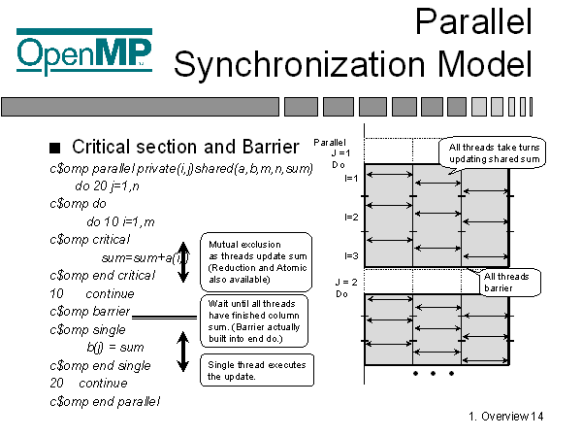

Slide 60
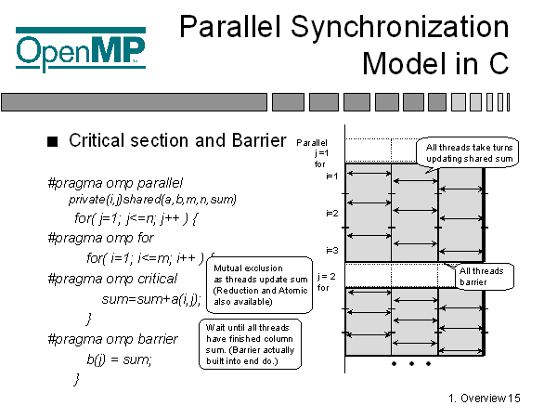

Slide 61
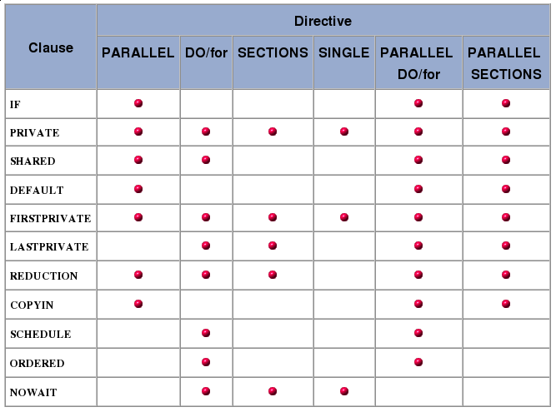
Clauses by Directives Table
https://computing.llnl.gov/tutorials/openMP
Notes:
I put a white text box over the shared clause for loop directive b/c this graphic was wrong., there is no shared on loop directives.

Slide 62
Sub-programs in parallel regions
Sub-programs can be called from parallel regions
static extent is code contained lexically
dynamic extent includes static extent + the statements in the call tree
the called sub-program can contain OpenMP directives to control the parallel region
  directives in dynamic extent but not in static extent are called Orphan directives

Slide 63
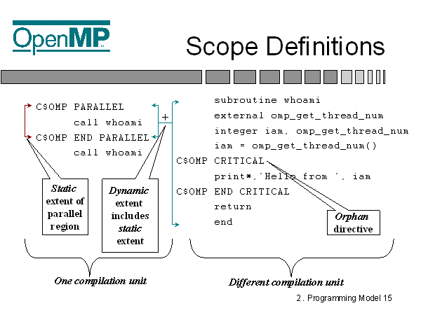

Slide 64
Threadprivate
Makes global data private to a thread
  Fortran: COMMON blocks
  C: file scope and static variables
Different from making them PRIVATE
  with PRIVATE global scope is lost
  THREADPRIVATE preserves global scope for each thread
Threadprivate variables can be initialized using COPYIN

Slide 65
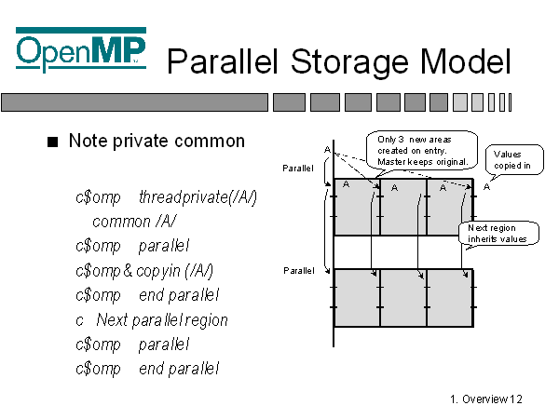

Slide 66
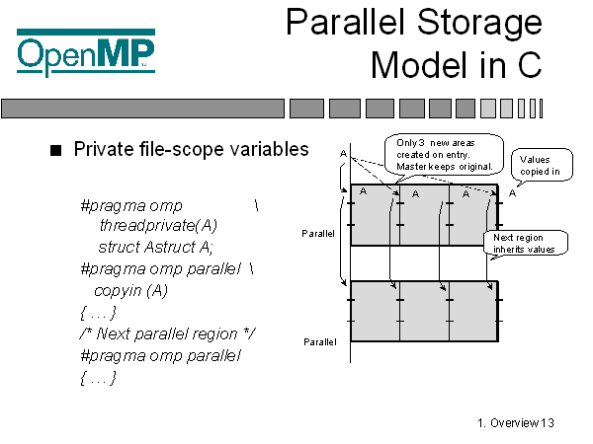

Slide 67
Environment Variables
These are set outside the program and control execution of the parallel code
Prior to OpenMP 3.0 there were only 4
  all are uppercase
  values are case insensitive
OpenMP 3.0 adds four new ones
Specific compilers may have extensions that add other values
  e.g. KMP* for Intel and GOMP* for GNU

Slide 68
Environment Variables
OMP_NUM_THREADS – set maximum number of threads
  integer value
OMP_SCHEDULE – determines how iterations are scheduled when a schedule clause is set to “runtime”
  “type[, chunk]”
OMP_DYNAMIC – dynamic adjustment of threads for parallel regions
  true or false
OMP_NESTED – nested parallelism
  true or false

Slide 69
Run-time Library Routines
There are 17 different library routines, we will cover some of them now
omp_get_thread_num()
  Returns the thread number (w/i the team) of the calling thread. Numbering starts w/ 0.
integer function omp_get_thread_num()
#include <omp.h>
int omp_get_thread_num()

Slide 70
Run-time Library: Timing
There are 2 portable timing routines
omp_get_wtime
  portable wall clock timer returns a double precision value that is number of elapsed seconds from some point in the past
  gives time per thread - possibly not globally consistent
  difference 2 times to get elapsed time in code
omp_get_wtick
  time between ticks in seconds

Slide 71
Run-time Library: Timing
double precision function omp_get_wtime()
include <omp.h>
double omp_get_wtime()
double precision function omp_get_wtick()
include <omp.h>
double omp_get_wtick()

Slide 72
Run-time Library Routines
omp_set_num_threads(integer)
  Set the number of threads to use in next parallel region.
  can only be called from serial portion of code
  if dynamic threads are enabled, this is the maximum number allowed, if they are disabled then this is the exact number used
omp_get_num_threads
  returns number of threads currently in the team
  returns 1 for serial (or serialized nested) portion of code

Slide 73
Run-time Library Routines Cont.
omp_get_max_threads
  returns maximum value that can be returned by a call to omp_get_num_threads
  generally reflects the value as set by OMP_NUM_THREADS env var or the omp_set_num_threads library routine
  can be called from serial or parallel region
omp_get_thread_num
  returns thread number. Master is 0. Thread numbers are contiguous and unique.

Slide 74
Run-time Library Routines Cont.
omp_get_num_procs
  returns number of processors available
omp_in_parallel
  returns a logical (fortran) or int (C/C++) value indicating if executing in a parallel region

Slide 75
Run-time Library Routines Cont.
omp_set_dynamic (logical(fortran) or int(C))
  set dynamic adjustment of threads by the run time system
  must be called from serial region
  takes precedence over the environment variable
  default setting is implementation dependent
omp_get_dynamic
  used to determine of dynamic thread adjustment is enabled
  returns logical (fortran) or int (C/C++)

Slide 76
Run-time Library Routines Cont.
omp_set_nested (logical(fortran) or int(C))
  enable nested parallelism
  default is disabled
  overrides environment variable OMP_NESTED
omp_get_nested
  determine if nested parallelism is enabled
There are also 5 lock functions which will not be covered here.

Slide 77

How many threads?
Order of precedence:
  if clause
  num_threads clause
  omp_set_num_threads function call
  OMP_NUM_THREADS environment variable
  implementation default (usually the number of cores on a node)

Slide 78
Weather Forecasting Example 1
!$OMP PARALLEL DO
!$OMP& default(shared)
!$OMP& private (i,k,l)
do 50 k=1,nztop
do 40 i=1,nx
cWRM remove dependency
cWRM l = l+1
l=(k-1)*nx+i
dcdx(l)=(ux(l)+um(k))
*dcdx(l)+q(l)
40 continue
50 continue
!$OMP end parallel do
Many parallel loops simply use parallel do
autoparallelize when possible (usually doesn’t work)
simplify code by removing unneeded dependencies
Default (shared) simplifies shared list but Default (none) is recommended.

Slide 79
Weather - Example 2a
cmass = 0.0
!$OMP parallel default (shared)
!$OMP& private(i,j,k,vd,help,..)
!$OMP& reduction(+:cmass)
do 40 j=1,ny
!$OMP do
do 50 i=1,nx
vd = vdep(i,j)
do 10 k=1,nz
help(k) = c(i,j,k)
10 continue
Parallel region makes nested do more efficient
  avoid entering and exiting parallel mode
Reduction clause generates parallel summing

Slide 80
Weather - Example 2a Continued
…
do 30 k=1,nz
c(i,j,k)=help(k)
cmass=cmass+help(k)
30 continue
50 continue
!$OMP end do
40 continue
!$omp end parallel
Reduction means
  each thread gets private cmass
  private cmass added at end of parallel region
  serial code unchanged

Slide 81
Weather Example - 3
!$OMP parallel
do 40 j=1,ny
!$OMP do schedule(dynamic)
do30 i=1,nx
if(ish.eq.1)then
call upade(…)
else
call ucrank(…)
endif
30 continue
40 continue
!$OMP end parallel
Schedule(dynamic) for load balancing

Slide 82
Weather Example - 4
!$OMP parallel !don’t it slows down
!$OMP& default(shared)
!$OMP& private(i)
do 30 I=1,loop
y2=f2(I)
f2(i)=f0(i) + 2.0*delta*f1(i)
f0(i)=y2
30 continue
!$OMP end parallel do
Don’t over parallelize small loops
Use if(<condition>) clause when loop is sometimes big, other times small

Slide 83
Weather Example - 5
!$OMP parallel do schedule(dynamic)
!$OMP& shared(…)
!$OMP& private(help,…)
!$OMP& firstprivate (savex,savey)
do 30 i=1,nztop
…
30 continue
!$OMP end parallel do
First private (…) initializes private variables

Slide 84
Sample batch script
sbatch openmp.sbatch
#!/bin/sh
#SBATCH -N 1
#SBATCH --ntasks=8
#BATCH --job-name="OPENMP"
#SBATCH --mem=2G
#SBATCH -p general
#SBATCH --time=00:05:00
export OMP_NUM_THREADS=$SLURM_NTASKS
parapi

Slide 85

Questions?

