Slide 1
Computing with Accelerators: Overview ITS Research Computing
Mark Reed

Slide 2
Objectives
Learn why computing with accelerators is important
Understand accelerator hardware
Learn what types of problems are suitable for accelerators
Survey the programming models available
Know how to access accelerators for your own use

Slide 3
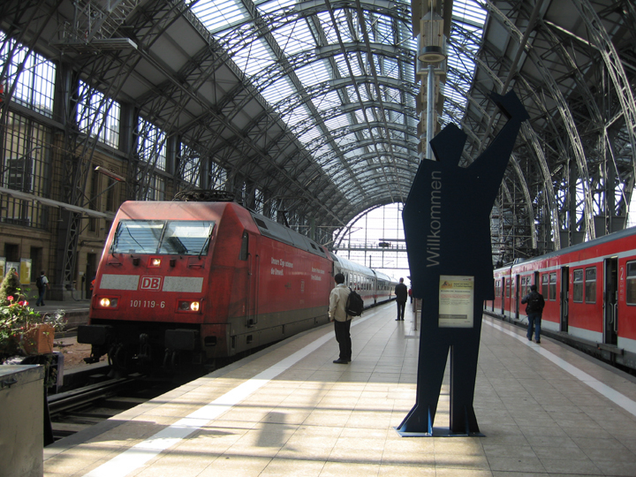
Logistics
Course Format – lecture and discussion
Breaks
Facilities
UNC Research Computing
http://its.unc.edu/research

Slide 4
Agenda
The answers to all your questions: What? Why? Where? How? When? Who? Which?
What are accelerators?
Why accelerators?
Which programming models are
available?
When is it appropriate?
Who should be using them?
Where can I ran the jobs?
How do I run jobs?

Slide 5
What is a computational accelerator?

Slide 6
… by any other name still as sweet
Related Terms:
Computational accelerator, hardware accelerator, offload engine, co-processor, heterogeneous computing
Examples of (of what we mean) by accelerators
GPU
MIC
FPGA
But not vector instruction units, SSD, AVX

Slide 7
Why Accelerators?
What’s wrong with plain old CPU’s?
The heat problem
Processor speed has plateaued
Green computing: Flops/Watt
Future looks like some form of heterogeneous computing
Your choices, multi-core or many-core :)

Slide 8
The Heat Problem
Additionally From: Jack Dongarra, UT

Slide 9
More Parallelism
Additionally From: Jack Dongarra, UT

Slide 10
Free Lunch is Over
From
“The Free Lunch Is Over A Fundamental Turn Toward Concurrency in Software”
By Herb Sutter
Intel CPU Introductions

Slide 11
Accelerator Hardware
Generally speaking you trade off clock speed for lower power
Processing cores will be low power, slower cpu (~ 1 GHz)
Lots of cores, high parallelism (hundreds of threads)
Memory on the accelerator is less (e.g. 6 GB)
Data transfer is over PCIe and is slow and therefore expensive computationally

Slide 12
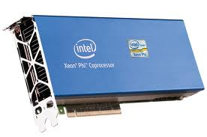
Programming Models
CUDA
OpenACC
PGI Directives, HMPP Directives
OpenCL
Xeon Phi

Slide 13
Credit: “A comparison of Programming Models” by Jeff Larkin, Nvidia (formerly with Cray)

Slide 14
Credit: “A comparison of Programming Models” by Jeff Larkin, Nvidia (formerly with Cray)

Slide 15
Credit: “A comparison of Programming Models” by Jeff Larkin, Nvidia (formerly with Cray)

Slide 16
Credit: “A comparison of Programming Models” by Jeff Larkin, Nvidia (formerly with Cray)

Slide 17
OpenACC
Directives based HPC parallel programming model
Fortran comment statements and C/C++ pragmas
Performance and portability
OpenACC compilers can manage data movement between CPU host memory and a separate memory on the accelerator
Compiler availability:
CAPS entreprise, Cray, and The Portland Group (PGI)
(coming go GNU)
Language support: Fortran, C, C++ (some)
OpenMP specification will include this

Slide 18
OpenACC Trivial Example
Fortran
!$acc parallel loop reduction(+:pi) do i=0, n-1 t = (i+0.5_8)/n pi = pi + 4.0/(1.0 + t*t) end do !$acc end parallel loop
C
#pragma acc parallel loop reduction(+:pi) for (i=0; i<N; i++) { double t= (double)((i+0.5)/N); pi +=4.0/(1.0+t*t); }

Slide 19
OpenCL
Open Computing Language
OpenCL lets Programmers write a single portable program that uses ALL resources in the heterogeneous platform (includes GPU, FPGA, DSP, CPU, Xeon Phi, and others)
To use OpenCL, you must
Define the platform
Execute code on the platform
Move data around in memory
Write (and build) programs

Slide 20
Intel Xeon Phi
Credit: Bill Barth, TACC

Slide 27
What types of problems work well?
GPU strength is flops and memory bandwidth
Lots of parallelism
Little branching
Conversely, these problems do not work well
Most graph algorithms (too unpredictable, especially in memory-space)
Sparse linear algebra (but bad on CPU too)
Small signal processing problems (FFTs smaller than 1000 points, for example)
Search
Sort

Slide 28
GPU Applications
See http://www.nvidia.com/content/tesla/pdf/gpu-accelerated-applications-for-hpc.pdf
16 Page guide of ported applications including computational chemistry (MD and QC), materials science, bioinformatics, physics, weather and climate forecasting
Or see http://www.nvidia.com/object/gpu-applications.html for a searchable guide

Slide 29
CUDA Pros and Cons
Best possible performance
Most control over memory hierarchy, data movement, and synchronization
Limited portability
Steep learning curve
Must maintain multiple code paths

Slide 30
OpenACC Pros and Cons
Possible to achieve CUDA level performance
Directives to control data movement but actual performance may depend on maturity of the compiler
Incremental development is possible
Directives based so can use a single code base
Compiler availability is limited
Not as low level as CUDA or OpenCL
See http://www.prace-project.eu/IMG/pdf/D9-2-2_1ip.pdf for a detailed report

Slide 31
OpenCL Pros and Cons
Low level so can get good performance
Generally not as good as CUDA
Portable in both hardware and OS
OpenCL is an API for C
Fortran programs can’t access it directly
The OpenCL API is verbose and there are a lot of steps to run even a basic program
There is a large body of available code

Slide 32
Where can I run jobs?
If you have a work station/laptop with an Nvidia card you can run it on that
Supports Nvidia CUDA developer toolkit
Killdevil cluster on campus
Xsede resources
Keeneland, GPGPU cluster at Ga. Tech
Stampede, Xeon PHI cluster at TACC (also some GPUs)

Slide 33
Killdevil GPU Hardware
Nvidia M2070 – Tesla GPU, Fermi microarchitecture
2 GPUs/CPU
1 rack of GPU, all c-186-* nodes
32 nodes, 64 GPU
448 threads, 1.5 GHz clock
6 GB memory
PCIe gen 2 bus
Does DP and SP

Slide 34
Running on Killdevil
https://help.unc.edu/help/computing-with-the-gpu-nodes-on-killdevil/
Add the module
module add cuda/5.5.22
module initadd cuda/5.5.22
Submit to the gpu nodes
-q gpu –a gpuexcl_t
Tools
nvcc – CUDA compiler
computeprof – CUDA visual profiler
cuda-gdb – debugger

Slide 35
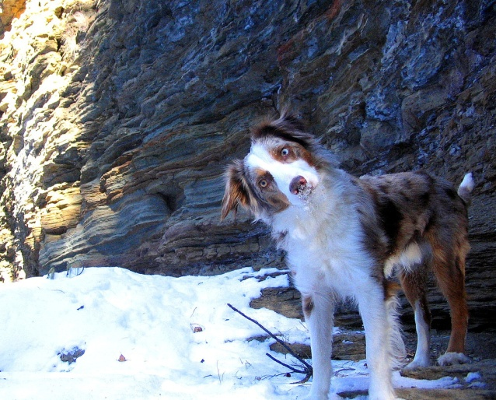
Questions and Comments?
For assistance please contact the Research Computing Group:
Email: research@unc.edu
Phone: 919-962-HELP
Submit help ticket at http://help.unc.edu

