Slide 1
MPI Short Course
Instructor: Mark Reed
Dept: Research Computing
Email: markreed@unc.edu

Slide 2
Overview
Parallel Programming Overview
The Message Passing Model
MPI – The Basics
MPI PTP Calls
MPI Collective Calls

Slide 3
Parallel Computing Overview

Slide 4
Course Objectives
Introduce message passing and parallel processing.
Learn the message passing model and how to implement this model through MPI.
Become familiar with the basic Point-to-point (PTP) and collective operation routines in MPI
Write your own parallel applications, for a Linux cluster, a large shared memory machine, or any other heterogeneous or homogeneous environment using basic MPI routines.

Slide 5
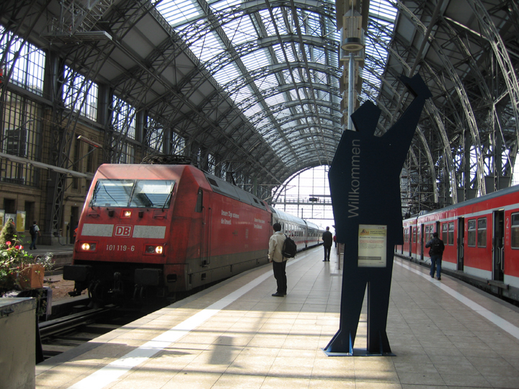
Logistics
Course Format
Lab Exercises
Lab Accounts
UNC – RC Resources
http://its.unc.edu/research
Breaks

Slide 6
Intro: Overviews of PP and MP
Parallel Processing
What and Why of PP
H/W Issues
S/W Issues
Terms and Concepts
Message Passing
Message Passing Models
Terms and Concerns
Configuration Control
Beware! Amdahl’s Law

Slide 7
What is parallelism?
An approach to performing large, complex and/or lengthy tasks that involves concurrent operation on multiple processors or cores.

Slide 8
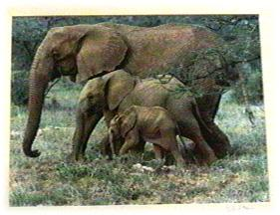
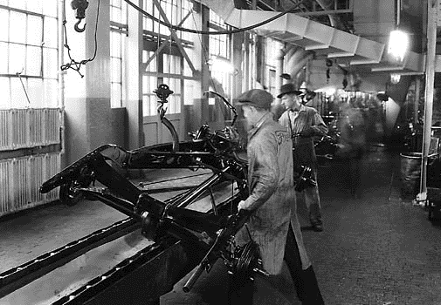
Why perform tasks in parallel?
Size
Functionality
Speed
Task Parallelism
Marion Jones
Nested Elephants

Slide 9
Hardware Issues
Distributed memory vs. shared memory
hierarchal memory
Network topology
SIMD, MIMD, SISD,etc.
SPMD special case of MIMD

Slide 10
Memory Types
Shared
CPU
CPU
Memory
Memory
CPU
CPU
CPU
CPU
Memory
Memory
Memory
CPU
Distributed
CPU

Slide 11
Clustered SMPs
Cluster Interconnect Network
Memory
Memory
Memory
Multi-socket and/or Multi-core

Slide 12
Distributed vs. Shared Memory
Shared - all processors share a global pool of memory
simpler to program
bus contention leads to poor scalability
Distributed - each processor physically has it’s own (private) memory associated with it
scales well
memory management is more difficult

Slide 13
Memory Access Time
Size
Hierarchical access to memory (many possibilities)
level 1 instruction cache level 1 data cache
secondary cache, tertiary cache, …
DRAM
off chip
off node, …
increasing
Decreasing
Delay

Slide 14
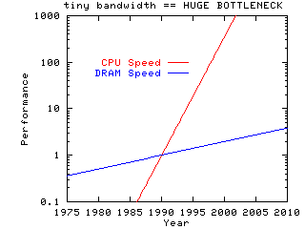
The Memory Problem
Processor speed is outpacing memory speed
Designers must rely on many “tricks” to offset this
Hierarchal memory
Streaming data
Out of order execution
Superscalar architecture
Branch Prediction
Compiler optimizations
STREAM benchmark

Slide 15
The Heat Problem
Additionally From: Jack Dongarra, UT

Slide 16
More Parallelism
Additionally From: Jack Dongarra, UT

Slide 17
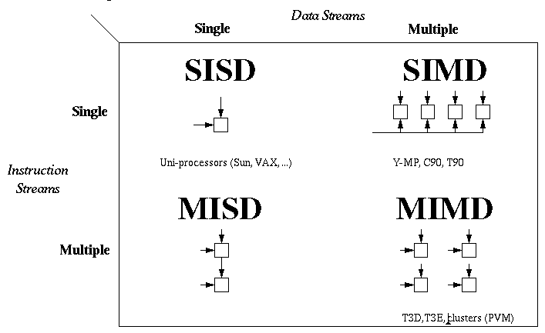
Flynn's Classification Scheme (1967)
Ordinary serial processors
Intel, AMD
Vector processors
Cray, NEC, GPU, Intel PHI
Fault Tolerance
General Parallel Arch: cluster

Slide 18
Software

Slide 19
Parallel Programming in a nutshell
Mapping “computations” onto processors
Algorithmic Level decomposition schemes
Implementation Level express parallelism
Coordinating Processors
Communication

Slide 20
Parallel Programming - A Different Sort of Beasty
Dr. Seuss anticipates the advent of parallel processing and message passing

Slide 21
Why is parallel programming harder than serial programming?
More to worry about!
race conditions
deadlock
load balancing
synchronization
memory management
architecture
network topology

Slide 22
Decomposition Strategies
Domain (Data) Decomposition
map data onto processors
Functional (Task) Decomposition
map tasks onto processors

Slide 23
Expressing Parallelism
Implicit - Compiler extracts parallelism from code (albeit w/ some help)
High Performance Fortran (HPF)
compiler directives – OPENMP
Unified Parallel C (UPC), Co-Array Fortran (COF)
Explicit - User introduces parallelism
PVM, MPI: for message passing (two-sided comm)
one-sided communication: active messages, shmem, global arrays (GA), LAPI
Linda: shared memory model
Lightweight Threads - POSIX pthreads

Slide 24
Terms & Concepts
Scalable - (1) cost or (2) performance of system grows linearly with the number of processors
granularity - (1) size of processing elements (h/w) or (2) amount of processing required between off-processor communication (s/w)
Speedup - ratio of parallel time to serial time
Efficiency - speedup divided by the number of processors

Slide 25
Message Passing
OLD
NEW

Slide 26
Message Passing Model
distributed set of processors each with it’s own memory (i.e. private data)
interconnection network
all communication and synchronization is performed through the exchange of messages
CPU
Mem
CPU
Mem
CPU
Mem
CPU
Mem
CPU
Mem

Slide 27
What is a message?
Communication between processors with disjoint memory spaces (possibly w/i a shared memory space).
Typically data is transferred from the memory space of one processor to another, however messages may be synchronization only.

Slide 28
What is required to send a message?
Sending and receiving processors must be uniquely identified
Memory locations on each end must be specified
Amount and memory access pattern of data to be shared must be specified
Optionally, many message passing systems allow the unique identification of the message itself

Slide 29
Message Passing Terms
Latency
Bandwidth
Computation/Communication ratio
Routing and Topology
Tightly/Loosely coupled networks
Synchronous/Asynchronous messaging
Latency hiding
overlap of computation and communication

Slide 30
Amdahl's Law
Let N be the number of processors,
s the amount of time spent (by a serial processor) on serial parts of a program
p is the amount of time spent (by a serial processor) on parts of the program that can be done in parallel,
then Amdahl's law says that speedup is given by
Speedup = (s + p ) / (s + p / N )
= 1 / (s + p / N )
where total time s + p = 1 for algebraic simplicity.

Slide 31
Amdahl’s Law revisited - Gustafson-Barsis Law
Maybe the picture isn’t as grim as first imagined
Amdahl assumes as N increases, that problem size remains fixed
In practice, this usually is not the case
More processors usually larger, more complex, problems Assume bigger problem with all additional work in parallel (Note this is scalability, not speedup)
Scaling = (s + p*N ) / (s + p )
= s + (1-s)*N or N(1-s) for N>>s
see also: http://www.scl.ameslab.gov/Publications/AmdahlsLaw/Amdahls.html

Slide 32
A Baby a Month?
This is the parallel programming equivalent of the old adage that while one woman can have a baby in nine months, nine woman can’t have a baby in one month (Amdahl) - but they can have nine babies in nine months (Gustafson). (special thanks to Kristina Nickel pictured)
Remember your serial fraction :)

Slide 33
Using MPI - the Fundamentals
Instructor: Mark Reed
Email: markreed@unc.edu
ITS - Research Computing

Slide 34
What is MPI?
Technically it is the definition of a standard, portable, message-passing library, the Message Passing Interface. The standard defines both
syntax
semantics
Colloquially, it usually refers to a specific MPI implementation of this library, which will include the process and communication control layers in addition to the MPI library.

Slide 35
MP implementations consist of:
a) Configuration Control - the ability to determine the machine’s type, accessibility, file control, etc.
b) Message Passing Library - syntax and semantics of calls to move messages around the system
c) Process Control - the ability to spawn processes and communicate with these processes

Slide 36
MPI Forum
First message-passing interface standard.
Sixty people from forty different organizations, began in 1992
Users and vendors represented, from the US and Europe.
Two-year process of proposals, meetings and review.
Message Passing Interface document produced in May 1994, MPI-1
Currently we have MPI 3.1 standard

Slide 37
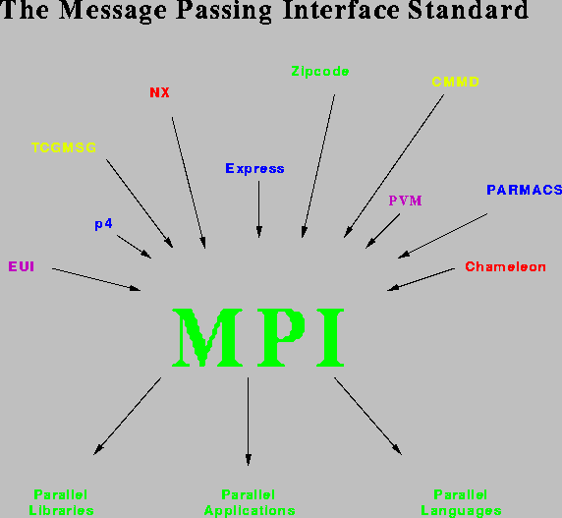

Slide 38
Goals and Scope of MPI
MPI's prime goals are:
To provide source-code portability.
To allow efficient implementation.
It also offers:
A great deal of functionality.
Support for heterogeneous parallel architectures.

Slide 39
What’s included in MPI?
PTP communication
collective operations
process groups
communication domains
process topologies
environmental management and inquiry
profiling interface
bindings for Fortran 77, C and C++
derived datatypes
parallel I/O
one sided communication
dynamic processes

Slide 40
Seven function version of MPI:
MPI_Init
MPI_Comm_size
MPI_Comm_rank
MPI_Send
MPI_Recv
MPI_Barrier
MPI_Finalize

Slide 41
MPI is Little? No, MPI is Big!
There are many additional functions, at least 133 functions at (my :) last count.
These functions add flexibility, robustness, efficiency, modularity, or convenience.
You should definitely check them out!
MPI is big and little

Slide 42
MPI Communicators
Every message passing system must have a means of specifying where the message is to go -> MPI uses communicators.

Slide 43
MPI Communicators
Communicator has two distinguishing characteristics:
Group Name - a unique name given to a collection of processes
Rank - unique integer id within the group
Context - the context defines the communication domain and is allocated by the system at run time

Slide 44
MPI Communicators - Rank
Rank - an integer id assigned to the process by the system
ranks are contiguous and start from 0 within each group
Thus group and rank serve to uniquely identify each process

Slide 45
Syntax: C vs Fortran
Syntax is generally the same, with the exception that C returns the status of the function call while Fortran has an additional integer argument at the end to return this error code
All MPI objects (e.g., MPI_Datatype, MPI_Comm) are of type INTEGER in Fortran.
Disclaimer: Henceforth, we will usually omit the Fortran syntax, as it should be clear what the syntax is from the C call

Slide 46
int MPI_Init (int *argc, char ***argv)
This must be called once and only once by every MPI program. It should be the first MPI call (exception: MPI_Initialized). argc and argv are the standard arguments to a C program and can be empty if none are required.
argc argument count
argv pointers to arguments
Fortran syntax: CALL MPI_Init(ierr)

Slide 47
int MPI_Comm_size (MPI_Comm comm, int *size)
Generally the second function called, this returns with the size of the group associated with the MPI communicator, comm. The communicator, MPI_COMM_WORLD is predefined to include all processes.
comm communicator
size upon return, set to the size of the group

Slide 48
int MPI_Comm_rank (MPI_Comm comm, int *rank)
Generally the third function called, this returns with the rank of the processor within the group comm.
comm communicator
rank upon return, set to the rank of the process within the group

Slide 49
What happens on a send?
Ideally, the data buffer is transmitted to the receiver, however, what if the receiver is not ready?
3 Scenarios:
Wait for receiver to be ready (blocking)
Copy the message to an internal buffer (on sender, receiver, or elsewhere) and then return from the send call (nonblocking)
Fail
Which is best?

Slide 50
Sending a message: 2 scenarios
CPU 0
CPU 1
DRAM
DRAM
array
Direct
array
Buffered

Slide 51
int MPI_Send (void *buf, int count, MPI_Datatype datatype, int dest, int tag, MPI_Comm comm)
This is the basic send call, note it is potentially a blocking send.
buf starting address of the send buffer
count number of elements
datatype MPI datatype of the data, typically it is the language datatype with ``MPI_'' prepended to it, e.g., MPI_INT and MPI_FLOAT in C or MPI_INTEGER and MPI_REAL in Fortran.
dest rank of the destination process
tag message tag
comm communicator
What
Where

Slide 52
int MPI_Recv(void *buf, int count, MPI_Datatype datatype, int source, int tag, MPI_Comm comm, MPI_Status *status)
This is the basic receive call, note it is a blocking receive.
buf starting address of the receive buffer
count number of elements to receive, it can be less than or equal to the number sent
datatype MPI datatype of the data, see MPI_Send
source rank of sender, or wildcard (MPI_ANY_SOURCE)
tag msg. tag of sender, or wildcard (MPI_ANY_TAG)
comm communicator
status structure containing a minimum (implementation dependent) of three entries, specifying the source, tag, and error code of the received message.
What
Where

Slide 53
Receive status
In C, the source, tag and error code are given by the structure fields
MPI_SOURCE, MPI_TAG, MPI_ERROR
In Fortran, the field MPI_Status is an integer array of size MPI_STATUS_SIZE.
The three predefined indices are MPI_SOURCE, MPI_TAG, MPI_ERROR.

Slide 54
int MPI_Barrier(MPI_Comm comm)
Blocks until all members of the group comm have made this call.
This synchronizes all processes.
comm the name of the communicator

Slide 55
int MPI_Finalize(void)
Cleans up all MPI states.
Should be called by all processes.
User must ensure all pending communications complete before calling this routine.

Slide 56
tokenring example
Proc 0
Proc 1
Proc 5
Proc 2
Proc 4
Proc 3

Slide 57
Simple Example:
program tokenring
implicit none
include "mpif.h"
c this is a sample test program to pass a token around the ring
c each pe will increment the token w/ by it's pe number
integer itoken,npts,npes,myrank,msgtag,iprev,inext
integer i,istat,irecvstat(MPI_STATUS_SIZE),len
c initialize mpi, set the npes and myrank variables
call MPI_Init(istat)
if (istat.ne.0) stop "ERROR: can't initialize mpi"
call MPI_Comm_size(MPI_COMM_WORLD,npes,istat)
call MPI_Comm_rank(MPI_COMM_WORLD,myrank,istat)
c initialize variables on all pe's
itoken = 0
npts = 1
msgtag = 101
iprev = mod(myrank+npes-1,npes)
inext = mod(myrank+npes+1,npes)

Slide 58
Simple Example Cont.
c now send and receive the token
if (myrank.eq.0) then
itoken = itoken + myrank
call MPI_Send (itoken,npts,MPI_INTEGER,inext,msgtag,
& MPI_COMM_WORLD,istat)
call MPI_Recv (itoken,npts,MPI_INTEGER,iprev,msgtag,
& MPI_COMM_WORLD,irecvstat,istat)
else
call MPI_Recv (itoken,npts,MPI_INTEGER,iprev,msgtag,
& MPI_COMM_WORLD,irecvstat,istat)
itoken = itoken + myrank
call MPI_Send (itoken,npts,MPI_INTEGER,inext,msgtag,
& MPI_COMM_WORLD,istat)
endif
print *, "myrank = ",myrank," received token = ",itoken
c call barrier and exit
call mpi_barrier(MPI_COMM_WORLD,istat)
call mpi_finalize (istat)

Slide 59
Sample tokenring output on 6 processors
myrank = 5 of 6 procs and has token = 15
myrank = 5 my name = baobab-n40.isis.unc.edu
myrank = 1 of 6 procs and has token = 1
myrank = 1 my name = baobab-n47.isis.unc.edu
myrank = 4 of 6 procs and has token = 10
myrank = 4 my name = baobab-n40.isis.unc.edu
myrank = 2 of 6 procs and has token = 3
myrank = 2 my name = baobab-n41.isis.unc.edu
myrank = 3 of 6 procs and has token = 6
myrank = 3 my name = baobab-n41.isis.unc.edu
myrank = 0 of 6 procs and has token = 15
myrank = 0 my name = baobab-n47.isis.unc.edu

Slide 60
Same example in C
/* program tokenring */
/* this is a sample test program to pass a token around the ring */;
/* each pe will increment the token w/ by it's pe number */;
#include <stdio.h>
#include <mpi.h>
void main(int argc, char* argv[])
{
int itoken,npts,npes,myrank,msgtag,iprev,inext;
int len;
char name[MPI_MAX_PROCESSOR_NAME];
MPI_Status irecvstat;
/* initialize mpi, set the npes and myrank variables */;
MPI_Init(&argc, &argv);
MPI_Comm_size(MPI_COMM_WORLD,&npes);
MPI_Comm_rank(MPI_COMM_WORLD,&myrank);

Slide 61
Tokenring Cont.
/* initialize variables on all pe's */;
itoken = 0;
npts = 1;
msgtag = 101;
iprev = (myrank+npes-1)%npes;
inext = (myrank+npes+1)%npes;
/* now send and receive the token */;
if (myrank==0) {
MPI_Send (&itoken,npts,MPI_INT,inext,msgtag,MPI_COMM_WORLD);
MPI_Recv (&itoken,npts,MPI_INT,iprev,msgtag,MPI_COMM_WORLD,&irecvstat);
} else {
MPI_Recv (&itoken,npts,MPI_INT,iprev,msgtag,MPI_COMM_WORLD,&irecvstat);
itoken += myrank;
MPI_Send (&itoken,npts,MPI_INT,inext,msgtag,MPI_COMM_WORLD);
}

Slide 62
Tokenring Cont.
printf ("myrank = %d received token = %d \n",myrank,itoken);
MPI_Get_processor_name(name, &len);
printf ("myrank = %d my name = %s\n",myrank,name);
/* barrier and exit */;
MPI_Barrier(MPI_COMM_WORLD);
MPI_Finalize ();
return;
}

Slide 63
Timing
MPI_Wtime returns wall clock (elapsed) time in seconds from some arbitrary initial point
MPI_Wtick returns resolution of MPI_Wtime in seconds
both functions return double (C) or double precision (Fortran) values
there are no calling arguments

Slide 64
References
“Using MPI” by Gropp, Lusk, and Skjellum
“MPI: The Complete Reference” by Snir, Otto, Huss-Lederman, Walker, and Dongarra
“Parallel Programming with MPI” by Peter Pacheco
Material from
Edinburgh Parallel Computing Centre
Maui High Performance Computing Center

Slide 65
Compiling
To compile you will need to specify where the MPI include files and libraries are in the usual way (-I, -L, -l) for whichever compiler you are using.
Luckily almost all MPI implementations provide wrappers that do this for you. Thus you should use mpif90, mpicc, mpicxx, etc.

Slide 66
Point to Point Communication
ITS Research Computing Instructor: Mark Reed Email: markreed@unc.edu

Slide 67
Send Types
Synchronous Sends
provide information about the completion of the message
Asynchronous Sends
Only know when the message has left.

Slide 68
Blocking Operations
Relate to when the operation has completed.
Only return from the function call when the operation has completed.

Slide 69
Non-Blocking Operations
Return immediately and allow the sub-program to continue and perform other work.
At some later time the sub-program can test or wait for the completion of the non-blocking operation.
These are used to overlap communication and computation
Computation
Communication
Time

Slide 70
Non-Blocking Operations (cont'd)
All non-blocking operations should have matching wait operations. Some systems cannot free resources until wait has been called.
A non-blocking operation immediately followed by a matching wait is equivalent to a blocking operation.
Non-blocking operations are not the same as sequential subroutine calls as the operation continues after the call has returned.

Slide 71
Point-to-Point Communication
Communication between exactly two processes.
Source process sends message to destination process.
Communication takes place within a communicator.
Destination process is identified by its rank in the communicator.

Slide 72
For a communication to succeed:
Sender must specify a valid destination rank.
Receiver must specify a valid source rank.
The communicator must be the same.
Tags must match.
Message types must match.
Receiver's buffer must be large enough.

Slide 73
Wildcarding
Receiver can wildcard.
To receive from any source
MPI_ANY_SOURCE
To receive with any tag
MPI_ANY_TAG
Actual source and tag are returned in the receiver's status parameter.

Slide 74
Rules of PTP communication
Messages are non-overtaking
Order is preserved
Progress
one of a pair of matching send/receives is guaranteed to complete, independently of other system actions
Fairness
there is no guarantee of fairness
an individual send or receive may never be satisfied due to the messages generated by a third process

Slide 75
Communication modes
Only completes when the receive has begun
Always completes (unless error occurs) irrespective of receiver
Either synchronous or buffered
Always completes (unless error occurs) irrespective of receiver
completes when a message has arrived
Synchronous send
Buffered send
Standard send
Ready send
Receive

Slide 76
Synchronous Send
MPI_Ssend
Call does not complete until an acknowledgement is returned by the receiver (i.e. a “handshake”)
“safer” - system is not overloaded with undelivered messages, more predictable, synchronized
can be slower or faster
sender idles - reduces comp/comm overlap
non-buffered - can write directly out of memory

Slide 77
Buffered Send
MPI_Bsend
Copies message to a system buffer for later transmission - completes immediately
not synchronized, local semantics
User must explicitly allocate buffer space by calling MPI_Buffer_attach and specify an unused array that is allocated by the user.

Slide 78
Ready Send
MPI_Rsend
assumes receiver is ready - posted receive is user responsibility,
behavior is undefined if receive is not ready
removes handshake, allows for potentially faster sends for some systems
completes immediately

Slide 79
Combined send/receive
MPI_Sendrecv
blocking send and receive
avoids deadlock from lack of buffering
send and receive buffers differ
use MPI_Sendrecv_replace to reuse the same buffer

Slide 80
Non-Blocking Communications
Separate communication into three phases:
Initiate non-blocking communication.
Do some work
Wait for non-blocking communication to complete.

Slide 81
Initiate non-blocking communication
Immediate modes
MPI_Isend- standard send
MPI_Issend - synchronous send
MPI_Ibsend - buffered send
MPI_Irsend - ready send
MPI_Irecv - receive
can mix and match blocking and non-blocking send receives
additional argument -request is returned by system to identify the communication

Slide 82
Testing for completion
int MPI_Wait(MPI_Request *request, MPI_Status *status)
blocks until request has completed
other variants
MPI_Waitany, MPI_Waitsome, MPI_Waitall
int MPI_Test(MPI_Request *request, int *flag,
MPI_Status *status)
returns immediately
flag is true if request has completed, else false
other variants
MPI_Testany, MPI_Testsome, MPI_Testall

Slide 83
Example: 1-D smoothing
Consider a simple smoothing operation used in image-processing
Replace each element of an image (here a 1-D array) with the average of itself and it’s two neighbors
domain decomposition
repeat for some number of iterations
use “ghost cells” for the two boundary cells (i.e. the ends of the subarray)

Slide 84
Domain Decomposition
0 1
0 1
0 1
0 1
0 1
0 1
processor 0 processor 1 processor 2
1 0
1 0
1 0
“ghost cells” for boundaries

Slide 85
Initial Algorithm
for (iterations)
update all cells
send boundary values to neighbors
receive ghost cells from neighbors

Slide 86
Smooth.f
program smooth
implicit none
include "mpif.h"
real, allocatable :: image(:),overimage(:)
real tinv
integer myblock,npts,npes,myrank,msgtag,iprev,inext
integer i,istat,irecvstat(MPI_STATUS_SIZE)
integer iter,numiters
c simple 1-D smoothing for image processing. Replace each
c element with the average of itself and each adjacent element
c initialize mpi, set the npes and myrank variables
call MPI_Init(istat)
if (istat.ne.0) stop "ERROR: can't initialize mpi"
call MPI_Comm_Size(MPI_COMM_WORLD,npes,istat)
call MPI_Comm_Rank(MPI_COMM_WORLD,myrank,istat)

Slide 87
Smooth.f
c enter the size of the block on each processor
c this ensures all are the same size
c note msgtag is defined for all processors
msgtag = 100
if (myrank.eq.0) then
print *, "enter the block size"
read (*,*) myblock
c now distribute it to all the processors
do i=1,npes-1
call MPI_Send (myblock,1,mpi_integer,i,msgtag,
$ mpi_comm_world,istat)
enddo
else
call MPI_Recv (myblock,1,mpi_integer,0,msgtag,
$ mpi_comm_world,irecvstat,istat)
endif

Slide 88
Smooth.f
c initialize variables on all processor's and allocate arrays
npts=myblock*npes
allocate (image(myblock), overimage(0:myblock+1))
numiters = 3
msgtag = 105
iprev = mod(myrank+npes-1,npes)
inext = mod(myrank+npes+1,npes)
c do initialization independent of num processors it runs on
c but it does depend on the total number of points
c initialize to 0 or 1 for even or odd
do i =1,myblock
image(i) = mod(myrank*myblock+i,2)
overimage(i) = image(i)
enddo
overimage(0) = mod(myrank*myblock,2)
overimage(myblock+1) = mod((myrank+1)*myblock+1,2)

Slide 89
Smooth.f
tinv = 1.0/3.0
do iter=1,numiters
c smooth the data
do i=1,myblock
image(i) = (overimage(i-1) + overimage(i) + overimage(i+1))*tinv
enddo
c update overimage, excluding the ghost cells
do i=1,myblock
overimage(i) = image(i)
enddo

Slide 90
Smooth.f
c now send and receive the ghost cells
c note: this can DEADLOCK depending on implementation
c everyone but the end sends to the next pe
c everyone but the first sends to the previous processor
if (myrank.ne.npes-1) then
call mpi_send (image(myblock),1,mpi_real,inext,msgtag,
& mpi_comm_world,istat)
call mpi_recv (overimage(myblock+1),1,mpi_real,inext,msgtag,
& mpi_comm_world,irecvstat,istat)
endif
if (myrank.ne.0) then
call mpi_send (image(1),1,mpi_real,iprev,msgtag,
& mpi_comm_world,istat)
call mpi_recv (overimage(0),1,mpi_real,iprev,msgtag,
& mpi_comm_world,irecvstat,istat)
endif
enddo ! end do iter
c call barrier and exit
call mpi_barrier(MPI_COMM_WORLD,istat)
call mpi_finalize (istat)

Slide 91
Sample Results of smoothing
Input
Output:
1000 Iterations

Slide 92
Drawbacks of this Algorithm
Deadlock can occur depending on the implentation of MPI (i.e. if MPI_SEND blocks)
There is no communication/computation overlap, that is, no latency hiding
Final processor must receive first and then propagate sends back down the line

Slide 93
Drawbacks
Time
Rank 0 | Rank 1 | Rank 2 | Rank 3
Send | Send | Send | Send
Recv | Recv | Recv | Recv
 |  | Send | Next Iter
 | Recv | Recv
 | Send | Next Iter
Next Iter | Next Iter

Slide 94
Solution to this puzzle?
Use non-blocking communication, e.g. immediate sends and receives
avoids deadlock
allows overlap of computation and communication

Slide 95
Improved Algorithm
for (iterations)
update boundary (ghost) cells
initiate sending of boundary cells to neighbors
initiate receipt of ghost cells from neighbors
update non-boundary values
wait for completion of sending of boundary values
wait for completion of receipt of ghost values

Slide 96
Smooth.immed.f
program smooth
implicit none
include "mpif.h"
real, allocatable :: image(:),overimage(:)
real tinv
integer myblock,npts,npes,myrank,msgtag,iprev,inext
integer i,istat,irecvstat(MPI_STATUS_SIZE)
integer iter,numiters
integer nsendreq,psendreq,nrecvreq,precvreq
c simple 1-D smoothing for image processing
c replace each element with the average of itself and each
c adjacent element
c initialize mpi, set the npes and myrank variables
call MPI_Init(istat)
if (istat.ne.0) stop "ERROR: can't initialize mpi"
call MPI_Comm_Size(MPI_COMM_WORLD,npes,istat)
call MPI_Comm_Rank(MPI_COMM_WORLD,myrank,istat)

Slide 97
Smooth.immed.f
c enter the size of the block on each processor
c this ensures all are the same size
c note msgtag is defined for all processor's
msgtag = 100
if (myrank.eq.0) then
print *, "enter the block size"
read (*,*) myblock
c now distribute it to all the pe's
do i=1,npes-1
call MPI_Send (myblock,1,mpi_integer,i,msgtag,
$ mpi_comm_world,istat)
enddo
else
call MPI_Recv (myblock,1,mpi_integer,0,msgtag,
$ mpi_comm_world,irecvstat,istat)
endif

Slide 98
Smooth.immed.f
c initialize variables on all processors and allocate arrays
npts=myblock*npes
allocate (image(myblock), overimage(0:myblock+1))
numiters = 3
msgtag = 105
iprev = mod(myrank+npes-1,npes)
inext = mod(myrank+npes+1,npes)
c make initialization independent of num processors it
c runs on - but it does depend on the total number of points
c initialize to 0 or 1 for even or odd
do i =1,myblock
image(i) = mod(myrank*myblock+i,2)
overimage(i) = image(i)
enddo
overimage(0) = mod(myrank*myblock,2)
overimage(myblock+1) = mod((myrank+1)*myblock+1,2)

Slide 99
Smooth.immed.f
tinv = 1.0/3.0
c smooth the data on the boundary cells
do iter=1,numiters
image(1) = (overimage(0)+overimage(1)+overimage(2))*tinv
image(myblock) = (overimage(myblock-1)+overimage(myblock)+
$ overimage(myblock+1))*tinv

Slide 100
Smooth.immed.f
c now send and receive the ghost cells
c everyone but the end sends to the next processor
c everyone but the first sends to the previous processor
if (myrank.ne.npes-1) then
call mpi_isend (image(myblock),1,mpi_real,inext,msgtag,
& mpi_comm_world,nsendreq,istat)
endif
if (myrank.ne.0) then
call mpi_isend (image(1),1,mpi_real,iprev,msgtag,
& mpi_comm_world,psendreq,istat)
endif
if (myrank.ne.npes-1) then
call mpi_irecv (overimage(myblock+1),1,mpi_real,inext,
$ msgtag,mpi_comm_world,nrecvreq,istat)
endif
if (myrank.ne.0) then
call mpi_irecv (overimage(0),1,mpi_real,iprev,msgtag,
& mpi_comm_world,precvreq,istat)
endif

Slide 101
Smooth.immed.f
c smooth data excluding the ghost cells which are done already
do i=2,myblock-1
image(i) = (overimage(i-1)+overimage(i)+overimage(i+1))*tinv
enddo
c update overimage, excluding the ghost cells
do i=1,myblock
overimage(i) = image(i)
enddo
call mpi_wait(nsendreq, irecvstat, istat)
call mpi_wait(psendreq, irecvstat, istat)
call mpi_wait(nrecvreq, irecvstat, istat)
call mpi_wait(precvreq, irecvstat, istat)
enddo ! end of do iter
c call barrier and exit
call mpi_barrier(MPI_COMM_WORLD,istat)
call mpi_finalize (istat)

Slide 102
Collective Communication
ITS - Research Computing Instructor: Mark Reed Email: markreed@unc.edu

Slide 103
Collective Communication
Communications involving a group of processes.
Called by all processes in a communicator.
Examples:
Barrier synchronization
Broadcast, scatter, gather.
Global sum, global maximum, etc.

Slide 104
Characteristics of Collective Communication
Collective action over a communicator
All processes must communicate
Synchronization may or may not occur
All collective operations are blocking.
No tags.
Receive buffers must be exactly the right size
This restriction was made to simplify the standard (e.g. no receive status required)

Slide 105
Why use collective operations?
Efficiency
Clarity
Convenience
Robustness
Flexibility
Programming Style
all collective ops

Slide 106
Barrier Synchronization
int MPI_Barrier (MPI_Comm comm)
all processes within the communicator, comm, are synchronized.

Slide 107
Broadcast
data
A0
A0
Processors
A0
A0
A0

Slide 108
Broadcast
int MPI_Bcast (void *buffer, int count, MPI_Datatype datatype, int root, MPI_Comm comm)
buffer - address of data to broadcast
count - number of items to send
datatype - MPI datatype
root - process from which data is sent
comm - MPI communicator

Slide 109
Gather/Scatter
data
scatter
A0
A1
A2
A3
A0
Processors
A1
gather
A2
A3

Slide 110
Gather
int MPI_Gather (void* sendbuf, int sendcount, MPI_Datatype sendtype, void* recvbuf, int recvcount, MPI_Datatype recvtype, int root, MPI_Comm comm)
sendbuf - each process (including root) sends this buffer to root
sendcount - number of elements in the send buffer
recvbuf - address of receive buffer, this is ignored for all non-root processes. Gather buffer should be large enough to hold results from all processors.
recvcount - number of elements for any single receive
root - rank of receiving process

Slide 111
Scatter
int MPI_Scatter (void* sendbuf, int sendcount, MPI_Datatype sendtype, void* recvbuf, int recvcount, MPI_Datatype recvtype, int root, MPI_Comm comm)
sendbuf - address of send buffer, this is ignored for all non-root processes
sendcount - number of elements sent to each process
recvbuf - address of receive buffer
recvcount - number of elements in the receive buffer
root - rank of sending process

Slide 112
Allgather
data
A0
A0
B0
C0
D0
Processors
B0
A0
B0
C0
D0
C0
A0
B0
C0
D0
D0
A0
B0
C0
D0

Slide 113
Allgather
int MPI_Allgather (void* sendbuf, int sendcount, MPI_Datatype sendtype, void* recvbuf, int recvcount, MPI_Datatype recvtype, MPI_Comm comm)
sendbuf - starting address of send buffer
sendcount - number of elements in the send buffer
recvbuf - address of receive buffer
recvcount - number of elements for any single receive
Like gather except all processes receive result

Slide 114
Alltoall
data
A0
A1
A2
A3
A0
B0
C0
D0
Processors
B0
B1
B2
B3
A1
B1
C1
D1
C0
C1
C2
C3
A2
B2
C2
D2
D0
D1
D2
D3
A3
B3
C3
D3

Slide 115
All to All Scatter/Gather
int MPI_Alltoall (void* sendbuf, int sendcount, MPI_Datatype sendtype, void* recvbuf, int recvcount, MPI_Datatype recvtype, MPI_Comm comm)
sendbuf - starting address of send buffer
sendcount - number of elements in the send buffer
recvbuf - address of receive buffer
recvcount - number of elements for any single receive
Extension of Allgather to the case where each process sends distinct data to each receiver

Slide 116
Additional Routines
Vector versions exist for all of these which allow a varying count of data from each process
MPI_Alltoallw provides the most general form of communication and indeed generalizes all of the vector variants
allows separate specification of count, byte displacement and datatype for each block

Slide 117
Identical send/receive buffers
The send and receive data buffers for all collective operations are normally two distinct (disjoint) buffers.
To reuse the same buffer, specify the MPI constant MPI_IN_PLACE instead of the send or receive buffer argument.

Slide 118
Global Reduction Operations
Used to compute a result involving data distributed over a group of processes.
Examples:
global sum or product
global maximum or minimum
global user-defined operation

Slide 119
Predefined Reduction Operations
MPI_MAX – maximum value
MPI_MIN – minimum value
MPI_SUM - sum
MPI_PROD - product
MPI_LAND, MPI_BAND – logical, bitwise AND
MPI_LOR, MPI_BOR – logical, bitwise OR
MPI_LXOR, MPI_BXOR - logical, bitwise exclusive OR
MPI_MAXLOC –max value and it’s location
MPI_MINLOC - min value and it’s location

Slide 120
Reduce
data
Processors
A0+A1+A2
B0+B1+B2
C0+C1+C2
A0
B0
C0
A1
B1
C1
A2
B2
C2

Slide 121
Reduce
int MPI_Reduce (void* sendbuf, void* recvbuf, int count, MPI_Datatype type, MPI_Op op, int root, MPI_Comm comm)
sendbuf - address of send buffer
recvbuf - address of receive buffer
count - number of elements in send buffer
op - reduce operation
root - rank of receiving process

Slide 122
Variants of MPI_REDUCE
MPI_ALLREDUCE
no root process
MPI_REDUCE_SCATTER
result is scattered
MPI_SCAN
“parallel prefix”

Slide 123
Allreduce
data
Processors
A0+A1+A2
B0+B1+B2
C0+C1+C2
A0
B0
C0
A1
B1
C1
A0+A1+A2
B0+B1+B2
C0+C1+C2
A2
B2
C2
A0+A1+A2
B0+B1+B2
C0+C1+C2

Slide 124
Reduce - Scatter
data
Processors
A0+A1+A2
A0
B0
C0
A1
B1
C1
B0+B1+B2
A2
B2
C2
C0+C1+C2

Slide 125
Scan
data
Processors
A0
B0
C0
A0
B0
C0
A1
B1
C1
A0+A1
B0+B1
C0+C1
A2
B2
C2
A0+A1+A2
B0+B1+B2
C0+C1+C2

Slide 126
Example: Find the maximum value of a function over some range
Let’s pick a simple function
y = cos(2πx+π/4)
Our range will be 0-> 2π so x will vary from 0-> 1.
Break x range into evenly sized blocks on each processor

Slide 127
Example: Find the maximum value of a function
/* program findmax */
/* find the maximum of the function
y=cos(2*pi*x + pi/4) across processors */
#include <stdio.h>
#include <math.h>
#include <float.h>
#include <mpi.h>
#define numpts 100
main(int argc, char* argv[])
{

Slide 128
findmax cont.
int numprocs,i,myrank;
float pi, twopi, phase, blksze,x,delx;
struct {
float data;
int idx;
} y[100],ymax, ymymax;
/* Compute number of processes and myrank */
MPI_Init(&argc, &argv);
MPI_Comm_size(MPI_COMM_WORLD, &numprocs);
MPI_Comm_rank(MPI_COMM_WORLD, &myrank);

Slide 129
findmax cont.
/* compute the block size and spacing of x points*/
blksze = 1.0/numprocs; /* 1.0 is max value of x */
delx = blksze/numpts;
/* define some constants */
pi=acos(-1.0);
phase = pi/4;
twopi = 2*pi;
/* note: x from 0 to 1-delx s.t. y over 2pi */
/* initialize across all processors */
for (i=0;i<numpts;i++) {
x = blksze*myrank + i*delx;
y[i].idx = numpts*myrank + i;
y[i].data = cos(twopi*x+phase); }

Slide 130
findmax cont.
/* Now find the max on each local processor */
ymymax.data = -FLT_MAX;
ymymax.idx = 0;
for (i=0;i<numpts;i++) {
if (y[i].data > ymymax.data) {
ymymax.data = y[i].data;
ymymax.idx = y[i].idx;
}
}
/* Now find the max across the processors */
MPI_Reduce (&ymymax,ymax,1,MPI_FLOAT_INT, MPI_MAXLOC, 0, MPI_COMM_WORLD);

Slide 131
findmax cont.
/* now print out answer */
if (myrank == 0) {
printf("The maximum value of the function is %f which occurs at x = %f \n",
ymax.data, ymax.idx*delx);
}
/* call barrier and exit */
MPI_Barrier(MPI_COMM_WORLD);
MPI_Finalize ();
}

Slide 132
Results
Results for numpts=10,000 :
The maximum value of the function is 1.000000 which occurs at x = 0.875000
i.e at x=7/8 or 2πx= 1 ¾ π ✓
In the previous example we found the minimum in data space and then reduced across processor space. We could have reversed this and reduced across processor space first and then found the minimum. What are the disadvantages of this second method?

