Slide 1

Linux Intermediate
Text and File Processing
ITS Research Computing
Mark Reed
Email: markreed@unc.edu
Notes:
The Title Slide: Add the name of the presentation, the appropriate division or presenter and date of the presentation.

Slide 2
Class Material
Point web browser to http://its.unc.edu/Research
Click on “Training” on the left column
Click on “ITS Research Computing Training Presentations”
Click on “Linux Intermediate”
Notes:
Basic content slide: Add slide title and slide text in the appropriate places. To create a new slide, go to “Insert > New Slide” from the main menu.

Slide 3
Course Objectives
We are visiting just one small room in the Linux mansion and will focus on text and file processing commands, with the idea of post-processing data files in mind.
This is not a shell scripting class but these are all pieces you would use in shell scripts.
This will introduce many of the useful commands but can’t provide complete coverage, e.g. gawk could be a course on it’s own.

Slide 4
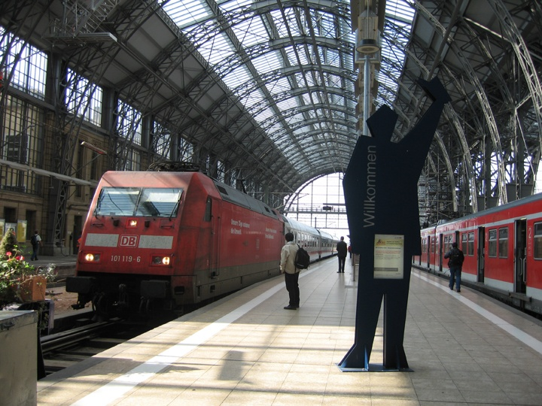
Logistics
Course Format
Lab Exercises
Breaks
Restrooms
Please play along
  learn by doing!
Please ask questions
Getting started on Kure
  http://help.unc.edu/ccm3_015682
UNC Research Computing
  http://its.unc.edu/research

Slide 5
ssh using SecureCRT in Windows
Using ssh, login to kure, hostname kure.unc.edu
To start ssh using SecureCRT in Windows, do the following.
  Start -> Programs -> Remote Services -> SecureCRT
  Click the Quick Connect icon at the top.
  Hostname: kure.unc.edu
  Login with your ONYEN and password
Notes:
Basic content slide: Add slide title and slide text in the appropriate places. To create a new slide, go to “Insert > New Slide” from the main menu.

Slide 6
Stuff you should already know …
man
tar
gzip/gunzip
ln
ls
find
  find with –exec option
locate
head/tail
echo
dos2unix
alias
df /du
ssh/scp/sftp
diff
cat
cal

Slide 7
Topics and Tools
Topics
streams
pipes and redirection
wildcards
quoting and escaping
regular expressions
Tools
grep
gawk
foreach/for
sed
sort
cut/paste/join
basename/dirname
uniq
wc
tr
xargs
bc

Slide 8


Tools
Power Tools
  grep, gawk, foreach/for
Used a lot
  sort, sed
Nice to Have
  cut/paste/join, basename/dirname, wc, bc, xargs, uniq, tr

Slide 9
Topics
Stdout/Stdin/Stderr
Pipe and Redirection
Wildcards
Quoting and Escaping
Regex
Notes:
In order for create a section divider slide, add a new slide, select the “Title Only” Slide Layout and apply the “Section Divider” master from the Slide Design menu. For more information regarding slide layouts and slide designs, please visit http://office.microsoft.com/training

Slide 10
stdout, stdin, stderr
Output from commands
  usually written to the screen
  referred to as standard output (stdout)
Input for commands
  usually come from the keyboard (if no arguments are given
  referred to as standard input (stdin)
Error messages from processes
  usually written to the screen
  referred to as standard error (stderr)
Notes:
Basic content slide: Add slide title and slide text in the appropriate places. To create a new slide, go to “Insert > New Slide” from the main menu.

Slide 11
Redirection and Pipe
> redirects stdout
>> append stdout
< redirects stdin
stderr varies by shell, use & in tcsh/csh and use 2> in bash/ksh/sh
| pipes (connects) stdout of one command to stdin of another command

Slide 12

Pipes and Redirection
You start to experience the power of Unix when you combine simple commands together to perform complex tasks.
Most (all?) Linux commands can be piped together.
Use “-” as the value for an argument to mean “read this from standard input”.

Slide 13


Wildcards
Multiple filenames can be specified using special pattern-matching characters. The rules are:
  ‘*’ matches zero or more characters in the filename.
  ‘?’ matches any single character in that position in the filename
  ‘[…]’ Characters enclosed in square brackets match any name that has one of those characters in that position
Note that the UNIX shell performs these expansions before the command is executed.
Notes:
Basic content slide: Add slide title and slide text in the appropriate places. To create a new slide, go to “Insert > New Slide” from the main menu.

Slide 14

Quoting and Escaping
‘’ - single quotes (apostrophes)
  quote exactly, no variable substitution
“ ” – double quotes
  quote but recognize \ and $
` ` - single back quotes
  execute text within quotes in the shell
\ - backslash
  escape the next character

Slide 15
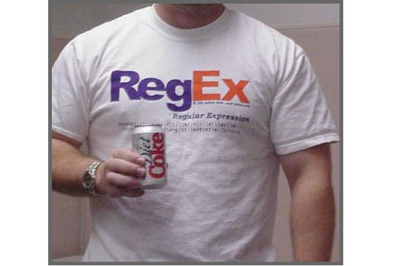
regular expressions
A regular expression (regex) is a formula for matching strings that follow some pattern.
They consist of characters (upper and lower case letters and digits) and metacharacters which have a special meaning.
various forms of regular expressions are used in the shell, perl, python, java, ….

Slide 16
regex cont.
A few of the more common metacharacters:
  . match any single character
  * match zero or more characters
  ? match 0 or 1 character
  {n} match preceding character exactly n times
  […] match characters within brackets
    [0-9] matches any digit
    [a-Z] matches all letters of any case
  \ escape character
  ^ or $ match beginning or end of line respectively

Slide 17
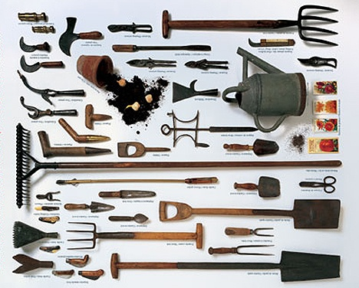
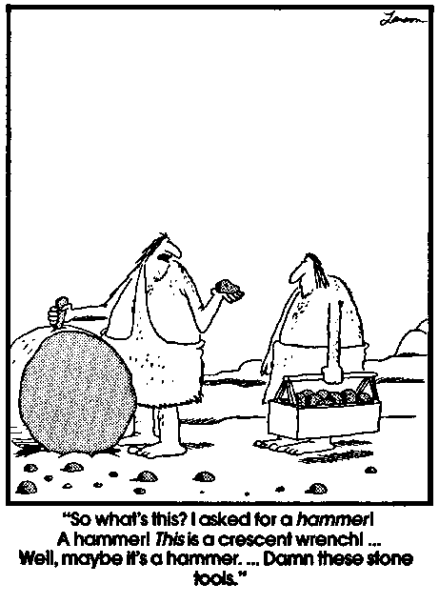


Tools

Slide 18
grep/egrep/fgrep
Generic Regular Expression Parser
  mnemonic - get regular expression
  I’ve also seen Global Regular Expression Print
Search text for patterns that match a regular expression
Useful for:
  searching for text in multiple files
  extracting particular text from files or stdin

Slide 19
grep - Examples
grep [options] PATTERN [files]
grep abc file1
  Print line(s) in file “file1” with “abc”
grep abc file2 file3 these*
  Print line(s) with “abc” that appear in any of the files “file2”, “file3” or any files starting with the name “these”
Notes:
Basic content slide: Add slide title and slide text in the appropriate places. To create a new slide, go to “Insert > New Slide” from the main menu.

Slide 20
grep- Useful Options
-i ignore case
-r recursively
-v invert the matching, i.e. exclude pattern
-Cn, -An, -Bn give n lines of Context (After or Before)
-E same as egrep, pattern is an extended regular expression
-F same as fgrep, pattern is list of fixed strings

Slide 21
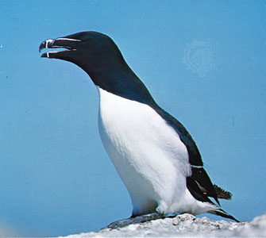
awk
awk
  is an entire programming language designed for processing text-based data. Syntax is reminiscent of C
  named for it’s authors, Aho, Weinberger and Kernighan
  pronounced auk
  new awk == nawk
  gnu awk == gawk
  Very powerful and useful tool. The more you use the more uses you will find for it. We will only get a taste of it here.

Slide 22
gawk
reads files line by line
splits each line (record) into fields numbered $1, $2, $3, … (the entire record is $0)
splits based on white space by default but the field separator can be specified
general format is
  gawk ‘pattern {action}’ filename
the “action” is only performed on lines that match “pattern”
output is to stdout

Slide 23
gawk patterns
the patterns to test against can be strings including using regular expressions or relational expressions (<, >, ==, !=, etc)
use /…/ to enclose the regular expression.
  /xyz/ matches the literal string xyz
the ~ operator means is matched by
  $2 ~ /mm/ field 2 contains the string mm
/Abc/ is shorthand for $0 ~ /Abc/

Slide 24
gawk by example
print columns 2 and 5 for every line in the file thisFile that contains the string ‘John’
  gawk ‘/John/ {print $2, $5}’ thisFile
print the entire line if column three has the value of 22
  gawk ‘$3 == 22 {print $0}’ thisFile
convert negative degrees west to east longitude. Assume columns one and two.
  gawk ‘$1 < 0.0 && $2 ~ /W/ {print $1+360, “E”} thisFile

Slide 25
gawk
special patterns
  BEGIN, END
Many built in variables, some are:
  ARGC, ARGV – command line arguments
  FILENAME – current file name
  NF - number of fields in the current record
  NR – total number of records seen so far
see man page for a complete list

Slide 26
gawk command statements
branching
  if (condition) statement [else statement]
looping
  for, while, do … while,
I/O
  print and printf
  getline
Many built in functions in the following categories:
  numeric
  string manipulation
  time
  bit manipulation
  internationalization

Slide 27
awk
Process files by pattern-matching
awk –F: ‘{print $1}’ /etc/passwd
Extract the 1st field separated by “:” in /etc/passwd and print to stdout
awk ‘/abcde/’ file1
Print all lines containing “abcde” in file1
awk ‘/xyz/{++i}; END{print i}’ file2
Find pattern “xyz” in file2 and count the number
awk ‘length <= 1’ file3
Display lines in file3 with only 1 or no character
See Examples
Notes:
Basic content slide: Add slide title and slide text in the appropriate places. To create a new slide, go to “Insert > New Slide” from the main menu.

Slide 28
foreach
tcsh/csh builtin command to loop over a list
Used to perform a series of actions typically on a set of files
  foreach var (wordlist)
  … (commands possibly using $var)
  end
Can use continue or break in the loop
Example: Save copies of all test files
  foreach i (feasibilityTest.*.dat)
    mv $i $i.sav
  end

Slide 29
for
bash/ksh/sh builtin command to loop over a list
Used to perform a series of actions typically on a set of files
  for var in wordlist
  do
  … (commands possibly using $var)
  done
Can use continue or break in the loop
Example: Save copies of all test files
  for i in feasibilityTest.*.dat
  do
    mv $i $i.sav
  done

Slide 30
sed - Stream Editor
Useful filter to transform text
  actually a full editor but mostly used in scripts, pipes, etc. now
Writes to stdout so redirect as required
Some common options:
  -e ‘<script>’ : execute commands in <script>
  -f <script_file> : execute the commands in the file <script_file>
  -n : suppress automatic printing of pattern space
  -i : edit in place

Slide 31
sed Examples
There are many sed commands, see the man page for details. Here are examples of the more commonly used ones.
sed s/xx/yy/g file1
Substitude all (globally) occurrences of “xx” in file1 with “yy” and display on stdout
sed /abc/d file1 Delete all lines containing “abc” in file1
sed /BEGIN/,/END/s/abc/123/g file1
Substitute “123” on lines between BEGIN and END with “abc” in file1
See Examples
Notes:
Basic content slide: Add slide title and slide text in the appropriate places. To create a new slide, go to “Insert > New Slide” from the main menu.

Slide 32
sed reference
The following page (Sed Intro and Tutorial from Bruce Barnett) will tell you more than you need to know about sed and is a good reference:
  http://www.grymoire.com/Unix/Sed.html
They claim if you google sed it’s the first page reference
  still true the last time I checked!

Slide 33
sort
Sort lines of text files
Commonly used flags:
  -n : numeric sort
  -g : general numeric sort. Slower than –n but handles scientific notation
  -r : reverse the order of the sort
  -k P1, [P2] : start at field P1 and end at P2
  -f : ignore case
  -tSEP : use SEP as field separator instead of blank

Slide 34
sort Examples
sort –fd file1
Alphabetize lines (-d) in file1 and ignore lower and upper cases (-f)
sort –t: -k3 -n /etc/passwd Take column 3 of file /etc/passwd separated by “:” and sort in arithmetic order
See Examples
Notes:
Basic content slide: Add slide title and slide text in the appropriate places. To create a new slide, go to “Insert > New Slide” from the main menu.

Slide 35
cut
These commands are useful for rearranging columns from different files (note emacs has column editing commands as well)
cut options
  -dSEP : change the delimiter. Note the default is TAB not space
  -fLIST: select only fields in LIST (comma separated)
Cut is not as useful as it might be since using a space delimiter breaks on every single space. Use gawk for a more flexible tool.

Slide 36
paste/join
paste [Options][Files]
  paste merges lines of files separated by TAB
  writes to stdout
join [Options]File1 File2
  similar to paste but only writes lines with identical join fields to stdout. Join field is written only once.
  Stops when mismatch found. May need to sort first.
  always used on exactly two files
  specify the join fields with -1 and -2 or as a shortcut, -j if it is the same for each file
  count fields starting at 1 and comma or whitespace separated

Slide 37
paste
Merge lines of files
$ cat file1
1
2
$ cat file2
a
b
c
$ paste file1 file2
1 a
2 b
c
$ paste –s file1 file2
1 2
a b c
Notes:
37
Basic content slide: Add slide title and slide text in the appropriate places. To create a new slide, go to “Insert > New Slide” from the main menu.

Slide 38
basename/dirname
these are useful for manipulating file and path names
basename strips directory and suffix from filename
dirname stips non-directory suffix from the filename
Also see csh/tcsh variable modifiers like :t, :r, :e, :h which do tail, root, extension, and head respectively. See man csh.

Slide 39
uniq
Gives unique output
discards all but one of successive identical lines from input
writes to stdout
typically input is sorted before piping into uniq

Slide 40
wc
Print a character, word, and line count for files
wc –c file1 Print character count for file “file1”
wc –l file2 Print line count for file “file2”
wc –w file3 Print word count for file “file3”
Notes:
Basic content slide: Add slide title and slide text in the appropriate places. To create a new slide, go to “Insert > New Slide” from the main menu.

Slide 41
tr
translate or delete characters from stdin and write to stdout
not as powerful as sed but simple to use
operates only on single characters

Slide 42
xargs
build and execute command lines from stdin
Typically used to take output of one command and use it as arguments to a second command.
Often used with find as xargs is more flexible than find –exec ...
Simple in concept, powerful in execution
Example: find perl files that do not have a line starting with ‘use strict’
  find . –name “*.pl” | xargs grep –L ‘^use strict’

Slide 43
bc – basic calculator
Interactively perform arbitrary-precision arithmetic or convert numbers from one base to another, type “quit” to exit
bc Invoke bc
1+2 Evaluate an addition
5*6/7 Evaluate a multiplication and division
ibase=8 Change to octal input
20 Evaluate this octal number
16 Output is decimal value
ibase=A Change back to decimal input (note using the value of 10 when the input base is 8 means that it will set ibase to 8, i.e. leave it unchanged
quit
Notes:
Basic content slide: Add slide title and slide text in the appropriate places. To create a new slide, go to “Insert > New Slide” from the main menu.

Slide 44
Putting It All Together: An Extended Example

Slide 45
Example
Consider the following example:
We run an I/O benchmark (spio) that writes I/O rates to the standard output file (returned by LSF)
We Want to extract the number of processors and sum the rates across all the processors (i.e. find aggregate rate)
Goal: write output (for use with plotting program, e.g. grace) with
  file_name number_of_cpus aggregate_rate
Notes:
Basic content slide: Add slide title and slide text in the appropriate places. To create a new slide, go to “Insert > New Slide” from the main menu.

Slide 46
Abbreviated Sample Output we wish to extract data from
$tstDescript{"sTestNAME"} = "spio02";
$tstDescript{"sFileNAME"} = "spiobench.c";
$tstDescript{"NCPUS"} = 2;
$tstDescript{"CLKTICK"} = 100;
$tstDescript{"TestDescript"} = "Sequential Read";
$tstDescript{"PRECISION"} = "N/A";
$tstDescript{"LANG"} = "C";
$tstDescript{"VERSION"} = "6.0";
$tstDescript{"PERL_BLOCK"} = "6.0";
$tstDescript{"TI_Release"} = "TI-06";
$tstDescData[0] = "Test Sequence Number";
$tstDescData[1] = "File Size [Bytes]";
$tstDescData[2] = "Transfer Size [Bytes]";
$tstDescData[3] = "Number of Transfers";
$tstDescData[4] = "Real Time [secs]";
$tstDescData[5] = "User Time [secs]";
$tstDescData[6] = "System Time [secs]";
$tstData[ 0][0] = 1;
$tstData[ 0][1] = 1073741824;
$tstData[ 0][2] = 196608;
$tstData[ 0][3] = 5461;
$tstData[ 0][4] = 24.70;
$tstData[ 0][5] = 0.00;
$tstData[ 0][6] = 0.61;
1073741824 bytes; total time = 25.31 secs, rate = 40.46 MB/s
$tstData[ 1][0] = 1;
$tstData[ 1][1] = 1073741824;
$tstData[ 1][2] = 196608;
$tstData[ 1][3] = 5461;
$tstData[ 1][4] = 20.03;
$tstData[ 1][5] = 0.00;
$tstData[ 1][6] = 0.67;
1073741824 bytes; total time = 20.70 secs, rate = 49.47 MB/s
each bullet above is one line in the output file – let’s call it file.out.0002

Slide 47
We can do this in three steps:
1) Capture the number of cpus from the line $tstDescript{"NCPUS"} = 2;
Use gawk to pattern match and print column 3 and then sed to strip the trailing “;”
  set ncpus = `gawk '/tstDescript\{"NCPUS"\}/ {print $3}' file.out.0002 | sed 's/\;//'`
2) Grep out the rate lines and sum them up (note the rates appear in column 10)
  set sum = `grep rate file.out.0002 | gawk 'BEGIN {sum=0};{sum=sum+$10}; END {print sum}' `
3) print out the information
  echo file.out.0002 $ncpus $sum

Slide 48
Extend this to many files
Do this for all files that match a pattern and write the results into one file that we will plot called io.plot.dat:
foreach i (file.out.*)
  set ncpus = `gawk '/tstDescript\{"NCPUS"\}/ {print $3}' $i | sed 's/\;//'`
  set sum = `grep $i | gawk 'BEGIN {sum=0};{sum=sum+$10}; END {print sum}' `
  echo $i $ncpus $sum >>! io.plot.dat
end

Slide 49
Conclusion
Many ways to do a certain thing
Unlimited possibilities to combine commands with |, >, <, and >>
Even more powerful to put commands in shell script
Slightly different commands in different Linux distributions
Emphasized in System V, different in BSD
Notes:
Basic content slide: Add slide title and slide text in the appropriate places. To create a new slide, go to “Insert > New Slide” from the main menu.

Slide 50
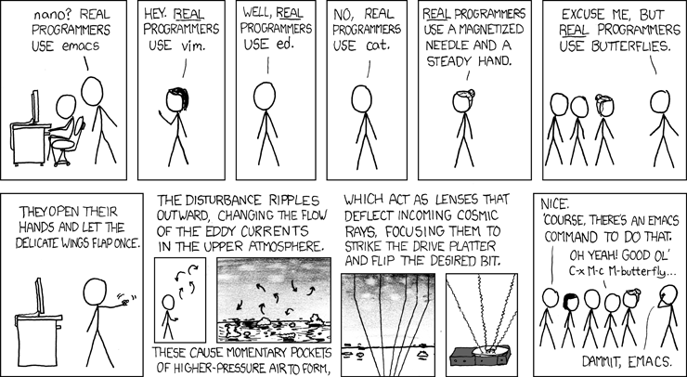
xkcd cartoon - Randall Munroe
xkcd.com

Slide 51
Tips and Tricks
Notes:
In order for create a section divider slide, add a new slide, select the “Title Only” Slide Layout and apply the “Section Divider” master from the Slide Design menu. For more information regarding slide layouts and slide designs, please visit http://office.microsoft.com/training

Slide 52
Tips and Tricks #1
Show files changed on a certain date in all directories
ls –l * | grep ‘Sep 26’
Show long listing of file(s) modified on Sep 26
ls –lt * | grep ‘Dec 18’ | awk ‘{print $9}’
Show only the filename(s) of file(s) modifed on Dec 18
Notes:
Basic content slide: Add slide title and slide text in the appropriate places. To create a new slide, go to “Insert > New Slide” from the main menu.

Slide 53
Tips and Tricks #2
Sort files and directories from smallest to biggest or the other way around
du –k –s * | sort –n
Sort files and directories from smallest to biggest
du –ks * | sort –nr
Sort files and directories from biggest to smallest
Notes:
Basic content slide: Add slide title and slide text in the appropriate places. To create a new slide, go to “Insert > New Slide” from the main menu.

Slide 54
Tips and Tricks #3
Change timestamp of a file
touch file1
If file “file1” does not exist, create it, if it does, change the timestamp of it
touch –t 200902111200 file2
Change the time stamp of file “file2” to 2/11/2009 12:00
Notes:
Basic content slide: Add slide title and slide text in the appropriate places. To create a new slide, go to “Insert > New Slide” from the main menu.

Slide 55
Tips and Tricks #4
Find out what is using memory
ps –ely | awk ‘{print $8,$13}’ | sort –k1 –nr | more
Notes:
Basic content slide: Add slide title and slide text in the appropriate places. To create a new slide, go to “Insert > New Slide” from the main menu.

Slide 56
Tips and Tricks #5
Remove the content of a file without eliminating it
cat /dev/null > file1
Notes:
Basic content slide: Add slide title and slide text in the appropriate places. To create a new slide, go to “Insert > New Slide” from the main menu.

Slide 57
Tips and Tricks #6
Backup selective files in a directory
ls –a > backup.filelist
Create a file list
vi backup.filelist
Adjust file “backup.filelist” to leave only filenames of the files to be backup
tar –cvf archive.tar `cat backup.filelist`
Create tar archive “archive.tar”, use backtics in the “cat” command
Notes:
Basic content slide: Add slide title and slide text in the appropriate places. To create a new slide, go to “Insert > New Slide” from the main menu.

Slide 58
Tips and Tricks #7
Get screen shots
xwd –out screen_shot.wd
Invoke X utility “xwd”, click on a window to save the image as “screen_shot.wd”
display screen_shot.wd
Use ImageMagick command “display” to view the image “screen_shot.wd”
Right click on the mouse to bring up menu, select “Save” to save the image to other formats, such as jpg.
Notes:
Basic content slide: Add slide title and slide text in the appropriate places. To create a new slide, go to “Insert > New Slide” from the main menu.

Slide 59
Tips and Tricks #8
Sleep for 5 minutes, then pop up a message “Wake Up”
(sleep 300; xmessage –near Wake Up) &
Notes:
Basic content slide: Add slide title and slide text in the appropriate places. To create a new slide, go to “Insert > New Slide” from the main menu.

Slide 60
Tips and Tricks #9
Count number of lines in a file
cat /etc/passwd > temp; cat temp | wc –l; rm temp
wc –l /etc/passwd
Notes:
Basic content slide: Add slide title and slide text in the appropriate places. To create a new slide, go to “Insert > New Slide” from the main menu.

Slide 61
Tips and Tricks #10
Create gzipped tar archive for some files in a directory
find . –name ‘*.txt’ | tar –c –T - | gzip > a.tar.gz
find . –name ‘*.txt’ | tar –cz –T - -f a.tar.gz
Notes:
Basic content slide: Add slide title and slide text in the appropriate places. To create a new slide, go to “Insert > New Slide” from the main menu.

Slide 62
Tips and Tricks #11
Find name and version of Linux distribution, obtain kernel level
uname -a
head –n1 /etc/issue
Notes:
Basic content slide: Add slide title and slide text in the appropriate places. To create a new slide, go to “Insert > New Slide” from the main menu.

Slide 63
Tips and Tricks #12
Show system last reboot
last reboot | head –n1
Notes:
Basic content slide: Add slide title and slide text in the appropriate places. To create a new slide, go to “Insert > New Slide” from the main menu.

Slide 64
Tips and Tricks #13
Combine multiple text files into a single file
cat file1 file2 file3 > file123
cat file1 file2 file3 >> old_file
cat `find . –name ‘*.out’` > file.all.out
Notes:
Basic content slide: Add slide title and slide text in the appropriate places. To create a new slide, go to “Insert > New Slide” from the main menu.

Slide 65
Tips and Tricks #14
Create man page in pdf format
man –t man | ps2pdf - > man.pdf
acroread man.pdf
Notes:
Basic content slide: Add slide title and slide text in the appropriate places. To create a new slide, go to “Insert > New Slide” from the main menu.

Slide 66
Tips and Tricks #15
Remove empty line(s) from a text file
awk ‘NF>0’ < file.txt
Print out the line(s) if the number of fields (NF) in a line in file
“file.txt” is greater than zero
awk ‘NF>0’ < file.txt > new_file.txt
Write out the line(s) to file “new_file.txt if the number of fields (NF)
in a line in file “file.txt” is greater than zero
Notes:
Basic content slide: Add slide title and slide text in the appropriate places. To create a new slide, go to “Insert > New Slide” from the main menu.

