Slide 1
An Introduction to Python
Title

Slide 2
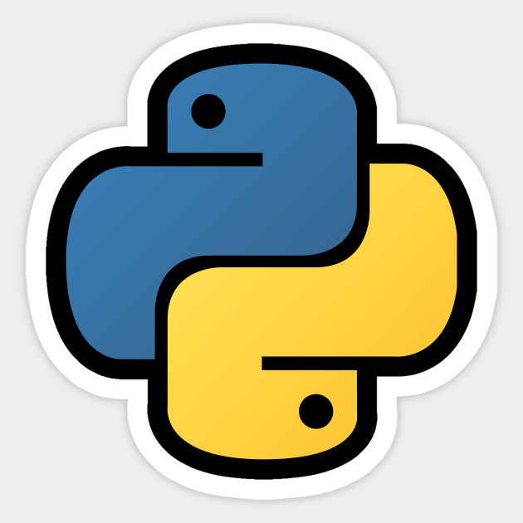
What is Python exactly?
Python is a modern rapid development language.
Code is very clean and easy to read.
Emphasizes single, intuitive approach to most problems.
Everything can be modified dynamically.
Highly object oriented.

Slide 3
When should you use Python?
Small to medium projects that may grow over time.
Where the ability to run anywhere is desired.
Where the ability to interface with a variety of languages and systems is important.
Where the amount of time the program takes to write is more important than the amount of time it takes to run.

Slide 4
Python History
Python was conceived in the late 1980s by
Guido van Rossum (formerly Benevolent Dictator for Life) in the Netherlands and developed in the early 90’sb
Python 3.0 was released on 3 December 2008. It was a major revision of the language that is not completely backward-compatible with python 2
Extended by the MANY python packages. For example pypi.org has over 200K projects

Slide 5
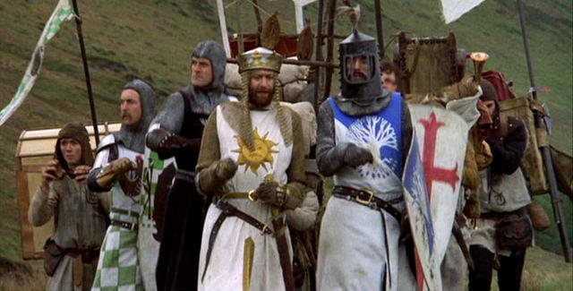
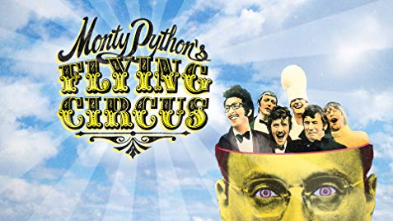
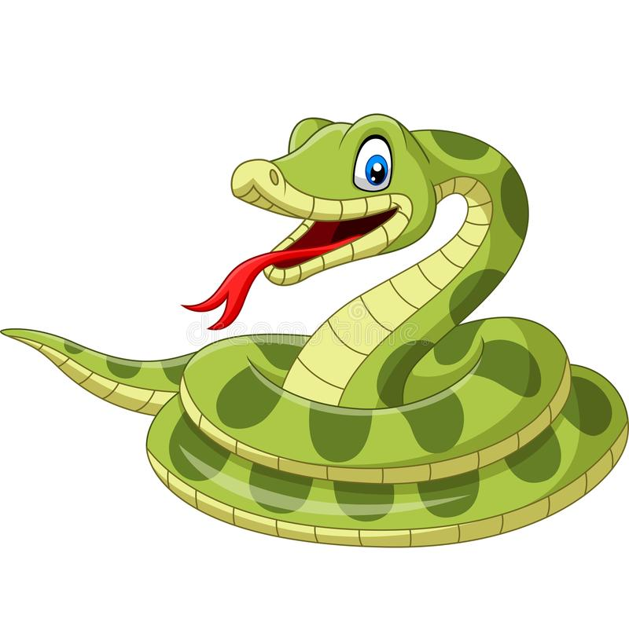
Python Trivia
It’s whimsically named for this
And not this

Slide 6
Programming 101
All (?!) programming languages use these basic concepts (and more). We’ll see example of all of these
Variables
Control Structures (Logic)
loops and iteration
Data Structures
data types
Syntax
Functions (methods, subroutines, …)

Slide 7
Python is highly object oriented
Everything is an object
Data types
Collections
Functions
Modules

Slide 8
Data types
What are data types?
Data types are simple objects that are coded directly into the python interpreter.
Data types are the basic unit of information storage.
Instances of data types are unique (in Python).

Slide 9
Python primitive data types
These are the most basic (and most frequently used) data types:
Integer – 0, 7, 13, 21, -1
Floating point – 3.14, 2.718, 1.618
String – “1”, “2.718”, “True”, “None”, “etc…”
Boolean – True, False
Null – None

Slide 10
Collections
What are collections?
Collections are containers that hold other objects.
Some collections will let you organize their contents, and some are not as cooperative.
Each collection type provides special features that make it useful in different circumstances.

Slide 11
Python collection types
List – an ordered, zero-indexed collection of objects, for example: [1, “A”, 3.0]
Set – an unordered collection of elements, guarantees each element is unique. For example: {1, “A”, 3.0}. You can use set operations on them.
Dictionary – an unordered collection of key/value pairs. Each key is unique. For example: {1:”One”, “A”:5, 3.0:”Three”}
There are also arrays and tuples

Slide 12
Basic language structure
Python abandons many of the common language formatting idioms.
Newline terminates a command – no semicolon required.
Indentation alone designates nested code blocks – no curly braces required.
A ‘#’ denotes the start of a single line comment.

Slide 13
Indentation matters
Unlike most programming languages, newlines and indentation are syntax in python.
Functions, nested loops and conditionally evaluated code are all indicated using indentation.
Consider the following valid python code:
if something is True:
do_something_else()

Slide 14
Basic numerical operations
The +, -, *, /, % (modulo) and ** (power-of) all behave roughly as expected.
The = assigns the value on the right to the variable on the left.
The +=, -=, *=, /= and **= perform the indicated operation between the variable on the left and the value on the right, then assign the result to the variable on the left.

Slide 15
Basic condition tests
A == tests to see if two things have the same value. != tests to see if two things have a different value.
The <, >, <=, >= all compare relative values.
An is tests to see if two things have the same identity.
An in tests element membership in a collection.

Slide 16
Boolean algebra in Python
Any value, other than None, False, 0, “”, or an empty collection evaluates to True in a boolean context.
The boolean operators supported by python, in order of increasing precedence, are:
and
or
not

Slide 17
Basic flow control
Python provides flow control using if, for and while statements.
You can terminate a for or while loop using break.
You can skip to the next iteration of a for or while loop using continue.
You can execute code after a for or while loop that is not terminated early using else.

Slide 18
Example: if statement
if x < 0:
print “x is less than 0”
elif x == 0:
print “x is 0”
elif x == 1:
print “x is 1”
else:
print “x is greater than 1”
There can be zero or more elif conditions. The else condition is optional. The first condition that evaluates to True has its code executed, and no further conditions are examined.

Slide 19
Practice intermission!
Time to see if you’ve been paying attention.
Go to http://codingbat.com/python/Warmup-1.
We’ll work through sleep_in together.
Please try monkey_trouble yourself.
If you finish quickly, try other exercises!

Slide 20
Example: for statement
mylist = [‘cat’, ‘dog’, ‘goat’]
for animal in mylist:
print “I have a “ + animal
When run, this results in:
I have a cat
I have a dog
I have a goat
The for statement in python is unique in that it works over collections (or things that act like collections).

Slide 21
Example: break and continue statements.
for number in [2, 3, 4, 5, 6, 7, 8, 9]:
if number % 2 == 0:
print “%s is even” % number
elif number > 7: break
else: continue
print “I will never be seen”

Slide 22
Defining Functions
Functions are defined in python using the def key word.
The format of a function definition is
def function_name(comma, separated, arguments):
…
After a function definition, any indented lines are considered part of the function.

Slide 23
Default Argument Values
It is also possible to define a function with default value for one or more arguments.
This creates a function that can be called with fewer arguments than it is defined to allow.
For example:
def make_circle(size, color=“white”, outline=True):
…

Slide 24
Keyword Arguments
Functions can be called using keyword arguments. Take the following function:
def parrot(age=10, state=‘awake’, type=‘African Grey’)
This could be called a variety of ways:
parrot(25)
parrot(15, type=“Norwegian Blue”)
parrot(state=“asleep”)
Etc…

Slide 25
Strings and Things
Strings in Python are created with paired single or double quotes.
Multi line strings can be created by enclosing them with three single or double quotes on each end (e.g. “””This could span several lines“””).
The + and * operators are work for strings, so “help” + “ me” produces the string “help me”, and “help” * 3 produces “helphelphelp”.

Slide 26
Another practice intermission
Go to http://codingbat.com/python/Warmup-2.
Try string_times using a trick you just learned for an easy warmup.
Try array_count9 for a slightly larger challenge.
As before, if you’re quick work ahead!

Slide 27
String Formatting Operations
String can be formatted via the % operator.
If you are only substituting a single value you may pass it directly after the %.
If you are passing multiple values you must wrap them in parenthesis.
For example:
“I have %s cats” % 10
“I have %s cats and %s dogs” % (5, 3)

Slide 28
Meet the List
Lists are mutable, ordered collections of objects.
Any type of object can be put in a list
Lists may contain more than one type of object at a time.
The + and * operators perform the same magic on lists that they do on strings.

Slide 29
Subscripts
In Python, all sequences (including strings, which can be thought of as sequences of characters) can be subscripted.
Subscripting is very powerful since it allows you to view a portion of a sequence with relative constraints.
Python subscripts may either be single elements, or slices. For example:
“Help”[0] is “H”
“Help”[0:2] is “He”
“Help”[2:4] is “lp”

Slide 30
Subscripts, continued
Subscript slices can be bounded on only one end, for instance:
“Help”[1:] is “elp”
“Help”[:2] is “He”
Subscripts can also be negative, to indicate position relative to the end of the sequence:
“Help”[-1] is “p”
“Help”[-3:-1] is “el”
Subscript slices will return an empty result if you use indices that are out of bounds or otherwise bad.
“Help”[5:10] is “”

Slide 31
Another practice session
Head back to http://codingbat.com/python/Warmup-2.
Try your hand at array_front9 using array slices and Python’s nifty in feature.
Use slices and the same string multiplication trick to complete front_times.

Slide 32
The Set
A set object is an unordered collection of distinct immutable objects.
Common uses include membership testing and removing duplicates from a sequence.
Support x in set, len(set), and for x in set.
Does not support indexing, slicing, or other sequence-like behavior.

Slide 33
The Dictionary
A dictionary maps key objects to to arbitrary value objects.
Dictionaries are accessed using square brackets like a list (slicing is not supported).
For example:
My_dictionary = {“A”:1, 0:”Zero”, “B”:2}
My_dictionary[“A”] is 1
My_dictionary[0] is “Zero”
You can set new values like so:
My_dictionary[“B”] = 3
My_dictionary[1] = “One”
Supports x in dict, len(dict) and for x in dict.

Slide 34
Modules
As your program gets longer, you may want to split it into several files for easier maintenance.
You may also want to use a handy function that you’ve written in several programs without copying it into each program.
Python makes this easy – if your file is somewhere in the PYTHONPATH, you can do the following:
import yourfile
Then you can access stuff in that file like this:
Yourfile.yourfunction()

